Slide 1
Smartphone Overview, Fundamentals of Analysis, and SQLite Forensics
FOR585.1
SMARTPHONE FORENSIC ANALYSIS IN-DEPTH
© 2024 Heather Barnhart and Domenica Crognale | all rights reserveD
J01_02
Notes:
This area is intentionally left blank.

Slide 2
Table of Contents
Notes:
This area is intentionally left blank.

Slide 3
Course Agenda
Notes:
Section 1: Smartphone Overview, Fundamentals of Analysis, and SQLite Forensics
Although smartphone forensic concepts are similar to those of digital forensics, smartphone file system structures differ and require specialized decoding skills to correctly interpret the data acquired from the device. On this first course day, students will apply what they know to smartphone forensic handling, device capabilities, acquisition methods, SQLite database examination, query development, and table joins. Students will become familiar with the most popular forensic tools required to complete comprehensive examinations of smartphone data structures.
Section 2: Android Forensics
Android devices are among the most widely used smartphones in the world, which means they surely will be part of an investigation that comes across your desk. Unfortunately, gaining access to these devices isn't as easy as it used to be. Android devices contain substantial amounts of data that can be decoded and interpreted into useful information. However, without honing the appropriate skills to bypass locked Androids and correctly interpret the data stored on them, you will be unprepared for the rapidly evolving world of smartphone forensics. Android backups can be created for forensic analysis or by a user. Smartphone examiners need to understand the file structures and how to parse these data. Additionally, Android and Google Cloud data store tons of valuable information. You will find Google artifacts from iOS users as well.
Section 3: iOS Device Forensics
Apple iOS devices contain substantial amounts of data (including deleted records) that can be decoded and interpreted into useful information. Proper handling and parsing skills are needed to bypass locked iOS devices and correctly interpret the data. This course section will cover extraction techniques using jailbreaks and exploits. Without iOS instruction, you will be unprepared to deal with the iOS device that will likely be a major component in a forensic investigation.

Slide 4
Notes:
Section 4: Backups and Cloud Data, Malware and Spyware Forensics, and Detecting Evidence Destruction
iOS backups are extremely common and are found in the cloud and on hard drives. Users create backups, and we often find that our best data can be derived from creating an iOS backup for forensic investigation. Android backups differ a bit as users do not commonly backup outside of Network Service Providers and Google. This section will cover methodologies to extract backups and cloud data and analyze the artifacts for each. Malware affects a plethora of smartphone devices. We will examine various types of malware, how it exists on smartphones, and how to identify and analyze it. Most commercial smartphone tools help you identify malware, but none of them will allow you to tear down the malware to the level we cover in this class. We'll conduct five labs on this day alone! The day ends with students challenging themselves using tools and methods learned throughout the week to recover user data from intentionally altered smartphone data (deleting, wiping, and hiding of data).
Section 5: Third-Party Application Analysis
This course section starts with third-party applications across all smartphones and is designed to teach students how to leverage third-party application data and preference files to support an investigation. The rest of the day focuses heavily on secure chat applications, recovery of deleted application data and attachments, mobile browser artifacts, and knock-off phone forensics. The skills learned in this section will provide students with advanced methods for decoding data stored in third-party applications across all smartphones. We will show you what the commercial tools miss and teach you how to recover these artifacts yourself.
Section 6: Smartphone Forensic Capstone Exercise
This final course day will test all that you have learned during the course. Working in small groups, students will examine three smartphone devices and solve a scenario relating to a real-world smartphone forensic investigation. Each group will independently analyze the three smartphones, manually decode data, answer specific questions, form an investigation hypothesis, develop a report, and present findings.
Note about URLs: Sometimes this courseware cites URLs that were valid at the time originally cited, but as URLs change all the time, some may no longer be valid. While we strive to maintain the URLs, out-of-date URLs still have value. They show that a statement is based on scholarship. They can give hints about how to find source material, even if it is no longer at the original URL, and they can be used to find material using web content caches.

Slide 5
Course Roadmap
Notes:
This area is intentionally left blank.

Slide 6
Additional Course Resources
Class Egnyte Resource
for585.com/XXX (i.e. for585.com/j01)
http://smarterforensics.com/for585/
PW= 10sAndr01dW1nd0w3BB
FOR585 Alumni Group
Email 585forensics@gmail.com to join
X: #FOR585
Notes:
There are several resources provided to you as a student of FOR585. Heather and Lee created the resources to provide additional information pertaining to smartphone forensics. The class Egnyte directory will contain bonus material for each section, tips on how to prepare for the GASF certification, and more. You must type all lowercase letters to access the course Egnyte directory. The “XXX” will be the version of your course you are taking. Please refer to the SANS portal or your book for this information.
www.smarterforensics.com is maintained and updated by Heather Mahalik Barnhart. She has created a password-protected section of the site to host updated materials that are shareable with FOR585 alumni. Expect to see updates in this portion of the website every time the authors complete an update with new cheat sheets, white papers, references, old lab datasets, and possibly test data. (Note: The use of numbers for the lower-case vowels along with the “s” in windows for the password.)
Do not share this password. You paid to be here, and you should reap the benefits.
We have created an alumni Google group for this course for discussions pertaining to mobile devices (https://groups.google.com/forum/#!forum/for585-alumni). To join the group, please email 585forensics@gmail.com and state which class you took and the email address you wish to use to join. Please place your questions here, as they are beneficial to everyone: FOR585-Alumni.
If you are on social media, please feel free to tag the course. We try to lookout for the #for585 tag.

Slide 7
Course Roadmap
Notes:
This area is intentionally left blank.

Slide 8
FOR585 Virtual Forensic Workstation
Media Files A - Extract the course VM from the provided .iso/media to your desktop (do not copy into a VM)
Linux machines may require drivers for ExFAT
Once copied and unzipped, press Play and log in to your new FOR585 virtual machine
Login: “FOR585”
Password: “forensics”
Simply follow the steps in Lab 0 and your MyLabs in the SANS portal
Media Files B – Contains all of the Lab_Data needed for the course, the Forensic Challenge data (7z), unarchiving utilities, and some other Bonus Items
Notes:
SANS teaches the latest tools and techniques available. In addition, our aim is to create a laptop setup that is simple to use to accomplish the daily exercises utilizing forensic tools and scripts we deem most helpful in smartphone investigations. The media files include a preconfigured VMware Forensic Workstation, which is ready to tackle forensics as soon as your tools are licensed.
The tools may prompt you for updates, since updates are released far more frequently than we can create course media files. We know the versions in your FOR585 VM function as expected. If you choose to update, you may find that your lab results differ from the course workbook. These results may not be beneficial, as the tools sometimes lose capabilities once upgraded. On the flipside, the tools may parse additional information that was previously missed. The choice is yours, but we recommend you update any tool you wish after class as homework.
If you are having issues with Lab 0, refer to the end of the lab for troubleshooting tips. Alert your instructor, TA, or SANS Online SME immediately if your issue is not listed in the Lab 0 troubleshooting steps.
The ISO A image contains your FOR585 Virtual machine (7z) file which must be unarchived and set up according to your Setup Instructions.
The ISO B Image contains the Lab_Data folder which is comprised of 5 7z archives for each of the Sections we will cover during the course. Other items on ISO B include:
Utilities folder: with unarchiving software available for your macOS or Windows host
Forensic_Capstone.7z: password-protected case data for the Forensic Challenge
Malware APK and IPAs.7z: archive of some Android and iOS malware
Bonus Slides: This is material that has been removed from the course over time due to end of life for different mobile operating systems. The slides have been decommissioned and PDF’d but contain information that may be useful if you encounter any of these legacy devices during your investigations.

Slide 9
Moving Lab Data into the VM
Download 585.24.1B.iso from your SANS portal
Mount the iso on your host
Transfer the Lab_Data directory into your VM using one of the options below:
Copy and Paste the Lab_Data directory to G:\Cases inside the VM
Simply drag the Lab_Data directory to G:\Cases inside the VM
Unarchive each section of labs into G:\Cases using 7zip utility
You can delete the .7z once the lab data has been successfully extracted
Notes:
This area is intentionally left blank.

Slide 10
A Glimpse of Your VM Environment
Cellebrite Physical Analyzer
Magnet AXIOM
ArtEx
Mushy PList Editor
iLEAPP and ALEAPP
DB Browser for SQLite
Andriller
iTunes
Frhed
JADX
Agent Ransack
Wireshark
DeCode
Dex2Jar
Java Decompiler/Dev Kit
FTK Imager
Autopsy
Elcomsoft Phone Breaker*
SQLite Forensic Explorer*
Elcomsoft Cloud eXplorer*
Custom scripts and more
3U Tools
Notes:
Note that Elcomsoft must be installed prior to use. The licenses and links to the software are available in your MyLabs portal.

Slide 11
Setting Expectations
This is not a push-button tool course
We are not training you on vendor tools
We are not teaching mobile acquisition
You will learn the best tools that currently support smartphone forensic analysis
Some of these tools come with a large cost
You will learn how the tool parses the data
You will learn that your tools will only get you so far—the rest is up to you!
You will learn where the artifacts exist in the file systems
And most importantly when the tool isn’t handling the data correctly.
Notes:
When it comes to mobile forensics, it is almost impossible to rely completely on open-source solutions. Often, for open-source tools to work, you need root access or a jailbreak to obtain file system information. In reality, this isn’t always feasible. Because of this, we aim to teach you the best tools for both acquisition and analysis for each iOS and Android. We will cover both commercial and open-source solutions, as well as custom scripts and SQL queries that were developed for smartphone data. While we do not cover obtaining mobile acquisitions in the course, we do provide a variety of extractions and share how the data was created.
This course will cover where the artifacts exist in the file system of iOS and Android devices and will include operating system updates. We will use our tools to get us to a certain point and then export the files of interest and use manual techniques to further our examination and validation. We do not want you to become the examiner that uses the “find evidence” button, but we do want you to learn how far the tools can take you. We all rely on forensic tools and this course will help you understand which tools are best for the different artifacts. Let’s be honest—forensics is not cheap. Smartphone forensics is expensive, and the costs can quickly get out of hand when you are building your toolbox. For that reason, we want to highlight the tools that work most effectively for mobile devices of interest.
We encourage you to be creative and develop SQL queries and scripts that replicate what the commercial tools do. Please share those with us so we can include them in the alumni group or even in the course. Several open-source and free tools are provided and used during the labs. Make sure you update these tools prior to using them for case work as the DFIR community is constantly updating and you want to make sure the versions you are using are current.

Slide 12

Keeping the Pace
New devices released
Operating system updates
Encryption
New applications
Cloud artifacts
Tool updates
Acquisition breakthroughs or new challenges
New techniques
Customized scripts
Image from Oleksiy Mark/Shutterstock.com
Notes:
This area is intentionally left blank.

Slide 13
Labs and Lecture
The labs in this course are designed to enhance your learning experience.
The labs are not intended to be a test of what you learned in the lecture.
The labs will go beyond the lecture and push you further.
Most questions are derived from our current investigations or from repeat student questions.
All labs have answers after the questions section.
We have included one potential way to solve the problem.
Use more than one method to validate your findings.
You may find other ways to answer the question.
Notes:
The labs in this course are designed to enhance your learning experience and to add a hands-on component to help you develop and hone your mobile forensics skill set. The course labs are not intended to be a test of what you learned in the lecture portion of class. They will go beyond the lecture and push you further as well as reinforce concepts touched upon in class.
The eWorkbook will have objectives, questions, answers, and walkthroughs. We have included one potential way to solve the problem—you may find other solutions. It’s up to you whether you’d like to try the lab without instructions or work through the lab based on the instructions. Included in this course are dozens of labs from multiple devices (all unique datasets), plus SIM, SD, and cloud data. Be sure to check your course media files for bonus labs!
Make sure you download public images for more data to practice with. These are available via Magnet, Cellebrite and Josh Hickman. Josh blogs at https://thebinaryhick.blog where you will find his shared iOS and Android extractions.

Slide 14
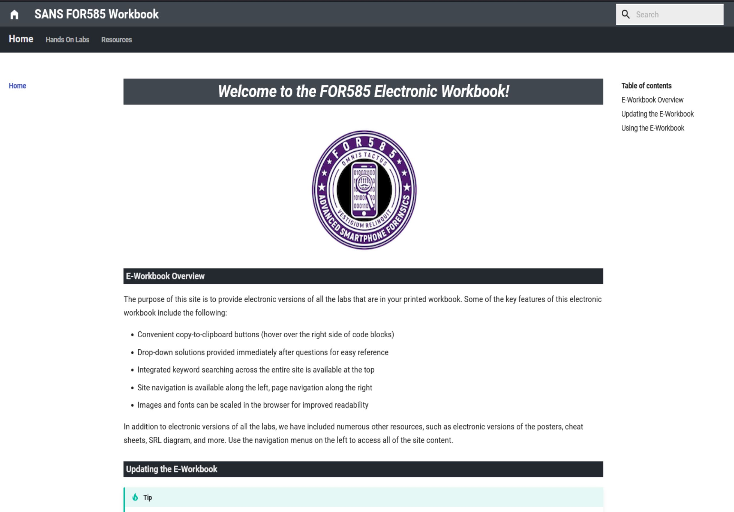
Introducing the eWorkbook
Notes:
Your instructor will provide an overview of the eWorkbook. This workbook is designed in a way to help you learn, yet not show the answers unless you elect to see them. We aim to provide hints and provide a thorough walkthrough of the best methods for uncovering the answers to the questions. One thing you will learn in this course is that there isn’t just one way to get to an answer. The important thing is that you learn various methods and learn to rely on the files that store the correct information.

Slide 15
Course Roadmap
Notes:
This area is intentionally left blank.

Slide 16
Smartphones Considerations
How many people do not use a mobile device?
How many investigations do not involve a mobile device?
Are smartphones replacing the need for laptops and desktops?
What is syncing to cloud?
Will the data on the devices be similar? Where does it exist?
Will your tools support acquisition?
Will the type of acquisition provide you everything you need for analysis?
Will your tools provide the the data parsing needed for analysis?
What is smartphone forensics?
How deep do you have to dive?
Is it okay to go from acquisition to reporting?
Almost everything you do on the device will leave a trace
Notes:
Smartphones are some of the most prevalent types of electronic media that exist today. Most people have at least one mobile device, and, commonly, that device will be a smartphone. Will you know how to handle these devices? Do you know what the data looks like and, more importantly, do you know where the data will be stored? Smartphones can have a variety of data storage capabilities and contain (and/or may be connected to) other storage components that may need to be addressed during the forensics process. These include:
Read-only memory for firmware
RAM
Flash memory for data storage
SIM card
Storage expansion cards (microSD)
Other cloud-based storage
Data on synced computer(s)
Servers hosting backup data
Evidentiary data may exist on the smartphone, on a data-expansion card (SD type card) installed in the smartphone, in a cloud-based account that is synced or connected with the phone, or on computers that the smartphone has been synced with. Also, remember that any other phones the smartphone has communicated with may also contain evidence that may be useful to your investigation, and if what you are looking for no longer exists on the smartphone itself, that data may have been transferred to another phone it communicated with.
Smartphones also use RAM, and there are recent developments in methodology for the collection and examination of RAM from smartphones. Most devices will require additional accesses in order to extract data from RAM. This is commonly done by jailbreaking or rooting the device. More on accessing specific data categories will be covered in sections 2 and 3 of this course.

Slide 17
Notes:
Smartphone forensics is the application of the forensic process to find information and answer questions about how a smartphone was (or was not) involved in a particular incident. Smartphone forensics is a sub-field of digital forensics, and it follows the same principles. Forensics is the application of scientific knowledge to legal problems.¹ Forensic sciences are widely tied to Locard’s Exchange Principle: “Every contact leaves a trace.”² The process of digital forensics is the same as other forensics sciences, and the process in mobile device forensics closely follows the same path. In mobile device forensics, however, we also have the extra challenge of isolation of devices we are working with because they are designed to communicate with the surrounding mobile network, satellites, surrounding wireless networks, and via Bluetooth or other means.
Not all applications of digital or mobile device forensics are designed to produce evidence, but all require reliability, integrity, and veracity, whether the forensics is being performed for information security, incident response, intelligence gathering, policy compliance, remediation, research, or for criminal or civil investigations.
Webster’s Dictionary
Prof. Edmond Locard, c. 1910

Slide 18
Cellular Technology (1)
CDMA - Code Division Multiple Access
Countries used: United States, Korea, Japan, India, and China
Some Carriers: Verizon, U.S. Cellular and Sprint
GSM - Global System for Mobile Communications
Countries used: The rest of the world
Some Carriers: AT&T, T-Mobile, Verizon (unlocked)
3G >4G/LTE > 5G
The “G” represents the generation
Each generation provides improvements on speed and technology
This may show up in your extraction summary from your forensic tool
Notes:
Smartphones generally operate using one of two mobile network technologies, which determines how the device communicates with its cellular network:
CDMA: Code Division Multiple Access
Some Carriers: Verizon, U.S. Cellular and Sprint
GSM: Global System for Mobile Communications
Some Carriers: AT&T, T-Mobile, Verizon (unlocked)
Although GSM and CDMA provide similar basic features and services to end users (voice calling, text messaging, and data services), they operate differently at many technical levels, making GSM phones completely incompatible with CDMA networks, and vice versa.
There are several generations of each technology, but for the purposes of smartphone handset forensics, it is primarily important to simply know whether you are working with a CDMA or GSM phone. In the past, it was easy to determine whether a phone was CDMA or GSM based on whether it contained a SIM card because only GSM phones contained SIM cards. Now, however, newer-technology (many) CDMA smartphones can have the capability to work on both CDMA and GSM networks and, therefore, may contain a SIM card or a R-UIM (Removable User Identity Module) card. Therefore, you may have to do some investigation to see whether the phone you are working with is a GSM or CDMA phone.
You can determine what network technology a phone is using by checking that phone by make and model at www.phonescoop.com, or by determining what service provider that phone uses, because the carrier either uses a CDMA or a GSM network. Knowing what general technology, the handset you’re trying to examine is using is an important first step in the examination process.
To get to these settings on Android and iOS, follow the steps below. These steps will also help you with the identifiers on the next slide.
iOS – Settings > General > About
Android – Settings > About phone > Status

Slide 19
Cellular Technology (2)
GSM
IMEI
MSISDN
IMSI
CDMA
ESN/MEID
MDN
MIN
Notes:
GSM Smartphones:
The International Mobile Equipment Identifier (IMEI) is a unique 15-digit number that identifies a GSM cellular phone handset on its network. This number is generally found under the battery of the cellular phone. The first eight digits are a Type Allocation Code (TAC), and the next six digits are the Device Serial Number (DSN). The final digit is a check digit, usually set to 0.
The Mobile Station International Subscriber Directory Number (MSISDN) is the phone's 15-digit, globally unique number. The MSISDN follows the International Telecommunication Union (ITU) Recommendation E.164 telephone numbering plan, composed of a 1–3-digit country code, followed by a country-specific number. In North America, the first digit is a 1, followed by a 3-digit area code.
The following links are good resources for researching IMEIs:
https://www.imei.info
https://www.numberingplans.com/
CDMA Smartphones:
The Electronic Serial Number (ESN) is located under the battery of the cellular phone. This is a unique 32-bit number assigned to each mobile phone on the network. The ESN may be listed in decimal (11 digits) and/or hexadecimal (8 Hex digits). Be aware that the Hex version of the ESN is not a direct numeric conversion of the decimal value. An ESN converter can be found at https://www.imei24.com/check/imei_esn_converter/.
The Mobile Equipment ID (MEID), also found under the battery cover, is a 56-bit number that replaced the ESN due to the limited number of 32-bit ESN numbers. The MEID is listed in Hex, where the first byte is a regional code, the next three bytes are a manufacturer code, and the remaining three bytes are a manufacturer-assigned serial number. CDMA phones also have two other identifying numbers, namely the Mobile Identification Number (MIN) and Mobile Directory Number (MDN). The MIN is a carrier-

Slide 20
Notes:
assigned, carrier-unique 24-bit (10-digit) telephone number. When a call is placed, the phone sends the ESN and MIN to the local tower. The MDN is the globally unique telephone number of the phone. Prior to Wireless Number Portability, the MIN and MDN were the same, but in today's environment, the customer can keep her phone number (MDN) even if she changes carriers.
Reference:
https://for585.com/3jas7 (Phonescoop.com network definitions)

Slide 21
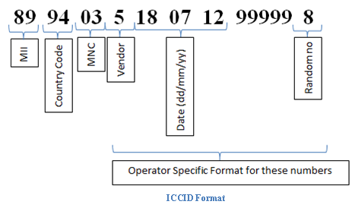
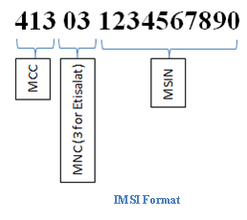
SIM Card Identifiers
ICCID: Integrated Circuit Card Identification
IMSI: International Mobile Subscriber Identity
Notes:
On GSM, LTE and 5G phones, there is at least a Subscriber Identity Module (SIM) card slot, which may be located under the battery. The SIM card may be branded with the name of the network to which the SIM is registered.
Also located on the SIM card is the Integrated Circuit Card Identification (ICCID), which is an 18- to 20-digit number (10 bytes) that uniquely identifies each SIM card. The ICCID number is tied to the International Mobile Subscriber Identity (IMSI), which is typically a 15-digit number (56 bits) consisting of three parts, including the Mobile Country Code (MCC; 3 digits), Mobile Network Code (MNC; generally 3 digits in India, Malaysia, a lot of the Caribbean and South America, and several other countries; may be 2 digits as well),¹ and Mobile Station Identification Number (MSIN; 9 digits in the U.S. and Canada, and 10 digits elsewhere), which are stored electronically within the SIM. The IMSI can be obtained either through analysis of the SIM or from the carrier.^{2, 3}
https://for585.com/b-imd (Wikipedia entry for Mobile Country Code)
https://for585.com/shafik
https://for585.com/c3jki (Images)

Slide 23
Notes:
The Universal Integrated Circuit Card (UICC) is the smart card that runs applications for devices to function. For example, the SIM is simply an application running on a UICC. As you know, multiple applications can run on a single device or SIM. It is not common, but more than one SIM can reside on a UICC. These are often referred to as SIM stackers. Most individuals never use the term UICC, but instead simply refer to the card as a SIM. SIM cards can range in size from 16 KB to 1+ GB.
SIM (Subscriber Identity Module) cards are smart cards used by Network Service Providers (NSPs) to authenticate the user to a network. A variety of mobile device technologies use SIM cards in different manners. For example, GSM phones won’t power on for specific handsets unless the device can function due to the use of Wi-Fi when the device is missing the SIM card.
Universal Mobile Telecommunications System (UMTS), otherwise nicknamed "world phones", featuring 3G, 4G, and LTE requires a SIM card to authenticate users to the network. A good example of a UMTS device is a Verizon iPhone 4s. The Verizon iPhone 4s contains a micro-SIM. This differs from the Verizon iPhone4, which is strictly CDMA and does not contain a SIM card.
The authentication key (Ki) is not copied during a forensic acquisition. Ki is used to authenticate the SIM on the GSM network. This key is unique for each SIM card. NOTE: Ki has been known to be decrypted by certain applications and groups. Once a network senses that two devices are using two SIM cards with the same Ki, both are disabled. Although you won't learn how to decrypt and capture Ki in this course, it doesn't mean it hasn't been done before.
The Removable User Identity Module (R-UIM) is a SIM card that was designed for CDMA handsets. This is commonly seen in China and is used by China Unicom.
Remember, the SIM card is not an SD card. They are completely different components of smart devices. For UICCs, the easiest thing to remember is that GSM devices use SIM cards, and CDMA devices use R-UIM. Forensic acquisition of R-UIM devices is not supported by all the commercial tools supporting SIM cards. A great tool for R-UIM devices is the SIMIS 3G kit from Teel Technologies.
SIM cards essentially have two sections of information. The first is the system area, which cannot be locked by a user PIN. The second is the data area, which contains the user data, including the contacts, dialed calls, and SMS messages. Deleted SMS messages are commonly recovered from SIM cards.
The system area contains the following equipment identifiers of interest:
Integrated Circuit Card ID (ICCID): An 18-digit number with a single check digit, which assists in error detection. This number is essentially the serial number of the SIM card. The ICCID is sometimes printed on the external side of the SIM card and is always stored internally on the media. Most forensic kits acquire this data, even on locked SIM cards.
Here is an example of an ICCID with a detailed explanation of the numbering:
8996430671601871055 – 19-digit ICCID (18 digits + one single check digit)
89 96 43 0671 60 187105 5
89: Represents the Telecom ID
96: Represents the country code
43: Represents the network code
0671: Represents the month and year of manufacturing
60: Represents the switch configuration code
187105: Represents the SIM number
5: Represents the check digit

Slide 24
Notes:
A tool such as https://www.numberingplans.com/ offers SIM analysis tools, which can assist the examiner in identifying the components listed. Understanding each chunk of the ICCID makes verifying the results from www.numberingplans.com, or your forensic tool, much easier.
International Mobile Subscriber Identity (IMSI): Used by the NSP to identify the device and the subscriber on handsets. The IMSI is normally 15–16 digits but can be shorter, depending on the NSP.
Here is an example of an IMSI with a detailed breakdown:
3101501234567892 – IMSI
310 150 1234567892
310: Represents the Mobile Country Code (MCC)
150: Represents the Mobile Network Code (MNC) (two digits used for European Standard and other countries who don’t use three digits, three digits used for North American Standard, India, the Caribbean, and South America); this number is the SIM card’s home network
1234567892: Represents the 10-digit Mobile Subscriber Identification Number (MSIN), which is the unique ID for the subscriber
Mobile Subscriber Integrated Services Digital Network Number or Mobile Station International Subscriber Directory Number (MSISDN) (may be interpreted in other manners): Phone number for the handset. This number is not always easy to recover because users often are required to save their own phone numbers to the SIM card or the handset. The MSISDN is not hard-coded to the device by the NSP.
Network Service Provider (NSP)
The file structure of a SIM card contains master files (MFs), dedicated files (DFs), and elementary files (EFs). Every SIM card must contain at least one MF, which is the root directory of the file system. The MF folder contains the DF and EF. The DFs are directories that contain elementary files. The EFs are containers storing user data. As shown above, an EF can fall directly under a MF.
The hexadecimal representation of the first byte of the SIM directories is:
3F = Master file
7F = Dedicated file
2F = Elementary file under the master file
6F = Elementary file under a dedicated file
For example, the DFTelecom contains several EFs. These EFs are comprised of user data, such as the phone number, contacts, SMS, and dialed calls. Each category of data is assigned to an individual EF. A further explanation of this is:
3F00 = Master file
7F10 = DFTelecom
6F40 = EF MSISDN
6F3A = EF ADN
6F3C = EF SMS
6F44 = EF LDN
To further explain this example, the MF containing the Telecom DF contains four EFs. The EF MSISDN (Mobile Station International Subscriber Directory Number) contains the phone number for the SIM card. The EF ADN (Abbreviated Dialing Number) contains the contacts for the SIM card. The EF SMS contains the SMS message communications. Deleted SMS messages may reside here and should be recovered for

Slide 25
Notes:
forensic examination. Finally, the EF LDN (Last Dialed Number) is comprised of the most recent outgoing calls. Only outgoing calls are tracked on SIM cards.

Slide 26
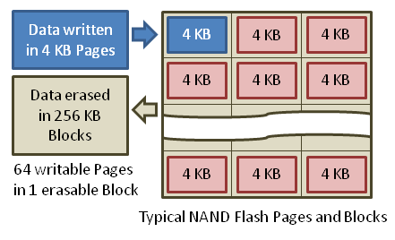
Solid State (Flash) Memory Properties
26
Retains data when not powered
Limited number of rewrites
Wear leveling assists in moving the data around to preserve the device
Solid state memory is organized in:
Cells
Pages
Blocks
Notes:
Solid state memory retains data even when it is not powered on. It can accept only a limited number of writes in its lifetime, however, and eventually wears out.
Wear leveling and garbage collection, which are discussed in detail in upcoming slides, are techniques used to extend the life of the memory and increase storage efficiency.
There are two types of solid-state memory used in smartphones, including NAND and NOR. NOR is commonly used for firmware, while NAND is generally used for storage of user data.
NAND versus NOR flash:
NOR commonly used for firmware
NAND commonly used for user data
NAND blocks are subdivided into pages
NAND is more commonly used today
Smartphones store data on one or more chips within the phone that use flash memory technology. They may also store additional data on removable storage cards (microSD) and/or SIM cards, which are discussed later in this section. For solid state memory, data is written to flash memory in units called pages. Pages are made up of multiple cells. Blocks are made up of multiple pages.¹
Flash memory can only be erased in larger units called blocks. An empty unit of flash memory is filled with 1s rather than with 0s as with traditional hard disk drive type media. Erased blocks are overwritten with 0x1111111. As previously mentioned, data is written to flash memory in units called pages. Pages are made up of multiple cells. However, flash memory can only be erased in larger units called blocks. Blocks are made up of multiple pages.
Unlike hard disk drives, flash memory-based solid-state devices (SSDs) don't contain spinning parts. In flash-based storage devices, data is written to pages (sometimes called cells) in an SSD that is made up of multiple flash memory chips. Cells have a finite life cycle, meaning that each one can only be written so

Slide 27
Notes:
many times, before it wears out and eventually becomes unprogrammable.
Wear leveling is a process that is designed to extend the life of solid-state storage devices. Solid-state storage is made up of multiple microchips that store data in blocks. Each block can tolerate only a finite number of write/erase cycles before becoming unreliable. For example, NAND flash is typically rated at about 100,000 program/erase cycles. Wear leveling arranges data so that write/erase cycles are distributed evenly among all the blocks in the device, thereby allowing the device to last longer.¹
In practical terms, the wear leveling process can result in many search hits for any search term during the examination of data from a physical image of a smartphone or other device using flash-based memory for data storage.
https://for585.com/9ahez (Image)

Slide 28
Garbage Collection and Database Vacuuming
Garbage collection is the process by which solid-state memory improves write performance by proactively eliminating the need for whole block erasures prior to every write operation.
Database vacuuming is the process of clearing data marked for deletion by the application or the user.
Notes:
Garbage collection is the process by which solid-state memory improves write performance, proactively eliminating the need for whole block erasures prior to every write operation.
As we just learned, data is written to flash memory in units called pages (made up of multiple cells). However, the memory can only be erased in larger units called blocks (made up of multiple pages). If the data in some of the pages of the block are no longer needed (also called stale pages), only the pages with good data in that block are read and rewritten into another previously erased empty block. Then the free pages left by not moving the stale data are available for new data. This process is called garbage collection. All SSDs include some level of garbage collection, but they may differ in when and how fast they perform the process.¹
Traditional hard disk drives simply overwrite unneeded data blocks with new data. Flash memory, however, must erase the unneeded data blocks before new data can be written. The garbage collection process works in the background and systematically identifies which memory cells contain unneeded data. Those blocks of unneeded data are cleared during off-peak times to maintain optimal write speeds during normal operation of the device.²
There is a great deal of potential complexity to the garbage collection process, which can occur at any of the following levels:
Operating system
Application code/programming language
Hardware controllers
How the programmer chooses to implement garbage collection
Each of the programming languages (Java, .NET, C#, and so on) have their own Garbage Collection (GC) functions and methods. The developer can choose to implement them (or not) in his code. Some developer platforms have their own garbage collection implementations outside of the standard language-based methods.

Slide 29
Notes:
Database vacuuming is different than garbage collection. Databases are vacuumed to claim space back that is no longer needed by active data. When a vacuum occurs, deleted rows are removed and data may be reorganized. The goal is to reorganize the data to make the database as small as possible. The reorganization takes data that may seem out of order due to deletions that cause the data to appear fragmented.³ Thus, the database is organized in a manner that makes more sense. Database vacuuming often removes data marked for deletion by the user.
Apple doesn't use any sort of garbage collection process across the entire device. It is not needed as the Automatic Reference Counting (ARC) handles the regular controls of memory and data allocation. A discussion of this issue can be found at https://www.macobserver.com/tmo/article/apple-warns-developers-garbage-collection-is-dead-move-to-arc/.
More information about how Android Dalvik uses and configures garbage collection can be found at https://developer.android.com/studio/profile/memory-profiler#LogMessages.
https://for585.com/b0hog (Wikipedia entry on garbage collection)
https://for585.com/b7rov (TechTarget article on garbage collection)
https://for585.com/vacuum (SQLite.org)

Slide 30
Smartphone Component Consideration
Will your tool acquire the SIM and SD card?
Will the phone lock if the SIM card is removed?
What will change if the data is pulled through the device?
What if you miss it?
Notes:
Smartphones commonly have SD cards and SIM cards, which contain unique data that may not be captured during forensic acquisition of the device. It is best to assume that the data saved on these devices (the SIMs and SD cards) will not be acquired during the smartphone acquisition and to acquire each individually.
SD cards can be acquired using most smartphone forensic tools; however, a tool like FTK imager is free and may work faster. When acquiring an SD card, ensure that your card reader is write protected to ensure changes are not made to the media. Always test your write protection method prior to acquiring evidence.
Prior to pulling a SIM card from a device, make sure you have already acquired the data. Some SIM cards will lock the device and possibly put it in a BFU state. SIM cards can be acquired using most smartphone forensic tools. With modern devices, the SIM card is often not acquired during forensic extraction, and data can be saved to these devices.
Methods for SIM extraction, which is more relevant when examining older Android (or some other deprecated Operating Systems) are included as Bonus_Exercises.

Slide 31
SD Cards Defined
Provides additional storage for your smartphone
The smartphone you use may limit the size of the card accepted
Transient devices (Stores anything)
Path to storage locations is similar whether the card is real or emulated
Acquire outside the phone, then inside the phone if time allows—you will soon understand why!
Modern devices will NOT ask to reformat the card, so you will see evidence of other device data as part of the file system
Notes:
SD cards are the most compact data storage available today. SD cards are often available for use in smartphones and sometimes improve the performance of the device since they prevent the internal memory on the device from being overused. Some devices, such as iOS devices, do not allow for the use of an SD card. This forces the consumer to purchase a device with a greater storage capacity.
There are three physical sizes of SD cards: original, mini, and micro. Most of the smaller SD cards come with an adapter that can be used to acquire the media. Most SD card readers have slots for each physical size.
Storage size differs for SD cards. Standard SD cards are 2 GB maximum in size. Micro Secure Digital High Capacity (SDHC) stores between 4 GB and 32 GB and are the most common SD cards found in smartphones. A 32 GB SD card allows for a lot more storage than what we are used to seeing on these devices. Secure Digital Extended Capacity (SDXC) can store between 32 GB and 2 TB of data. Most modern Samsung (and not only Samsung) phones supporting SDXC can reach at least 512 GB. We see them quite often.
Remember, these devices are transient. Consumers may reuse these SD cards, and you might be surprised to find information relating to other smartphones, cameras, and computers during your investigation.
Although it may take longer, the best method for acquiring SD cards found in smartphones includes:
Acquire the smartphone with the SD card inserted in the handset.
Remove the SD card and acquire using a tool such as FTK Imager.
Examine with both traditional forensic tool (EnCase, XWAYS, Autopsy, FTK, etc.) and mobile device forensic tools.

Slide 32
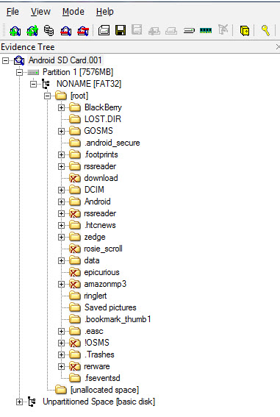
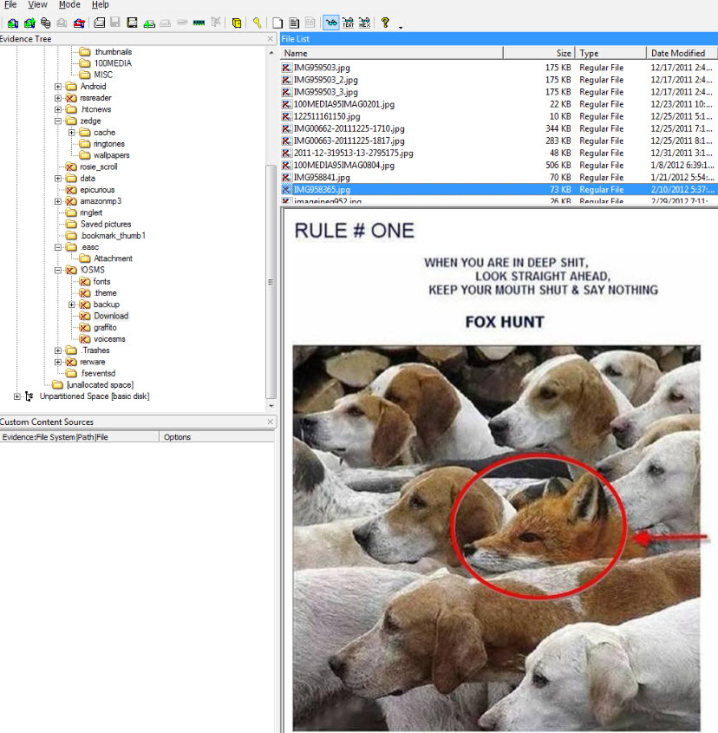
SD Cards Analysis
Notes:
SD cards can store data in any format. Examiners must take this into consideration when conducting a forensic examination of an SD card. Smartphones, however, use the SD cards to store application data, user-created files, backup files, and possibly encrypted volumes. Depending on the smartphone, the data stored and acquired from the SD card may vary.
A full file system examination of the SD card should be conducted in your forensic tool of choice. XWAYS, Autopsy, Inspector, EnCase, or FTK provide access to all the files (deleted and active) on the media to include encrypted volumes. Mobile device forensic tools may be required for parsing third-party applications and phone backup files. Andrew Hoog, from viaForensics, references the use of SD cards in Android devices in his book Android Forensics: Investigation, Analysis and Mobile Security for Google Android.
The examiner should use tools that allow him/her to search by file extension, keyword search, mount files, and carve data that may reside on the media, but isn't being interpreted. Analysis for the Android portion of this SD card are covered in the corresponding sections of this course.

Slide 33
Notes:
Deleted images may be recovered from the SD card. Depending on the SD card and the process for deleting the image, EXIF data may be recoverable. FTK Imager shows the deleted images from the SD card but may not display the EXIF data. Should you not find any EXIF data, it is best to export the image and attempt to recover the data using another tool or a hex editor.

Slide 34
Notes:
Many smartphones contain microSD data storage expansion cards that are used for increased storage and functionality. These storage cards can contain data that has great evidentiary value.
Most MicroSD data storage cards are generally formatted with FAT file system; however, some are formatted NTFS, and some contain proprietary formatting. Many phones allow the user to encrypt data stored on the microSD card, and some of these cards are locked to the device they are installed in and are not readable outside the device. You may find that a microSD card has been used in several smartphones or other devices.
If possible, microSD expansion cards should be processed as you would traditional media, including the use of write protection devices. Processing data expansion cards while installed in a device may result in changes to the date and timestamps on the card, and so the cards should first be processed outside the phone, and then with the phone if you choose to see the data in its native context. Some expandable storage cards are locked to the device and are not readable outside the device and, therefore, need to be processed while installed in the device.

Slide 35
Notes:
Some Android devices allow for external and additional internal storage. The standard SD cards range in size and can be added and removed from the device by the user. Once inserted, the SD card must be mounted for the Android to access the media. The Android YAFFS2 file system relies on external SD cards for additional storage. eMMC (embedded multimedia cards) were introduced with the EXT file system. The reasoning was to allow more internal storage that didn't rely on or use up the NAND flash memory. Keep in mind that the trend is no longer to use an SD card that can be removed from the device. ISP supports many eMMC devices. An alternative to ISP is to acquire the device as a USB mass storage device, similar to what your instructor will demo in the next few slides using FTK Imager.
Android devices may have removable batteries, but this is no longer the standard. Removable SD cards make Android and iOS devices very different smartphones. This used to be one of the biggest differences in the two smartphones. However, Android phones don’t always allow for SD cards to be inserted as they have in the past. SD cards can either be physical (removable) or emulated, which makes forensic acquisition and analysis more challenging for examiners when trying to put together the puzzle pieces. Third-party applications can store unique data on the SD card and, if separated, the application cannot be fully parsed, depending on how the data is stored by the application. Acquiring Android devices with SD cards is a lengthy process. When time allows, we recommended the following steps:
If the phone is powered off, acquire the SD card first, using methods we will demo in the next few slides or by referring to the bonus material included within the media files provided with the course.
If the phone is powered on, acquire the phone with the SD card in it, even if the SD card is not mounted by the Android file system. You do not want to power off the device to remove external media if you made the choice to keep the device powered (i.e., preventing the device from locking or avoiding encryption).
Ensure that you have acquired the SD card separate from the phone as well as inside the phone, where time allows.
Make sure to document all steps to ensure that nothing is overlooked, and your methods are as forensically sound as possible. (For example, if the device was rooted during acquisition, this should be noted.) Keep in mind that a phone can only pull data from an SD card that the phone “understands.” This means if the user has tax documents or encrypted containers stored on the SD card prior to using it with an Android, this data could be overlooked during acquisition because the phone doesn’t understand that type of data. You, the examiner, need to make sure you make every effort to capture all data from the smartphone media. This means you should acquire the SD card as traditional digital media, in a write-protected manner, and not just through the smartphone.

Slide 36
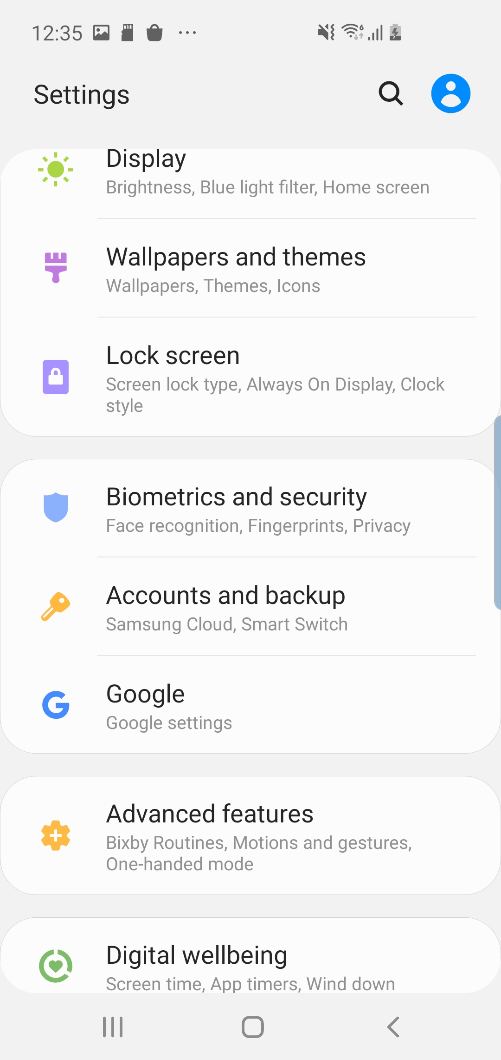
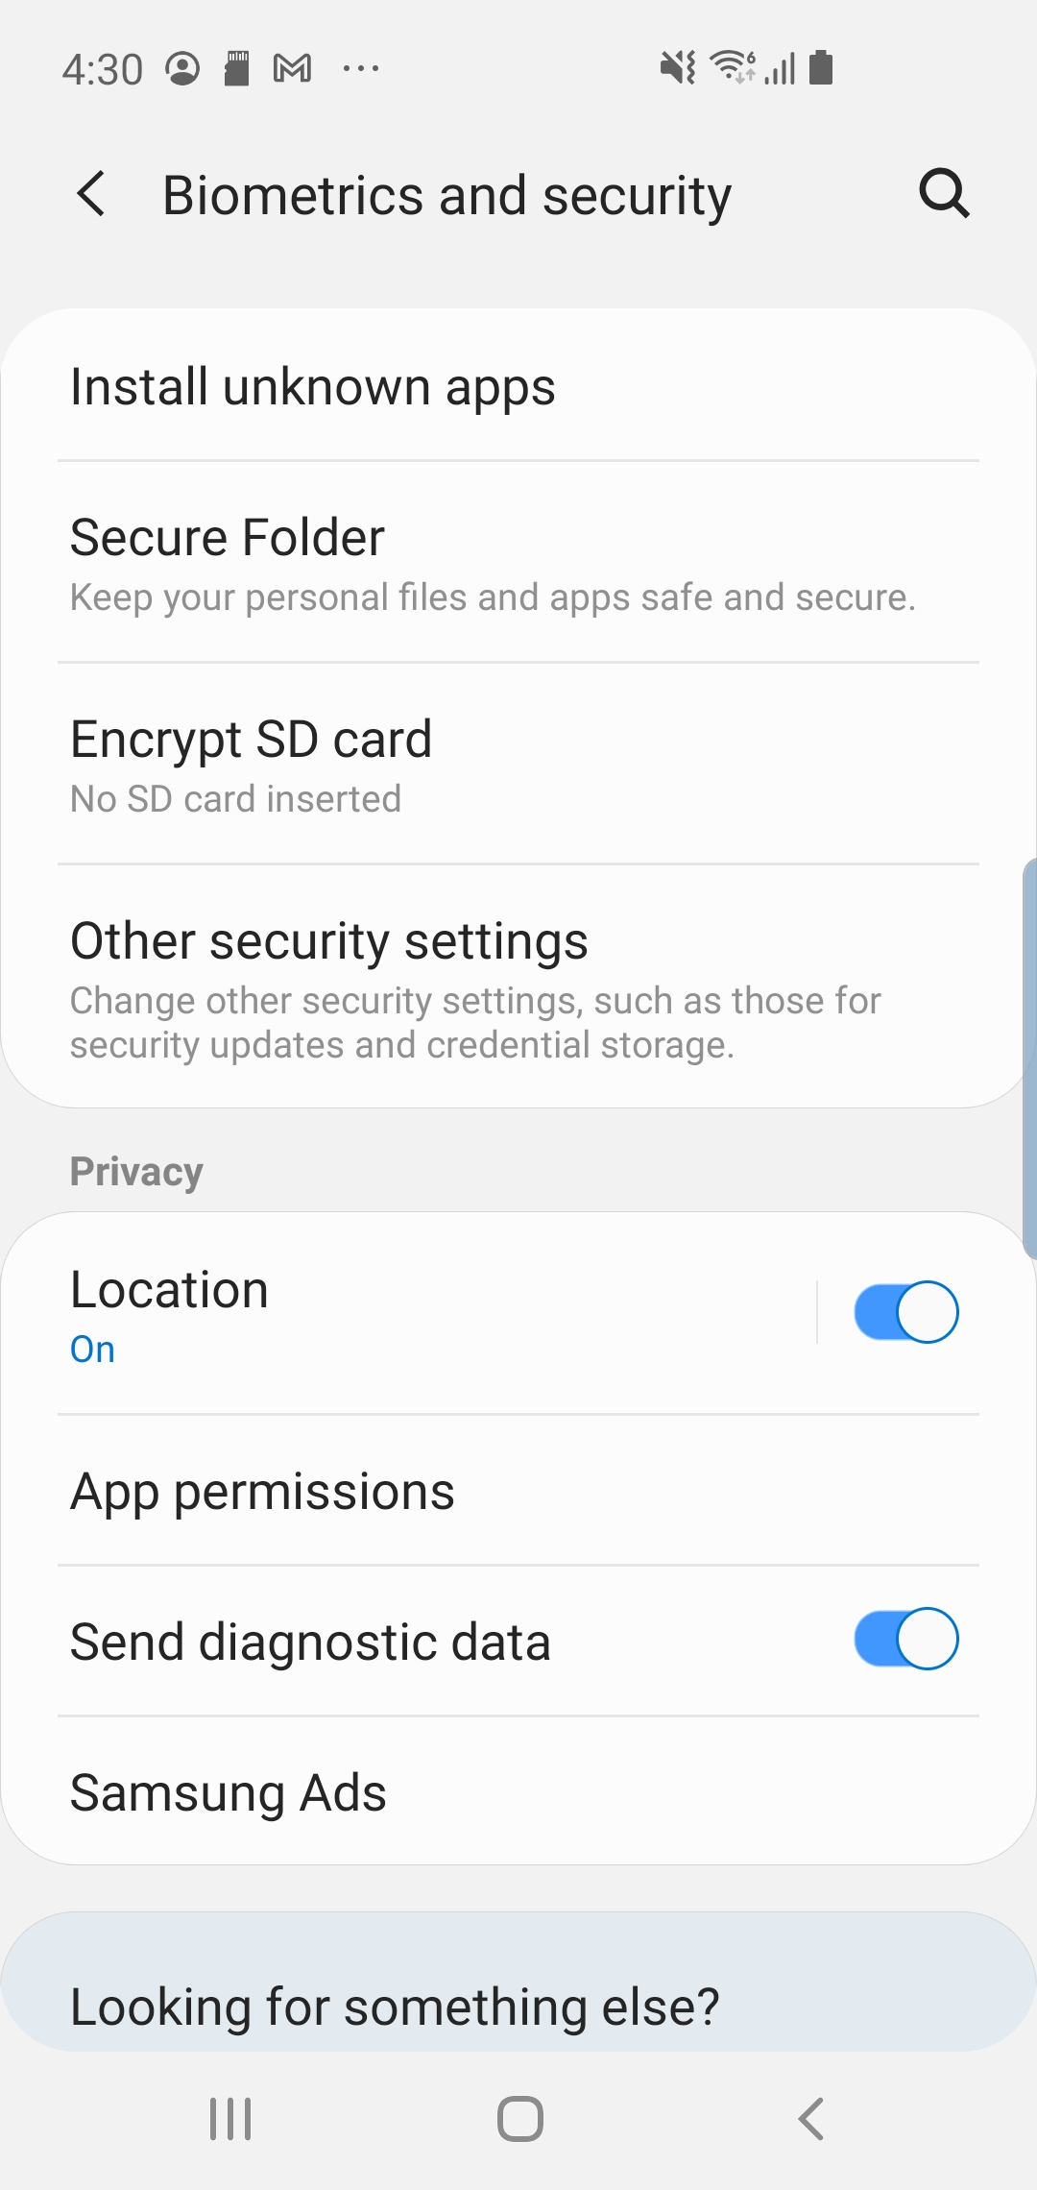
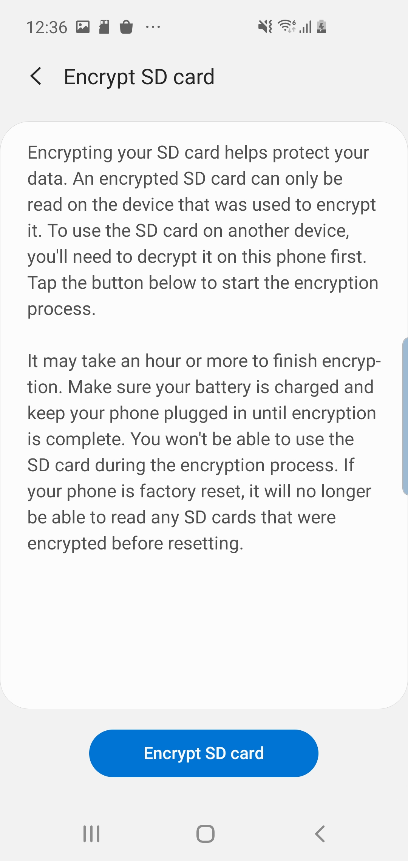
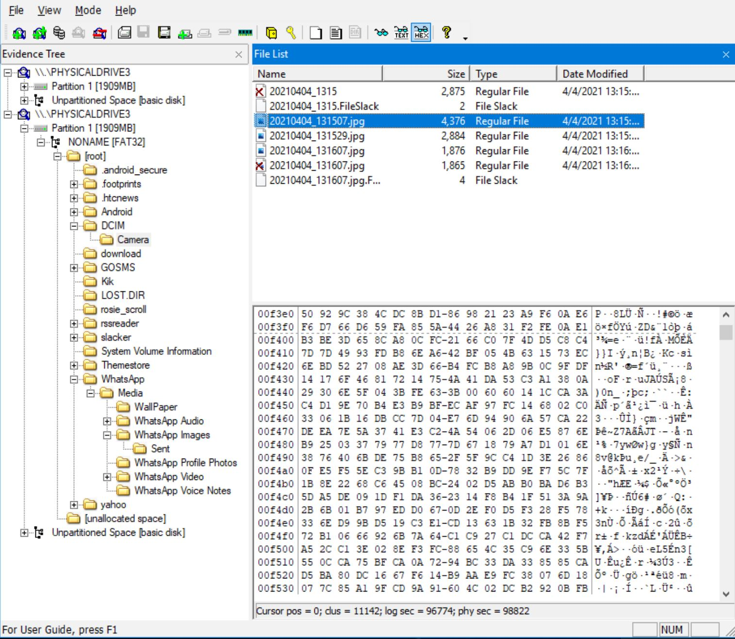
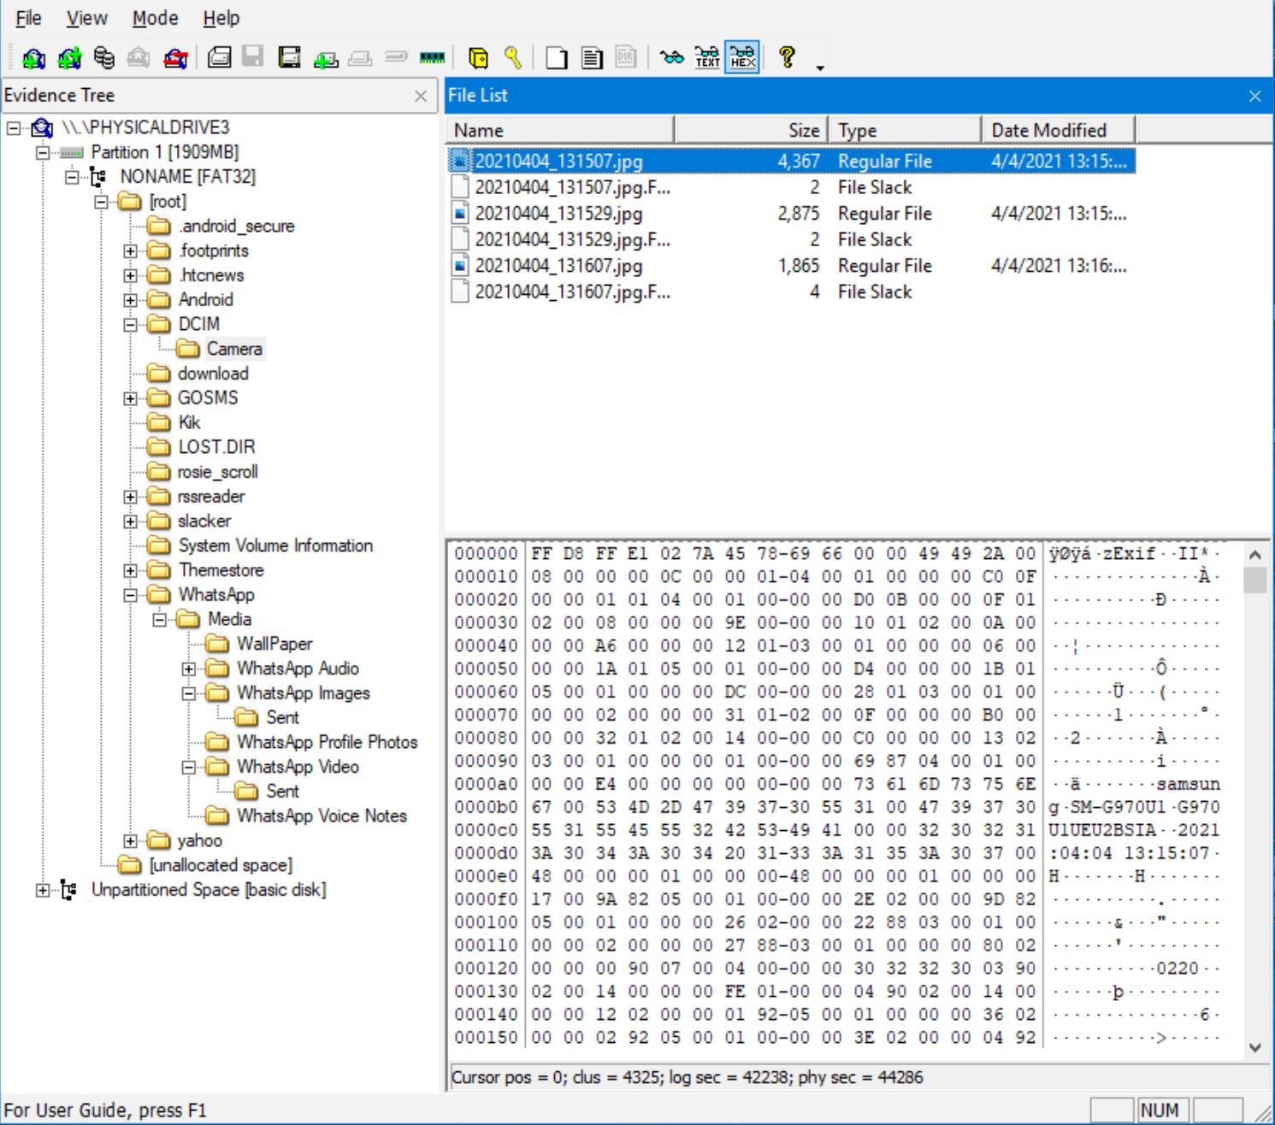
Media Card Encryption
Media card encryption is tied to device passcode.
Change settings if you have access to device.
Without the original device, encrypted media cards are inaccessible.
Encrypted
Decrypted
Notes:
The pictures above depict the contents of a file on an encrypted and decrypted media when removed from an Android.
First, check the device to see if the media card is encrypted. Encrypted media cards can only be decrypted using the device that applied the encryption. This can be done in the settings of the Android.
In order to successfully acquire meaningful data from the associated media cards, encryption settings should be turned off before removing the media card. Make sure to double-check that your acquisition contains readable data!
In modern Android devices, this can be accessed through:
Settings > Biometrics and Security > Encrypt/Decrypt SD card > Enter your device pin/passcode/password and the data will be encrypted/decrypted.

Slide 38
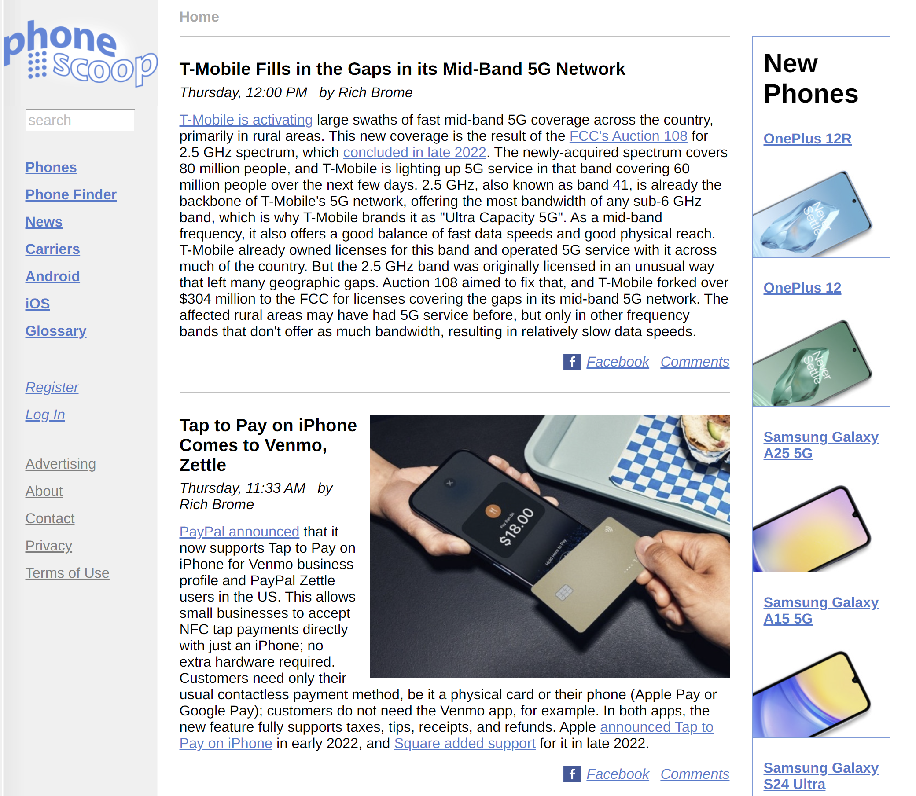
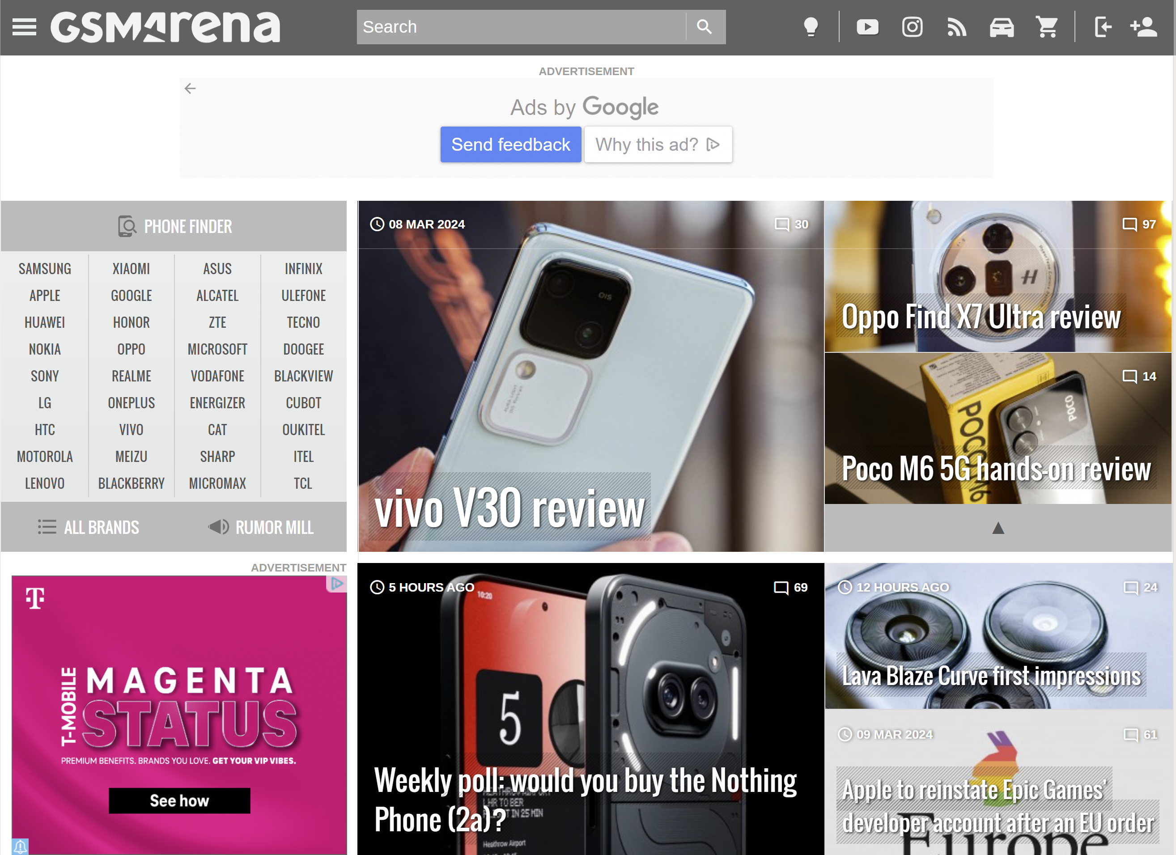
Researching Components
It is always a good idea to research your particular device if you are unfamiliar with its components.
Phonescoop and GSMArena are two sites that provide relevant information.
Notes:
There are many available sites dedicated to providing extensive information about the different mobile devices on the market. Sites like Phonescoop.com and GSMArena are great places to research specific phone makes/models for internal storage capacity, support for removable media, model numbers, and other notable characteristics.
This can be a valuable part of your acquisition step to make sure that no extraneous media is overlooked.

Slide 39
SD Card Analysis
Lab 1.1
Notes:
This area is intentionally left blank.

Slide 40
Course Roadmap
Notes:
This area is intentionally left blank.

Slide 41
Smartphone Handling
Many different makes, models, and operating systems
There is no one-tool-fits-all forensic solution
Mobile devices are constantly changing when powered on
There is no write blocking solution for mobile devices
Collection decisions may have implications for the success of the exam – is the device HOT or COLD?
Removing a SIM card may remove the biometric lock
Looking at it could remove the biometric lock!
Faraday solutions don’t always work
Expect the unexpected
Notes:
Mobile devices, including smartphones, present a variety of unique challenges to investigators involved in forensic examinations of data from these devices. Part of the challenge arises from the fact that there are so many different makes and models of phones using a variety of underlying operating systems. Because of this, there is no one-size-fits-all forensic solution for mobile devices, and in many cases, numerous tools may need to be used to obtain the data needed for a particular investigation. Additionally, traditional digital forensics concepts may not apply due to the way flash memory functions.
Mobile devices are constantly changing when powered on, and there is no way to write block a mobile device because they communicate using modem protocols, such as AT commands and others. Because of these factors, the goal in forensics is to make as little change as possible and to document those changes that were made to the device during the forensic process.¹
Just powering on a smartphone generates changes to the data and traces that can be observed during a forensic examination of the device. This is true even if the user does not operate the device other than just powering it on. The device, once powered on, reaches out to the mobile network to authenticate on the system and may store last-location data related to mobile towers or GPS if it is enabled.
At some point, however, with few exceptions, the phone most likely must be turned on in order to work with it, unless the capability for data extraction through physical, JTAG, ISP (In System Programming), or chip-off methods exists. Therefore, we need to take steps to make as few changes to the device as possible and to control and document the changes we do make.
Another consideration is the current state of the device when you receive it. Is the device HOT or COLD? A HOT device would be one that was recently unlocked with the passcode by the user. A COLD device would be one that was freshly restarted and has yet to be unlocked. These concepts make a difference in handling and how the tools can access the data. For more information on HOT and COLD devices, refer to the Cellebrite webinar provided by Heather Mahalik and Shahar Tal on Android Encryption (https://www.cellebrite.com/en/resources/webinars/).

Slide 42
Notes:
For more information on the worse mistakes to make on iOS devices, refer to the blog by Elcomsoft: https://blog.elcomsoft.com/2020/01/the-worst-mistakes-in-ios-forensics/. It’s crazy to think that simply looking at the phone could hurt your chances of accessing it if you reset the biometric lock.
As stated earlier, smartphones are specifically designed to communicate with other devices, whether through the mobile network, a data connection, Bluetooth, or similar wireless technologies.
To prevent incoming calls, texts, and other data from affecting the integrity of data of potential evidentiary value on the smartphone, as well as to prevent overreaching legal authority, attempts should be made to block incoming and outgoing signals to the device.
Additionally, it is possible to remotely wipe a smartphone or other mobile device either by use of a variety of mobile applications or by having the carrier remotely wipe the device by reporting it stolen and requesting that it be wiped.
Common methods for isolating smartphones include Radio Frequency (RF) blocking container or jamming appliances.* Be aware that blocking radio frequency signals will drain the battery as the smartphone tries to connect to the mobile network. Faraday devices can be expensive, and use of the devices may not prevent the alteration of mobile phone data if the device fails.² It is also difficult to operate touchscreen devices through Faraday materials, and not all Faraday technologies are see-through or flexible enough to allow manipulation of a smartphone. Additionally, Faraday technologies have a fairly high failure rate and cannot be completely relied on to block wireless signals.³ If a Faraday failure occurs, document any known changes that were made to the phone, including incoming text messages, calls, or other communications.
*Be sure that it is legal for you to use signal jamming equipment. In the United States, most private and public organizations do not have legal authority to do so.
https://for585.com/byg0f ("Cellular Phone Evidence Data Extraction and Documentation", V.3, Cindy Murphy)
https://for585.com/0q38a (SWGDE Best Practices for Mobile Phone Forensics)
https://for585.com/t5ugz (Eric Katz’s dissertation on Faraday solutions, Purdue)

Slide 43
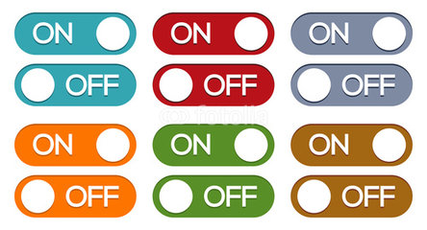
Collection of Smartphones as Evidence
Generally, there are two acceptable collection methods for smartphones, both of which can have pros and cons:
First method: Always turn off the phone upon collecting it as evidence.
Second method: Leave phone off if it is off, and leave it turned on if it is on, and use Faraday protection.
Notes:
Generally, there are two accepted collection methods for smartphones, both of which can have pros and cons. Knowing each method, you can decide which is most appropriate given the circumstances of your investigation.
The first collection method is to always turn off the phone upon collecting it as evidence.
The second is to leave the phone off if it is off and leave it turned on if it is on. (Use Faraday protection if you collect a phone that is powered on.)
Faraday bags are fallible, and a device inside the Faraday bag may receive signals from the surrounding mobile network. NOTE: If a charger is attached to a phone inside a Faraday bag, the charger cable may act as an antenna and can allow the phone to receive incoming data.

Slide 44

Method 1: Always Off Rule for Smartphone Collection
This is recommended for devices that cannot be immediately examined—unless it is hot!
If hot, acquire the devices ASAP!
Otherwise, do not turn the phone on unless the tool states to do so.
Con: Turning off the phone may engage the screen lock, and it may be impossible to get into the phone later (it may turn cold).
Notes:
Method 1: Always Off Rule for Cell Phones¹
This method works well if there will be a time delay in the examination of the phone that could potentially result in battery discharge and data loss:
Seize the phone and turn it off for evidence preservation
May remove the battery to prevent phone from accidentally being turned on
Only turn the phone on when a trusted tool directs you to do so
The benefits of turning off the phone during collection include:
Preserving call logs and last cell tower location information (LOCI)
Preventing overwriting deleted data
Preventing data destruction signals from reaching the mobile phone
Preventing improper mobile phone handling (for example placing calls, sending messages, taking photos, or deleting files)
The risks of turning off the mobile phone include possibly engaging protection mechanisms, such as encryption, passwords, PIN codes, and more.² Turning off the phone also results in loss of data from RAM. However, it is unlikely you will capture that data due to constraints that will be discussed later in this course. Make sure to use caution when turning off a device that was HOT (aka. Recently unlocked with a passcode) as this may be your only chance to get the most thorough dump of data from that phone.
Det. Cynthia Murphy, Collection of Cell Phones as Evidence: Suggested Practices (Madison, WI: Madison Police Department, 2011).
https://for585.com/0q38a (SWGDE Best Practices for Mobile Phone Forensics)

Slide 45

Method 2: On/Off Rule for Smartphone Collection
Recommended for devices that can be examined quickly or on-site
If phone is on, do NOT turn it off; if phone is OFF, leave it OFF
Place ON cell phones in a Faraday protection or place phone in Airplane mode and disable other wireless communications
Maintain power to the battery so that phone does not die – Never let a HOT device go COLD!
Notes:
The ON/OFF method works well if the phone can be examined in a timely manner. The ON/OFF rule is explained here.
If the phone is on, do NOT turn it off. If the phone is OFF, leave it OFF. Place ON cell phones in a Faraday bag, arson can, or four to five layers of aluminum foil, or place the phone in Airplane mode (if equipped) to prevent the phone from communicating wirelessly, which could potentially destroy evidence. Maintain power to the battery so that the phone doesn’t die, causing potential loss of some or all data, depending on the phone model. Gather any associated cables, accessories, or documentation for the device.
Remember that turning off a password-protected cell phone could render the data on the phone inaccessible if the phone is turned off. Also, turning on a phone to go through it looking for numbers, contacts, text messages, pictures, or anything else may destroy valuable evidence.¹
Exigency may dictate that the mobile phone remains on for immediate processing. If the mobile phone must be left on, isolate it from its network while maintaining power.²
Radio Frequency (RF) shielding: Mobile phones communicate with cell towers. Allowing this communication changes data on the phone.
Many mobile phones can be placed in Airplane mode, limiting access to cell towers (911 calls still available). This requires user input on the handset.
Disable Wi-Fi, Bluetooth, RFID, and IrDA communications if practical.
Before beginning the examination of a mobile device, to avoid legal penalty or exclusion of evidence, ensure that you have proper legal authority to perform the forensic examination.
Legal authority varies by jurisdiction and can be significantly different depending on where you live and what sort of examination you are performing.

Slide 46
Notes:
In the U.S., case law regarding mobile devices is in a state of flux. If you have any questions about whether what you are doing is legally acceptable, consult legal counsel. Search of cell phones incident to arrest has been determined to be unlawful in most circumstances by the U.S. Supreme Court (Riley v. California).³
Be particularly conscious of the fact that a mobile device is a “window” to access other user accounts where the data exists not on the device itself, but in the cloud or in an account on the internet. Legal authority to perform a search of data contained within the mobile device does NOT normally extend to data stored on the internet but accessed by the device.
Det. Cynthia Murphy, Collection of Cell Phones as Evidence: Suggested Practices (Madison, WI: Madison Police Department, 2011).
https://for585.com/0q38a (SWGDE Guide to Mobile Phone Forensics)
https://for585.com/mez8q (Riley v. California)

Slide 47
Smartphone Acquisition Terms
Manual examination
Physically scroll through the mobile device and document data using photographs/videos
Logical acquisition
May obtain content of logical storage objects (contacts, call log, SMS, pictures, videos, calendar, and more) that reside on a file system partition
File system acquisition (Advanced Logical)
Partial file system dump, possibly including associated data (directories and files) from the user data partition
Full file system acquisition
Full file system dump, including data from the user data partition. Common with exploits and advanced extraction (CAS, Premium, GrayKey)
Physical acquisition
May obtain data from the first to last bit on one or more chips in mobile device
Notes:
There are five basic levels of acquisition for smartphones, including:
Manual examination: Process undertaken when the examiner physically scrolls through the mobile device and documents data using photographs or written notes regarding the contents of the device.
Logical acquisition: Obtaining specific contents of logical storage objects that reside on a file system partition within a mobile device. A tool that communicates with the phone and obtains and reports only existing non-deleted contacts, call history records, SMS text messages, pictures, videos, or one or more items from the previously listed categories is conducting a logical acquisition of the data from the device.
File system acquisition/Advanced Logical: Partial file system dump. Physical analyzer uses the term “Advanced Logical” for some smart devices, more commonly iOS devices. If we think about “iOS Advanced Logical” it is a partial file system obtained through backup + AFC, if we think about “Android Advanced Logical” it is again a partial file system obtained through backup + MTP + ADB. This will be covered in detail in each phone-specific section of the course.
Full file system: Full file system dump, including data from the user data partition. Common with exploits and advanced extraction (CAS, Premium, GrayKey). This is the next best thing to a full physical acquisition.
Physical acquisition: Use of the term physical acquisition in mobile-device forensics refers to the process of obtaining all the data from the first to last bit and from one or more physical stores (memory chips) in the mobile device. JTAG, ISP, and chip-off methods fall under physical acquisition. The ability to obtain this type of extraction is becoming rare as encryption mechanisms are constantly growing in strength.
When performing smartphone forensics, it is ideal to first obtain the deepest level of acquisition supported for the make and model of phone you’re working on that the tools you are using will support. Then go back and complete other supported extraction methods that may do a better job of parsing and displaying data from the phone.

Slide 48
Notes:
For example, if you are able to obtain a physical memory dump from the phone, you get deleted information and files that are locked by the OS when they are in use. You may also be able to obtain security and unlock codes with a physical acquisition. The tool you are using, however, may or may not parse user data in an easily readable format with a physical acquisition.
Therefore, if you next perform a file system and/or logical acquisition of the data, you may obtain better results for reporting purposes. Finally, taking pictures of particularly important pieces of data from the device.

Slide 49
Not All Tools Are Equal… Not All Smartphones Are Equal…
Different mobile device forensic tools support various makes and models of phones to different levels of acquisition and analysis.
Even if the same acquisition type is supported, you may see differences between tools in the data acquired and parsed.
Always verify acquisition against the phone itself.
Remember that a full file system acquisition will yield the best data for analysis should a physical acquisition not be available.
Check results in the native file(s) and manually decode to verify results if necessary.
Use more than one tool—ALWAYS!
Know what your tools are doing – bootloaders, jailbreaks, roots.
Notes:
One important thing to keep in mind when conducting mobile device forensics is that not all tools are equal, and not all smartphones are equal. Different mobile device forensic tools support various makes and models of phones to different levels of acquisition, and the way they report data back to the examiner may not be consistent. Even if the same acquisition level is supported by different tools, there may be differences between tools in the data acquired and in how it is reported. There are also sometimes errors in data translation, especially when it comes to date and timestamps because there are so many different data formats utilized by mobile devices.
For these reasons and others, it is important that you make a habit of always verifying acquired data against the phone itself and/or manually verify decoded data by checking the underlying hex yourself.
It is important not only to know how to use the mobile forensic tools you have access to, but also to know what they are doing when you process a phone. Different mobile forensic tools use different methods to access and acquire the data from different makes and models of phones. The tool itself often makes changes to the data on the phone, including the installation of bootloaders or applications, or use of jailbreaking and rooting methods. These methods are acceptable and necessary to obtain data from the devices, but it is advisable to know what your tools are doing for each phone so you can document and explain any changes made to the device and why they were made. In this course, we will discuss new methods for access like checkra1n and checkm8. It’s important for you to understand how these exploits work and how the tools leverage them.
Another reason to know what your tools are doing is that you may find different methods to use the tool to obtain better results. For example, with Cellebrite Physical Analyzer, on many Android-based devices, using Generic Android Methods under the File System acquisition option may parse more data into a usable format than a successfully supported physical acquisition of the same model of phone.
Sometimes, tools may make changes to the original device during acquisition that affect subsequent acquisition attempts. For example, when performing acquisitions on newer iPhones, Oxygen applies an

Slide 50
Notes:
encryption password to devices that have not had a previously encrypted backup, without notification to the examiner. If the examiner attempts a subsequent acquisition using Cellebrite or another tool, they will be asked to supply the encryption password applied by Oxygen during the parsing process, though that password is not well documented. The password is “oxygen”. Cellebrite uses “1234” or “12345” and Magnet uses “mag123” when backup encryption is applied to the extraction. This information isn’t readily available in the documentation, and Elcomsoft Phone Breaker was used to solve the puzzle of what the password was; keep in mind this may happen to you and you may find yourself having to crack a password you and the user did not set on the device.

Slide 51
Android: Additional Extraction Methods
SmartFlow in UFED
Qualcomm Live, MTK Live, Kirin Live, and more
The goal is full file system access
Older methods if you come across legacy devices
Bootloader extractions - Can be injected into RAM prior to the OS loading to allow access to the device
Custom recovery images - Only supported on older, non-encrypted Android devices
Emergency Download Mode (EDL) - Allows low-level access to the chipset
JTAG/Chip-off/ISP – Irrelevant?
Notes:
Cellebrite offers smartflow in Inseyets that tries all methods in order to obtain a full file system acquisition. These methods of acquisition include Qualcomm Live, MTK Live, Huawei (Kirin Live), and more. These extraction methods are linked to the chip inside of the Android and are accessible via UFED. Most of the acquisitions in the class were obtained with this method.
For older Android devices, we can perform full physical extractions of data using a small program or set of instructions called a “bootloader”.¹ The bootloader is injected into the RAM of the device and executes before the operating system boots. Bootloaders are usually a generic solution, based upon a family of devices, often defined by the chipset in the phone. They are designed to be read-only and are therefore considered safe and forensically sound. Bootloaders allow for complete acquisition of flash memory of a mobile device, including spare area of the flash memory.¹
Manufacturers of cell phone forensic tools will often create custom bootloaders for full physical acquisition purposes. In order to use a bootloader for acquisition, sometimes the phone must be put into rescue or recovery mode, or a specialized cable might be necessary.² Sometimes firmware update protocols are used to insert a bootloader.
When a device is locked, it may be possible to use Android’s recovery partition to access the data on the device. The Android device needs to be placed into recovery mode so the custom recovery image can be pushed to the device. A custom recovery is a third-party image that replaces the stock Android recovery partition and allows the user to gain access to the data or root the device. Again, this is only supported for older, non-encrypted Android devices. A common custom recovery partition is Team Win Recovery Project (TWRP).
EDL mode is available with some Qualcomm chips and can allow low-level access to the chipset. This is designed to allow for device analysis, repair, or re-flashing, but can present the opportunity to achieve a full physical extraction of the data from the chip.³ EDL mode can be accessed by several software methods, including:

Slide 52
Notes:
Special key combinations: Depending on the manufacturer, the key combination may be different. The most common combination from a powered-off state is: Hold Vol Up + Vol Down while connecting USB. Other combinations may include Vol Up, Vol Up + Vol Down + Power, etc. Some vendors have
early boot menus that offer the choice of entering the mode (recovery, fastboot, download).
ADB: Most phones with EDL available allow entry to EDL mode via a command available from an authorized ADB session. (Try: adb reboot edl.) This is useful for obtaining a physical extraction of an unlocked device. This is what Cellebrite UFED attempts when trying "Generic Qualcomm ADB".
Fastboot: An alternative vendor-specific method exists from the fastboot mode, which is sometimes reachable by other key combinations (usually Vol Down + Power).
FTM: Some vendors have implemented FTM mode (hold Vol Down while connecting the USB), which exposes an ADB interface. Cellebrite UFED can detect this mode and continue to extract normally using the "Generic Qualcomm ADB" method.
Hardware methods may include:
EDL cable: Some devices will detect a special cable that will signal the device to enter EDL. Specialized cables may be obtained from various stores and will be supplied by Cellebrite to customers when the phone is supported.
Test points: Some devices have test points that, when shorted to ground, will cause the device to enter into EDL mode. Depending on the board, they may be easily accessible, even without significant disassembly.
eMMC faults: Electrical faults are introduced to the eMMC chip as it boots. With a pinout chart for the specific board in the device, you may short the CMD, CLK, or D0 lines to ground temporarily during power on.
The Joint Test Action Group (JTAG) method used to be heavily relied upon when forensic and open-source tools did not support data acquisition of a smartphone. Currently, many devices do not support this method of acquisition. Encryption and lack of TAPs are to blame for this lost craft. This type of acquisition can damage a device if done by an untrained examiner. The JTAG method acquires data via the Test Access Ports (TAPs), which requires the device be taken apart, yet remain functional⁴ (For example, the device must be able to be powered and recognized by the forensic workstation). Thus, if an examiner is untrained, the device may become damaged during disassembly or soldering to the TAPs, which renders the evidence unusable. Use caution when exploring this method and make sure you have proper training, and practice on test devices prior to attempting JTAG on real evidence.
When done correctly, JTAG is a great way to recover data from devices. Prepaid/throw-away/burner phones present challenges during examinations because they are usually difficult to acquire. The data ports have often been disabled to prevent individuals from re-flashing the firmware on these inexpensive phones and reselling them for use with a different carrier for a much higher price. These devices are generally good use cases for JTAG, ISP, or chip-off techniques.⁴
ISP, or In-System Programming, is a method that enables examiners to extract data physically by connecting to the chip on the Printed Circuit Board containing phone data to obtain a full physical extraction. This method does not require the removal of the chip and is comparable to JTAG in that aspect.

Slide 53
Notes:
Chip-off forensics is a data acquisition procedure that involves physically removing the non-volatile integrated circuit (IC) chip from a device and reading it directly on a specialized external reader designed specifically to read the make or model of chip being worked with. A complete bit-for-bit forensic image file is made from the data contained in the removed chip, which is read directly from the chip, and the data is not changed during the imaging process.⁶ Use caution when exploring this method and make sure you have proper training, equipment, and practice on equivalent test devices prior to attempting chip-off on real evidence.
Chip-off data extraction is a forensically sound way to recover data from devices and may be the only option in some circumstances when phones are not supported for data extraction due to locked data ports, unsupported operating systems, encryption, or physical damage to the phone. In cases where a mobile forensic tool may support a full physical image of a device for decoding and parsing but cannot obtain a full physical image due to passcode protection, chip-off can be used to extract data from the device, and scripts can then be used to deal with passcodes or swipe codes once the data is loaded into the forensic tool. Chip-off is usually considered the last option because the removal of the chip is generally a one-way operation, and the original hardware will be damaged during the process. However, in modern-day forensics, this may be the only option, so it is important that you are aware of the possibilities.
The chip is taken off by removing the epoxy that surrounds it and then heating up the solder, allowing the chip to be removed from the Printed Circuit Board (PCB). The other option is to grind the chip away from the board. After the chip is removed from the phone, it will need to be cleaned up to remove remaining solder and residue so that it can be read. The chip may also need to be “re-balled” in order to repair contacts damaged during removal. The chip will then be placed in a reader or adapter of the exact size and pin out. Many adapters are custom made to accommodate various proprietary chips. The NAND chips follow the specifications from the Open NAND Flash Interface (ONFI) group, and while the pin out will remain the same for most chips, there may be different package sizes. Once the correct reader or adapter is found, the chip can be mounted, and a full physical image of the chip can be made.⁷
https://for585.com/e0d7p (Cellebrite white paper: “What Happens When You Press That Button?”)
https://for585.com/cnosp (Magnet Forensics: "White Paper: Android Acquisition Methods from Root to Recovery”)
https://for585.com/a4p61 (Cellebrite Practical Guide: Qualcomm EDL Extractions)
https://for585.com/jtagchipoffisp (Alternative acquisition solutions)
Tamma, Sulkin, Mahalik, and Bommisetty, "JTAG defined", in Practical Mobile Forensics, Fourth Edition (Birmingham, UK: Packt, 2020).
https://for585.com/o19f6 (Chip-Off and JTAG Analysis)
https://for585.com/ox4u5 (Open NAND Flash Interface)

Slide 54

iOS—Jailbreaks and Exploits
checkra1n
First jailbreak released from the checkm8 exploit
Provides access to the Full file system extraction
Cydia will be installed
Built into most commercial tools now
No longer functional on iOS17
The exploit detected by axi0mX
Cellebrite built the solution into UFED
No need to jailbreak with checkra1n or install Cydia and AFC2
checkm8
Notes:
The discovery of the checkm8 exploit on Apple devices (4S – X and several iPads) by axi0mX opened a door to access most haven’t seen in almost a decade. We can now extract a Full file system extraction from iOS devices affected by this exploit. The best news for us in forensics: It cannot be patched as it’s an exploit that lives on the chips inside of these iOS devices. At the time of this update, statistics show that 85% of devices currently in use fall into the realm of being susceptible to the checkm8 exploit. Now, all we needed was a jailbreak.
Enter checkra1n, the first public jailbreak that utilizes the checkm8 exploit. Cellebrite was the first to implement the capability into their tools. You can leverage UFED to obtain a Full file system extraction via checkm8 without manually jailbreaking the device. This jailbreak and others are available in Inseyets powered by UFED. This method is deemed safer than manually using checkra1n and other jailbreaks because the exploit and jailbreak run in RAM and do not permanently change the file system. More information on this topic will be covered in section 3.

Slide 55
Course Roadmap
Notes:
This area is intentionally left blank.

Slide 56
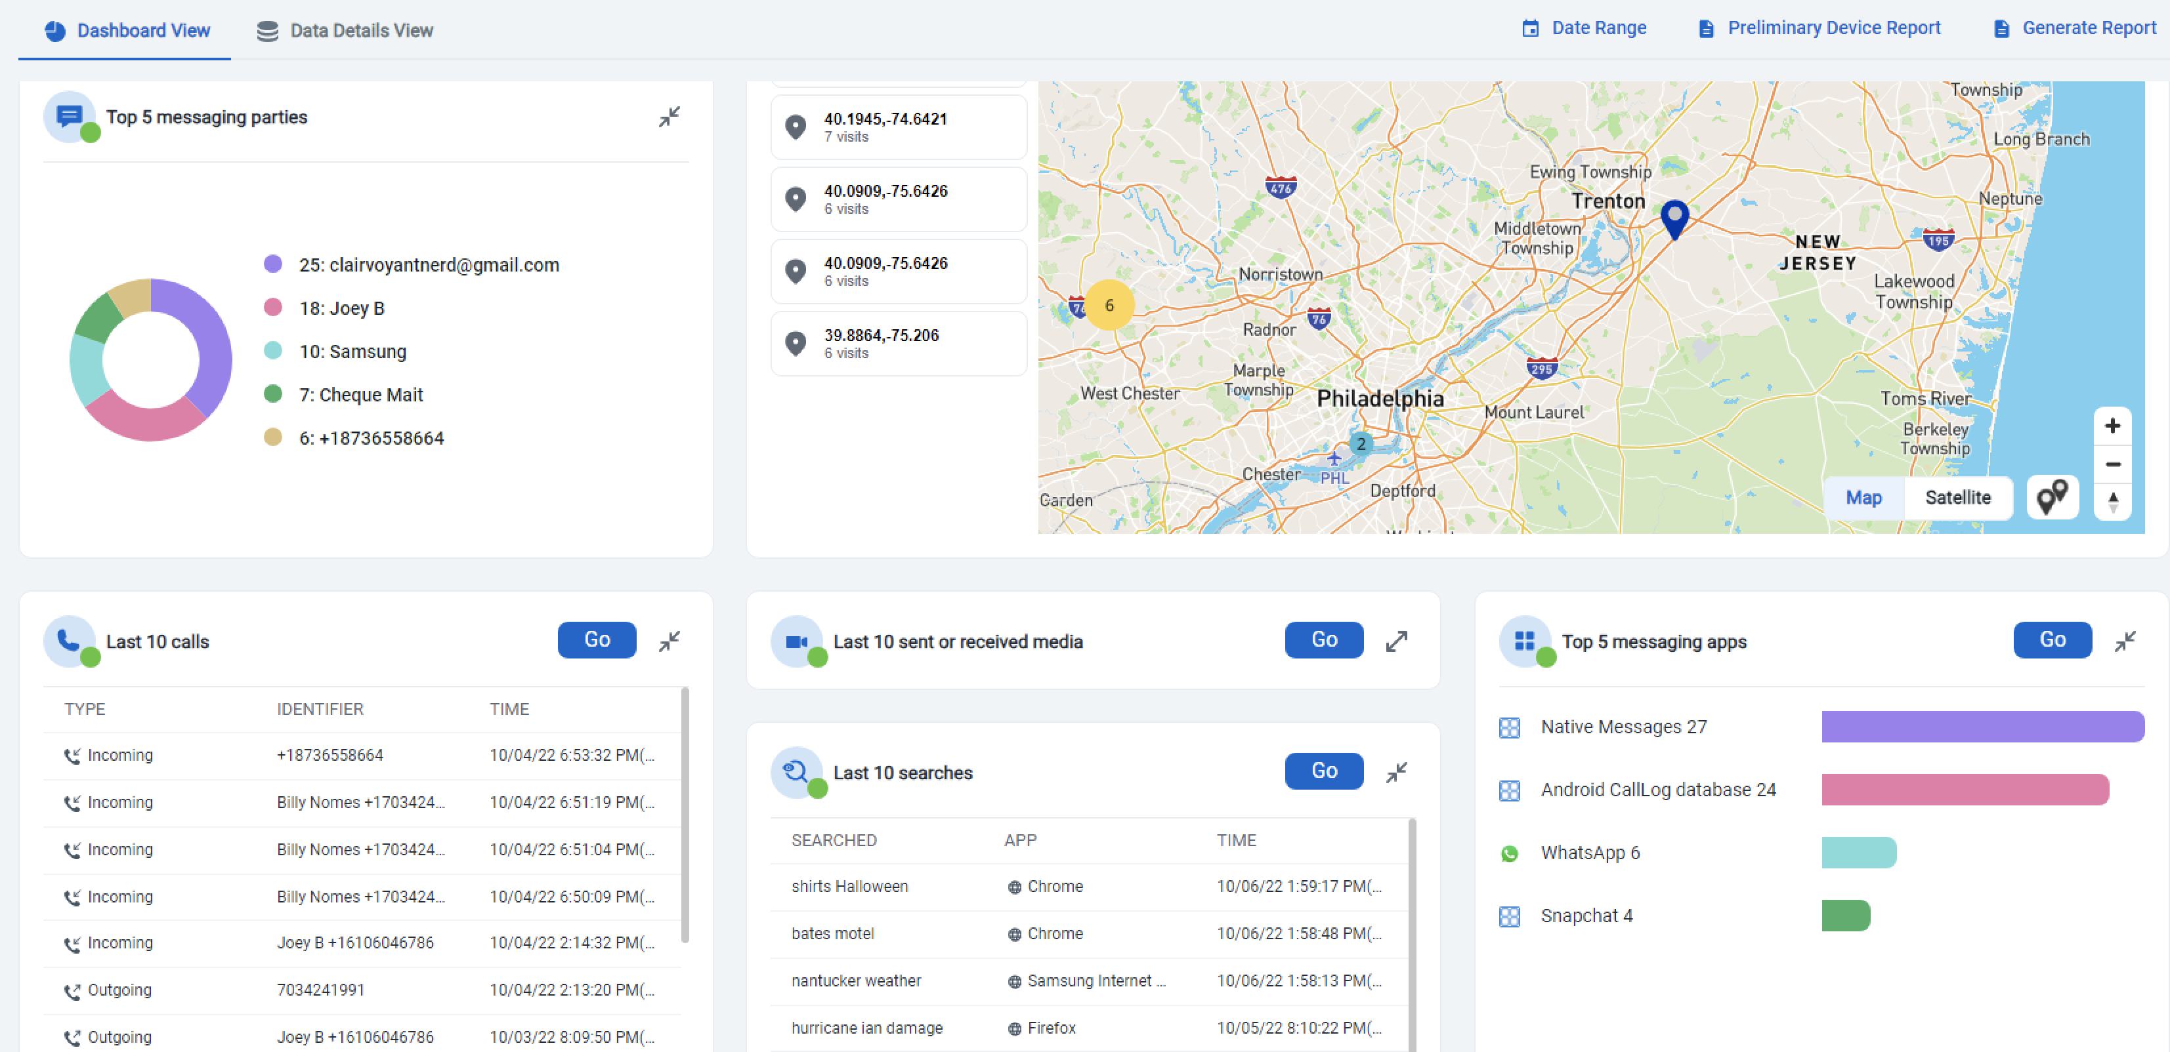
Cellebrite Physical Analyzer Overview
Inseyets powered by Physical Analyzer (PA)
Ability to pre-process cases and load .clbe files
Notes:
Cellebrite introduced Inseyets in 2024 as a suite of tools that is powered by UFED and Physical Analyzer. Many acquisitions in this course were created using Inseyets powered by UFED. For the labs, you will have access to Inseyets powered by Physical Analyzer. Physical Analyzer is strong at application parsing, timelining and carving additional artifacts. It is a great platform for conducting analysis as it provides support for almost all mobile platforms and shows you both the phone extraction image file and the file system for examiners to dig into data that isn’t parsed.
The screenshot shown above is the Dashboard View. Here, you will see a summary of what is parsed in Physical Analyzer. The Data Details View will show extraction and device information pertaining the device being examined. Date Range filters are available as are reporting options. The Preliminary Device Report offers the ability to export account information and device identifiers. Generate Report would offer the ability to create a full report right from the main screen. Use caution when doing this as you will quickly learn in this course that the data parsed may not always speak the truth. Validation is key here.

Slide 57
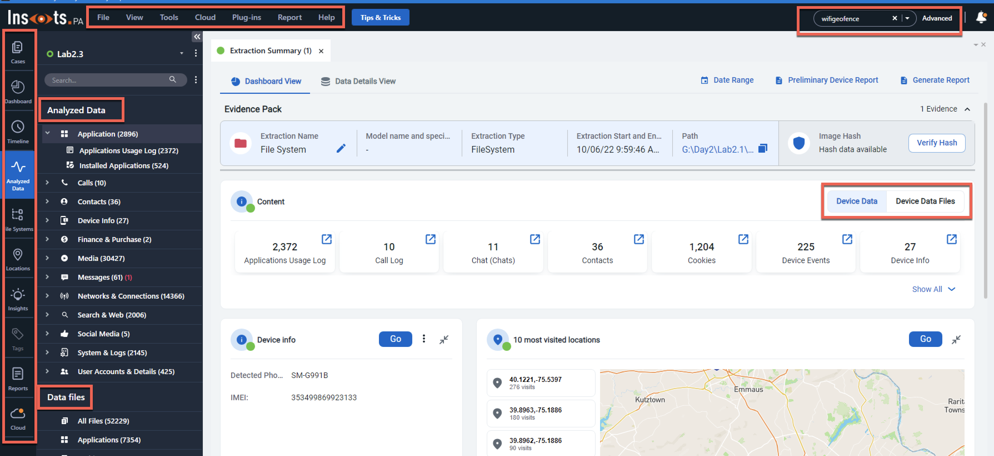
Physical Analyzer Workspace Areas
Notes:
Your instructor will show you how to properly navigate the options in Physical Analyzer. For those new to this tool, the more you use it, the easier it becomes. The key areas highlighted are the toolbar, where many features are accessible and will be shown in the next few slides. A logical keyword (global search) or an Advanced Search at the top right, which lets you search generically for a keyword or as an “and” or “or” request. This also includes the ability to conduct an “in document” search which may provide additional keyword hits.
A good place to start is the Extraction Summary, which is just that – a summary of the files parsed from the extraction. From there, most go to the Analyzed Data section of the tree pane on the left and let the investigation take it away. The data models on the left hand pane allow you to decide where to focus your investigation. The views include Timeline, Analyzed data, File Systems, Locations, and more. Throughout this week, you will have an opportunity to use Physical Analyzer in many labs. All the intricacies will appear in the labs and the reviews.

Slide 59
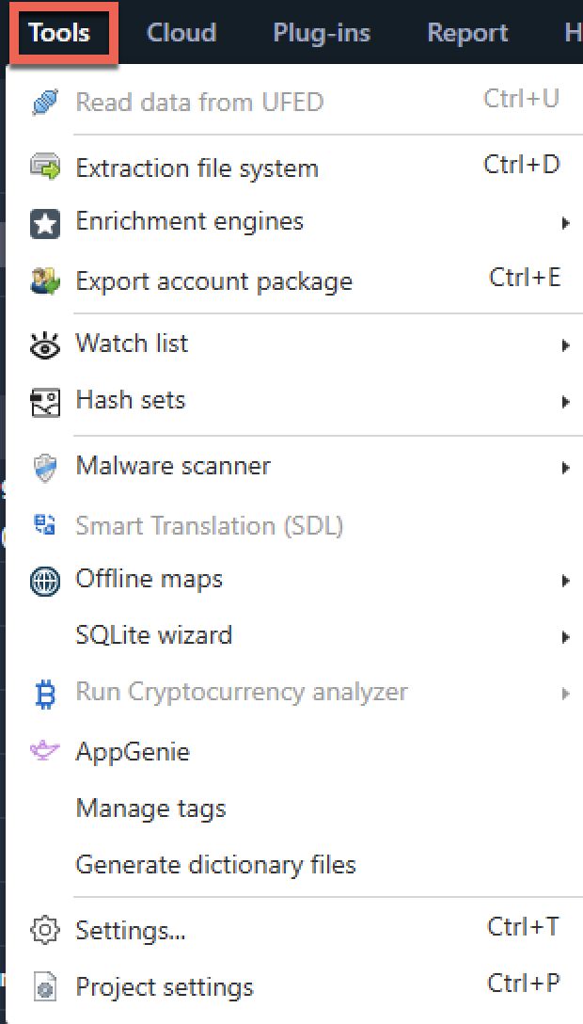
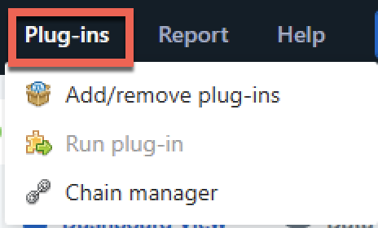
Physical Analyzer: Tools Menu
Additional features are available in the main toolbar
Most features are listed under Tools
Plug-ins, Cloud, and Reports are their own tab
If the option is grayed out, it may not be available for your license or that extraction type
Notes:
The Tools menu in Physical Analyzer allows the user to access carving functions, and specialty tools within the software, such as the AppGenie, enrichments (media categorization) the ability to create dictionary files, Watch List Editor, and Malware Scanner. A watch list is a list of keywords that are created by the examiner and are used to search for and identify items of interest in the extracted data. Specialized watch lists can be developed and run across multiple extractions. The malware scanner is a signature-based scanner that searches data extractions from mobile devices for known malware. Be sure to update the malware signature database before running the malware scanner so that you are using the most recent definitions. More will be covered on this in Section 4. The AppGenie digs for additional application artifacts that may assist in your investigation. The results from AppGenie will be in the Analyzed Data section under Manual Data Collection.
The Plug-ins menu option allows the user to Add/Remove Plug-ins by displaying a list of pre-installed plug-ins and allowing the user to manage them by adding or removing them from the list. Also in the Plug-ins menu is the Run Plug-in option, which enables the examiner to select and run one or more specific pre-installed plug-ins against the active data. The Chain Manager option in the Plug-ins menu displays the Chain Manager window and allows the user to create and edit device-processing chains, which essentially consist of multiple plug-ins run in a determined order.
The Settings and Project settings are important and are covered below. Make sure you enable the Deep Carving for SQLite and other features discussed by your instructor, so you get the same lab results as explained in the eWorkbook.

Slide 60
Notes:
The Project settings are where you set the time zone settings. The Settings is where you will control different aspect of the settings in Physical Analyzer. Under Duplicate rules, we recommend selecting Show group of similar items to ensure media files are not omitted from your investigation. For more information on this, watch the Tip Tues by Heather Mahalik Barnhart on Cellebrite YouTube.
When determining what to select for parsing, we recommend customizing your options. We recommend you should select all checkboxes under Decoding. Recover deleted data for Android and Windows Phone devices via carving from unallocated space isn’t relevant to the extractions you will see in this course, but it won’t hurt to check the box.
Using deep carving for SQLite is needed to ensure your answers match the eWorkbook

Slide 61
Notes:
Under Timeline, it is pertinent that you select all boxes. Otherwise, you may see gaps in your timeline for multimedia files. For Activities, you need to choose wisely here are Apple Health data can take a long time to include in the timeline. If this information is relevant, include it, if not, do not select Show activities. Selecting Show device events will highlight the device being powered on/off, plugged in, etc.

Slide 62
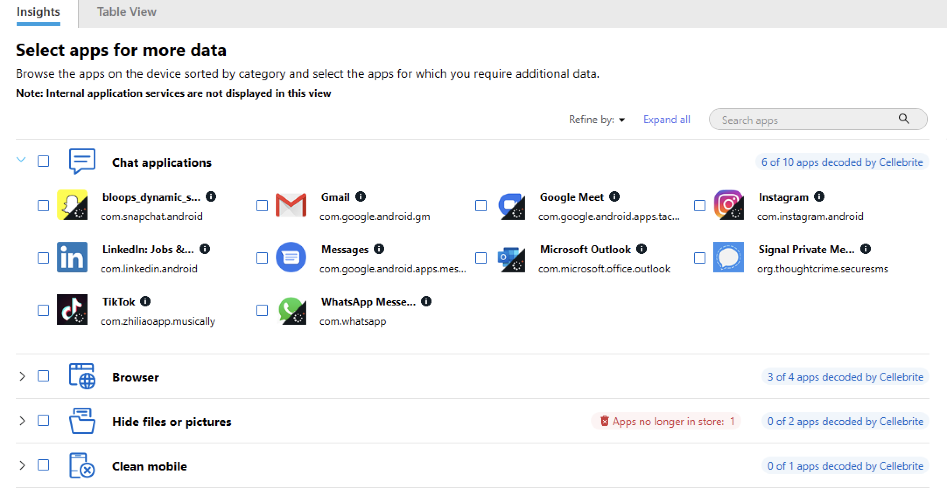
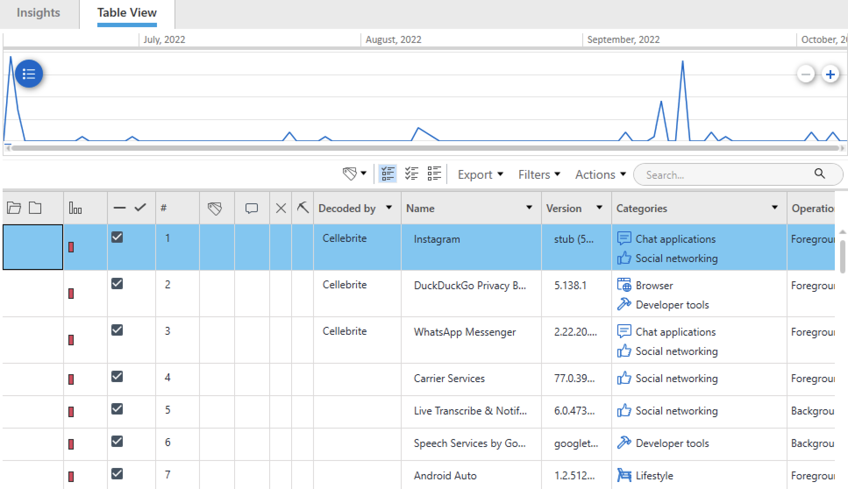
Physical Analyzer: Installed Application Views
Notes:
Installed applications can be viewed in the Insights view or within the Table View in Physical Analyzer. The Table View is probably what most are used to for those who have used Physical Analyzer in the past. Here, we can tell how the app was parsed (Decoded By) if it was deleted (the pickaxe) and the category it falls under. More importantly, it shows the source, which is the fastest way to hop directly into the file system. The App Genie, as previously mentioned, is a tool that tried to identify databases with artifacts of interest like chats, contacts, and more. Cellebrite recommends using these results for triage and then manually review them to ensure they are legitimate prior to putting them in your forensic report – that concept is the theme behind this class.

Slide 63
Notes:
The Insights view can be used to view the chunks of categorized apps. Under utilities, we see the groups of application categories and the files associated with them. From here, one can launch AppGenie (if not previously run) or launch the SQLite Wizard.

Slide 64
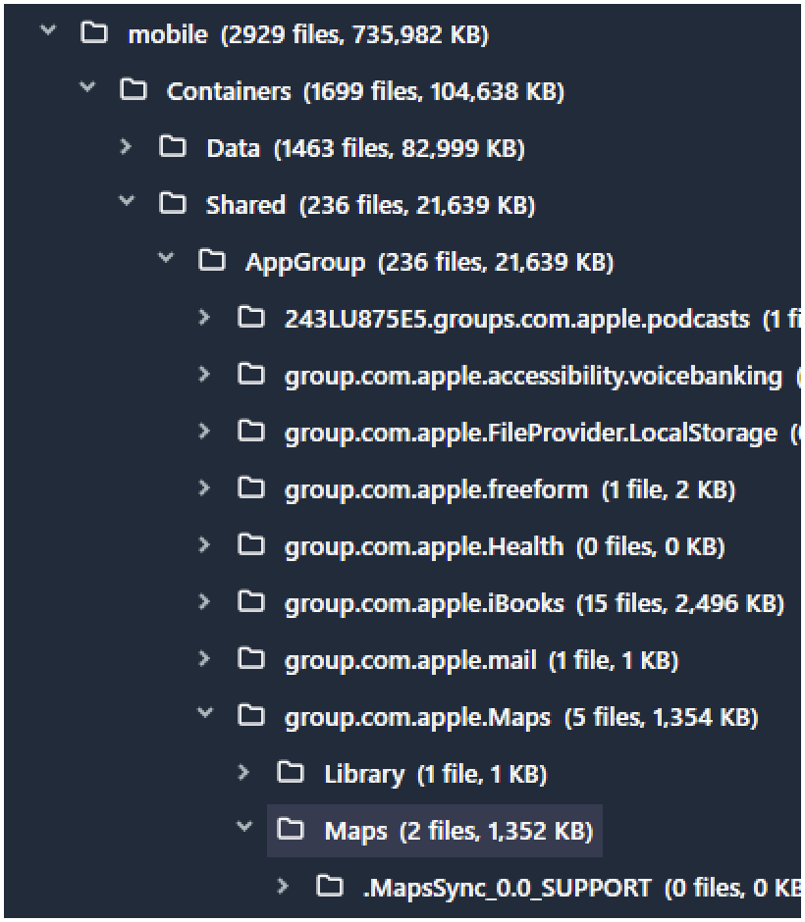
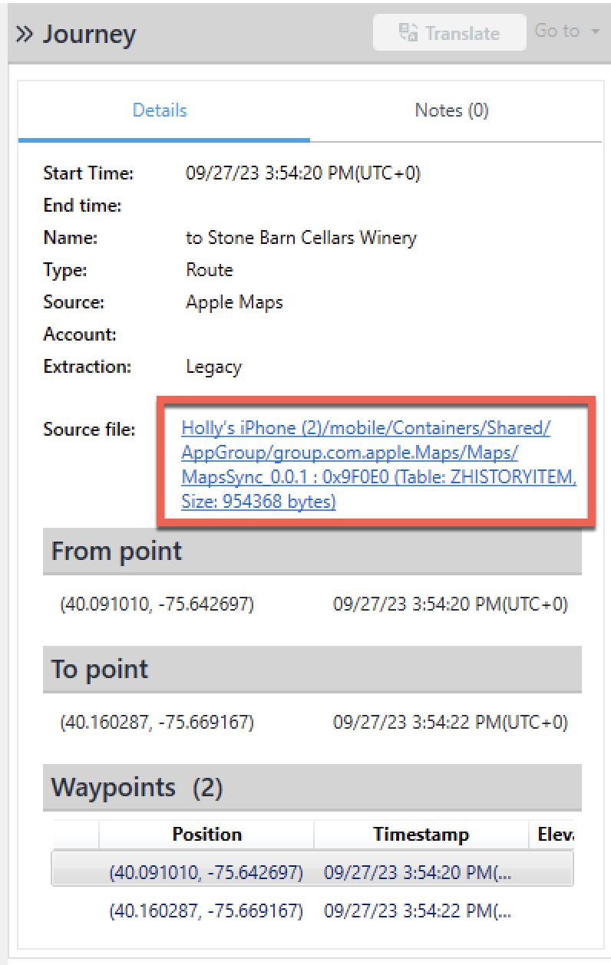
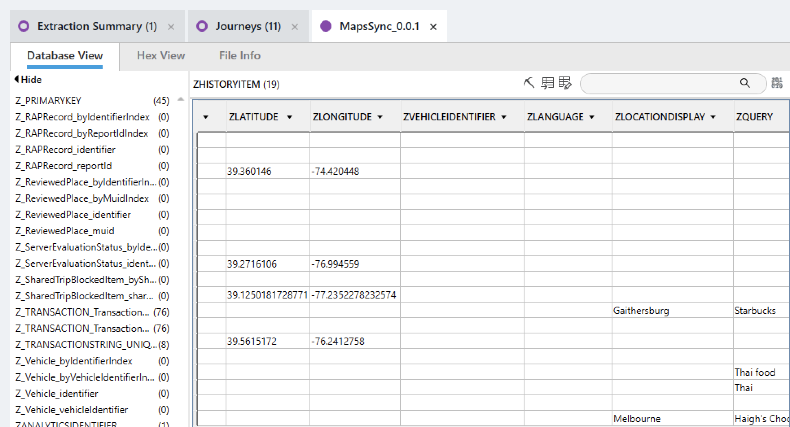
Physical Analyzer: Browsing the File System
The source files provide a direct hop to the file system
The file system is available in the left tree pane
Notes:
The file system is easily accessible in Physical Analyzer as it’s right in the left pane of the primary view and remains there as you navigate within the tool. The easiest way to locate files of interest in the file system is to click on the source file for the artifact of interest. It will take you directly to the file. If you land in the Hex view, simply change it to the view of your choice by selecting your tab of interest.

Slide 66
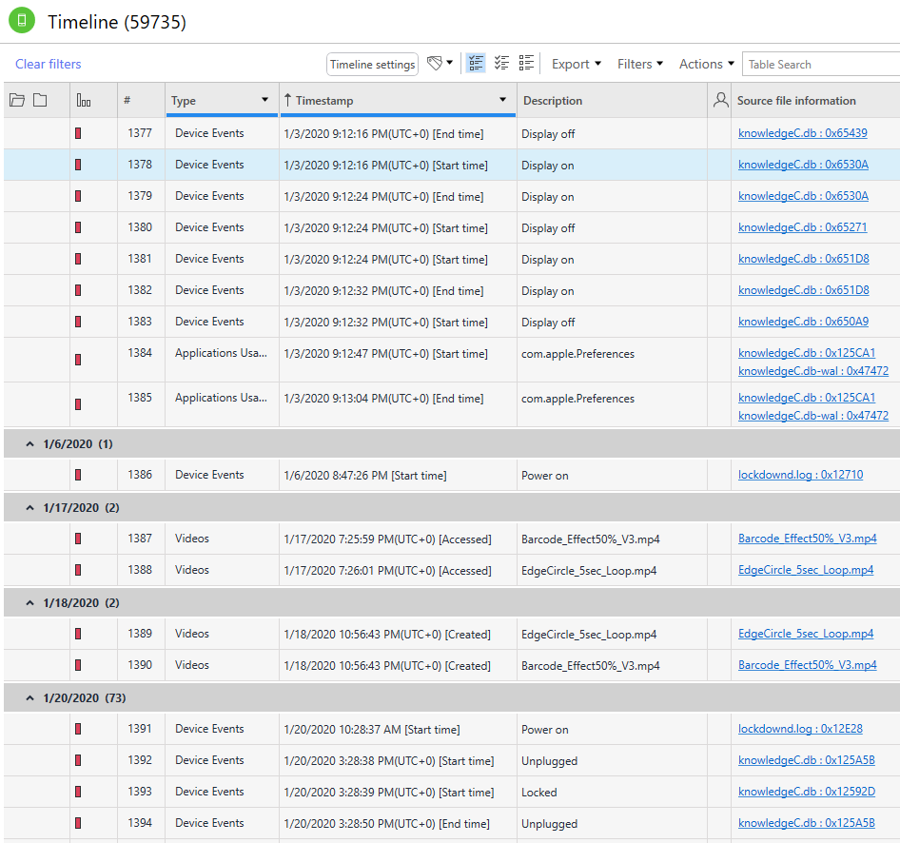
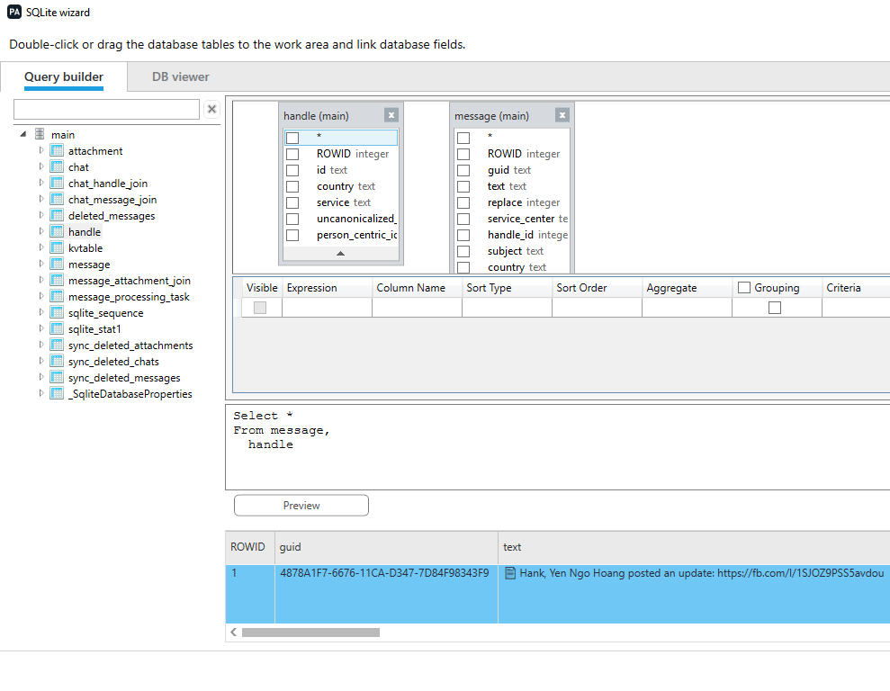
Physical Analyzer: Key Features
Timeline
Data Carving
“Go to” option
Multiple Tab Navigation
Media Categorization
SQLite Wizard/DB Viewer
Plist/XML/Protobuf Viewer
Notes:
Some of the key features of Physical Analyzer are highlighted above. The DB Viewer is where you can carve for deleted artifacts and BLOBs hidden inside of databases while the SQLite Wizard is where you can draft queries. There are built in viewers for plists, xml and protobuf files. Data carving is available upon parsing and after loading the data. Keep in mind that some carving features must occur while parsing. The timeline view is useful when trying to decide when an event occurred. Finally, the “Go to” lets you jump from artifact results straight to the timeline.
The View menu option allows the user to easily navigate to the welcome screen to navigate between projects.
The View menu also allows the user to open a Trace Window, which opens a log of all the operations and actions performed by the software on the data extraction so that the examiner can know what is going on behind the scenes.

Slide 67
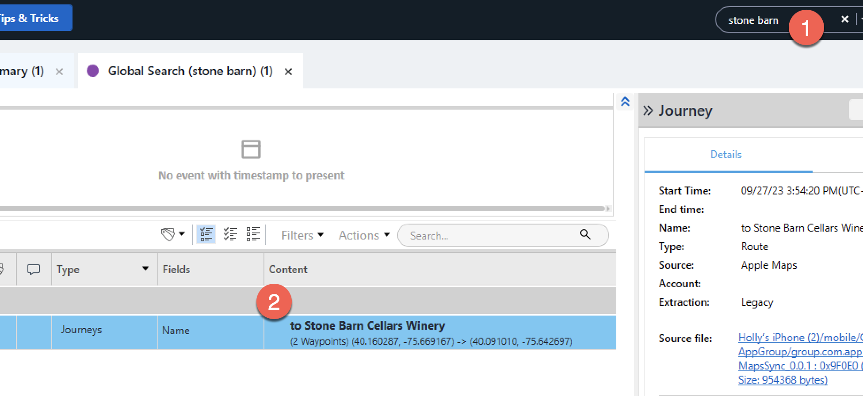
Physical Analyzer: Keyword Searching (1)
Notes:
There are several keyword searching options available in Physical Analyzer. The first is the logical or global search, which simply searches for files parsed or file names in the parsed file system, data files and analyzed data. Simple keywords or phrases can be used with this method of searching.

Slide 69

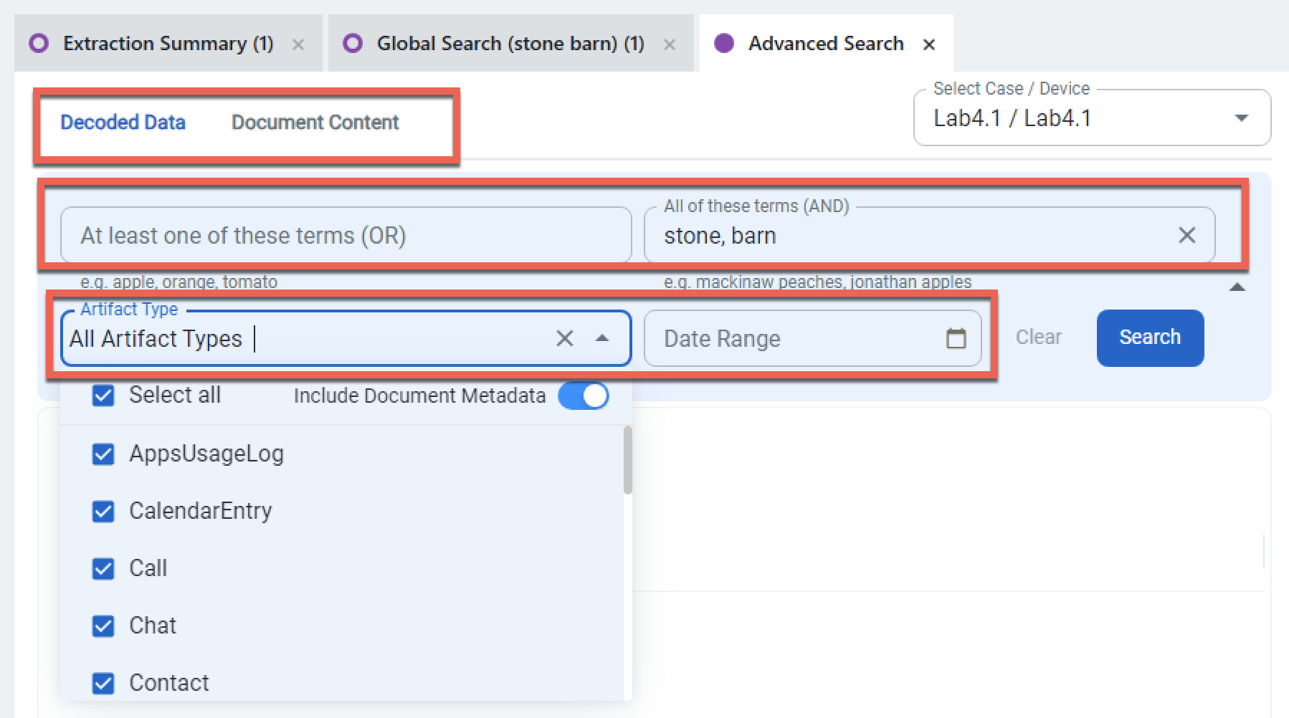
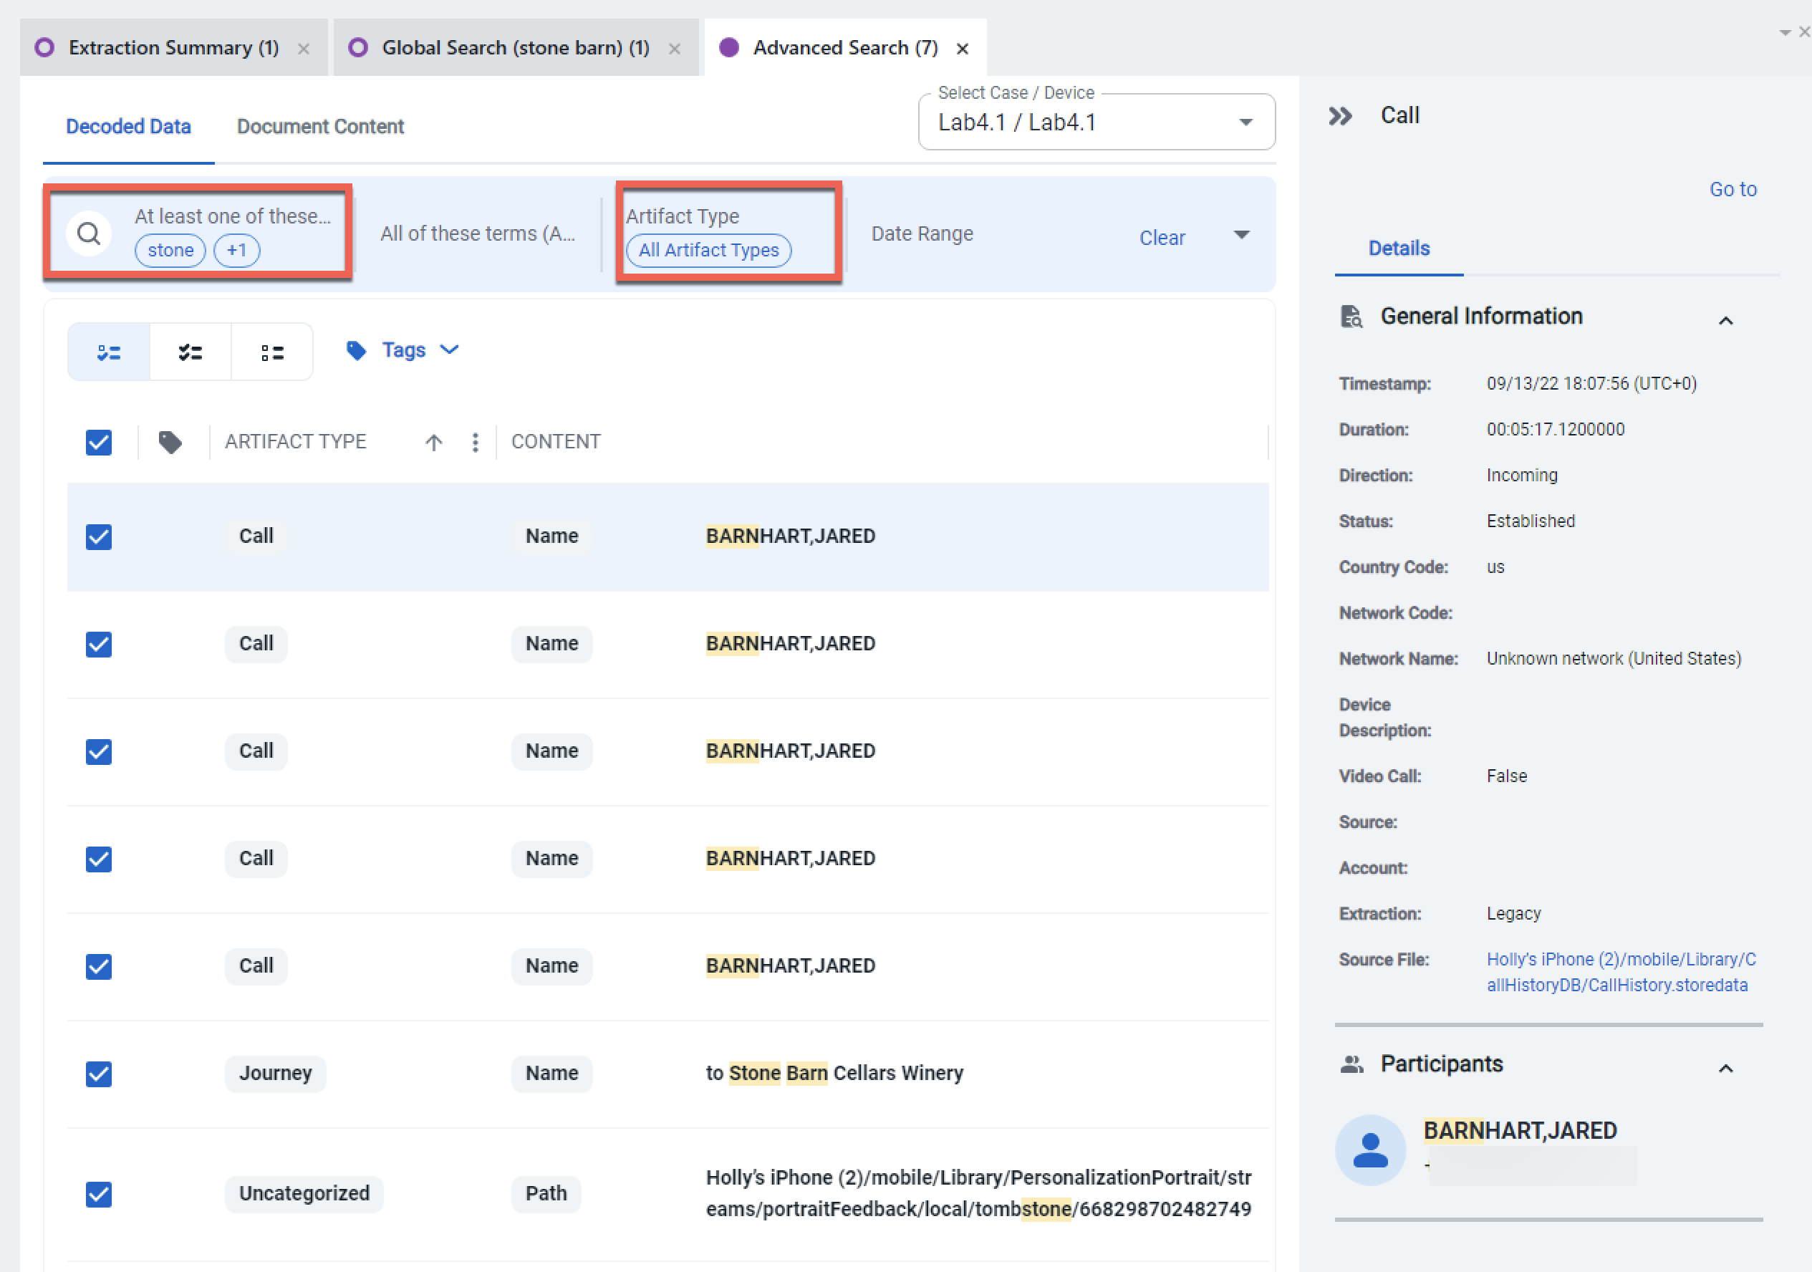
Physical Analyzer: Keyword Searching (2)
69
Notes:
The next search is an Advanced Search, which is shown above. To get to this search, you simply select Advanced by the logical/global search window. There are several options in the Advanced Search. You can search for a keyword or as an “and” or “or”, select artifact types, provide a date range, and choose between decoded data or document content. Your selections will impact the results you are provided.

Slide 70
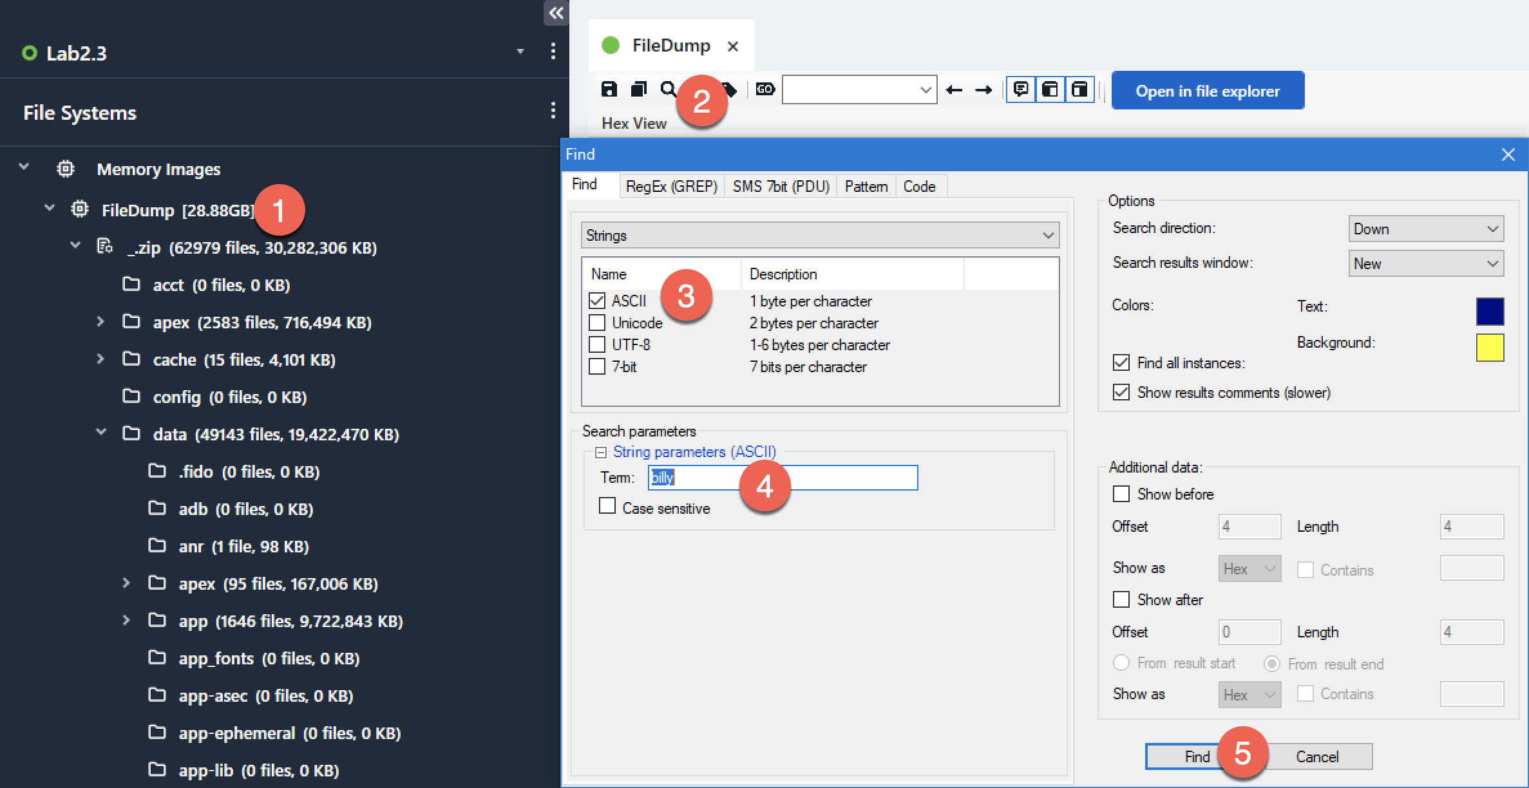
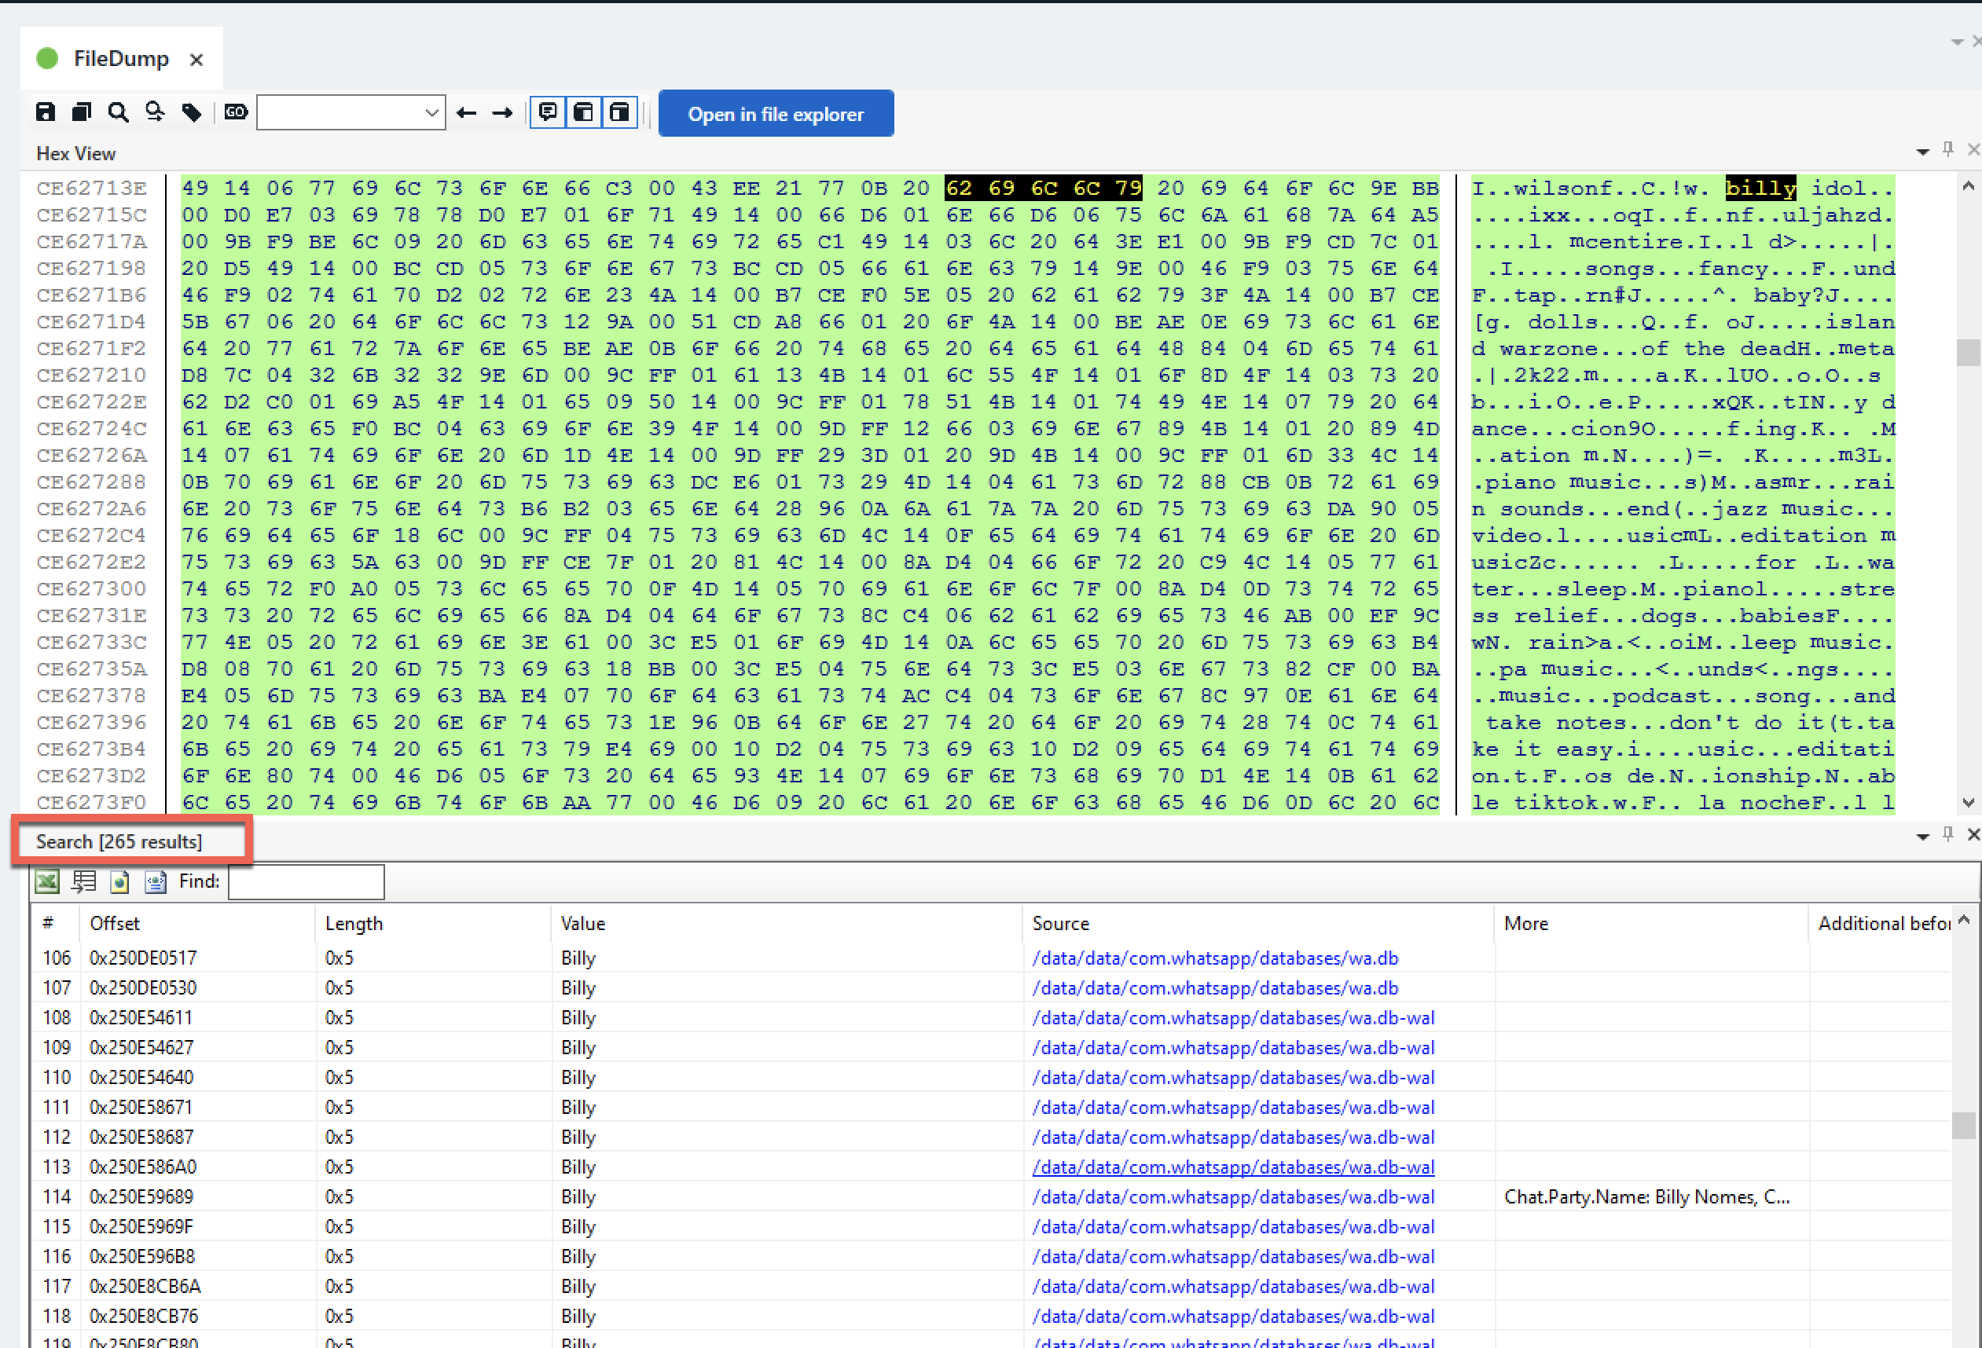
Physical Analyzer: Keyword Searching (3)
Notes:
The final and most thorough search is a hex search. A hex search can be conducted across the entire FileDump or specific files. This search is done by selecting the magnifying glass, using the dropdown (strings shown here), and then ticking the box for the encoding schema. Individual searches can be performed on each section of data, including searching for text, phone numbers, emails, geocoordinates, IP addresses, MAC addresses, and credit card numbers; also, a regular expressions search. Data can be searched from a single device, all devices involved in the case, or all acquired devices. Physical Analyzer is the most thorough at providing access for hex searching for mobile devices. Keep in mind, your extraction matters for the keyword results provided. For example, a full file system or physical extraction will provide more keyword hits than a backup file. You can always hex search inside of a database or file of interest if you don’t have a full file system.

Slide 72
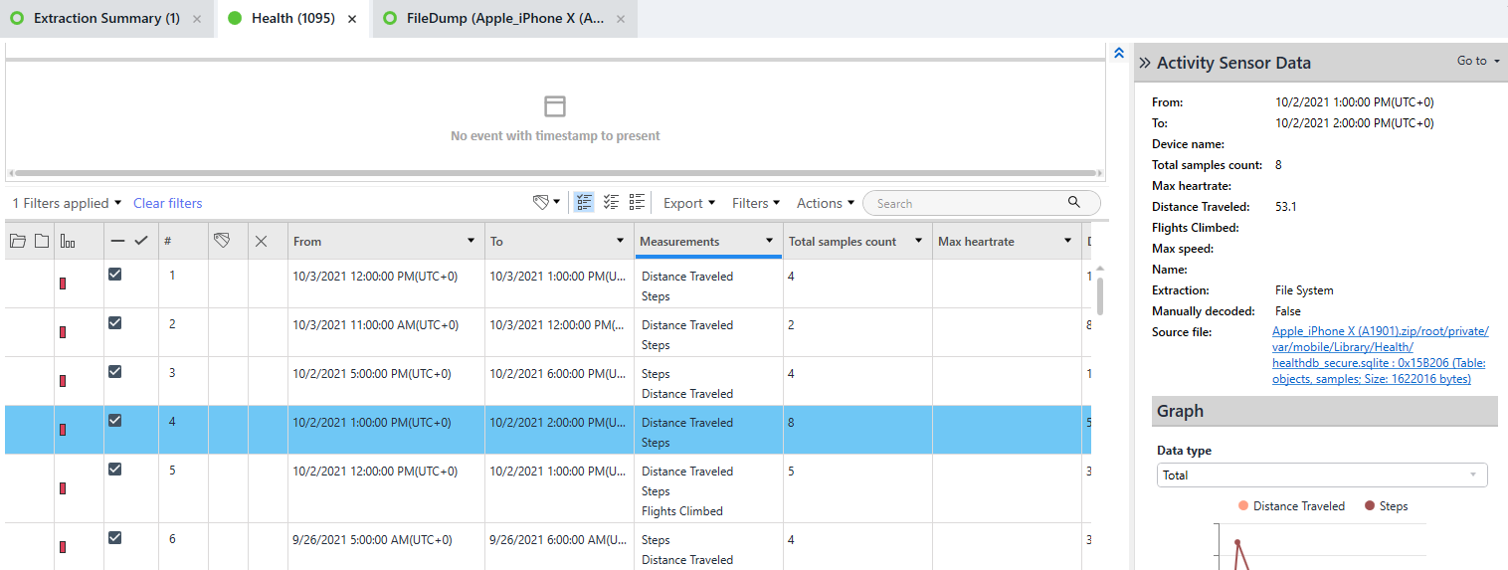
Physical Analyzer: Key Features (1)
You can toggle between parsed data in the Analyzed Data section and the device image.
Analyzed Data View
Filesystem View
Notes:
It is possible to navigate between an entry from the Analyzed Data section in Physical Analyzer and the source of that data (offset) in the original image. To do so, you must have both the tab for the associated analyzed data (in this case, “Health”) and the tab containing the data from image or extraction that the data was parsed from open, as noted by the arrows.
To navigate to the location of the parsed data within the image that contains the analyzed data, simply highlight the data in the analyzed data tab and switch tabs to the image tab. The cursor is adjacent to the data that was shown, as parsed in the analyzed data tab. This is shown in the next slide.

Slide 73
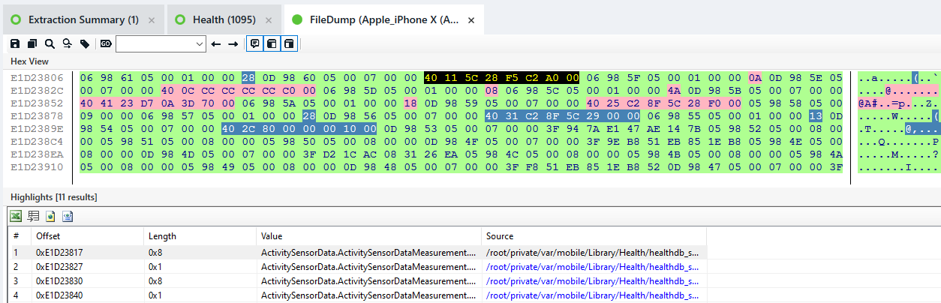
Physical Analyzer: Key Features (2)
You can toggle between parsed data in the Analyzed Data section and the device image.
Offset in Filesystem
Analyzed Data View
Notes:
Here we can see the offset in the file dump where the data exists. This offset will be different than the offset of the content in a database, plist or other file.

Slide 74
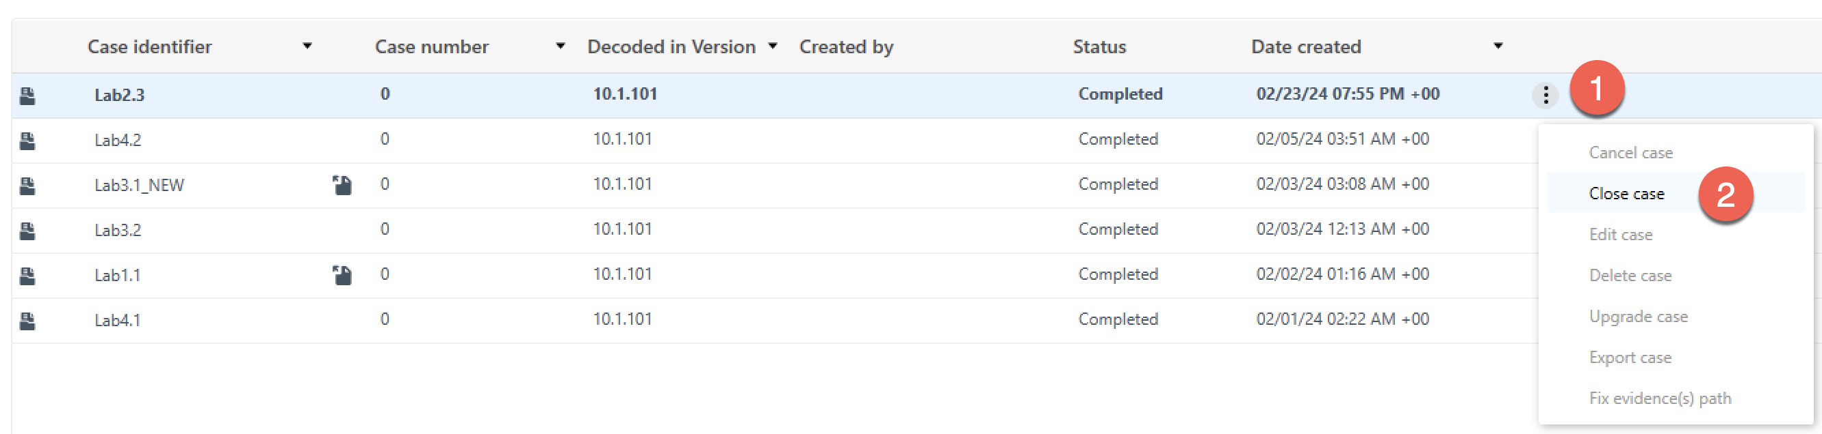
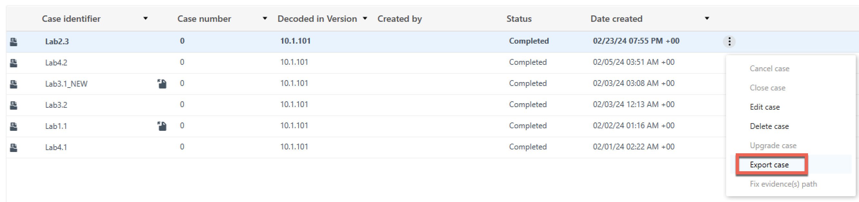
Creating .clbe Files
Make sure your case is closed so you can properly export the file
Notes:
In order to share processed cases, you need to create a .clbe file. To do this, you need to follow the following steps:
In Cases view make sure your case is closed.
Once the case is closed, you will se the option to Export case.
Select the location to save the .clbe and press export.

Slide 75
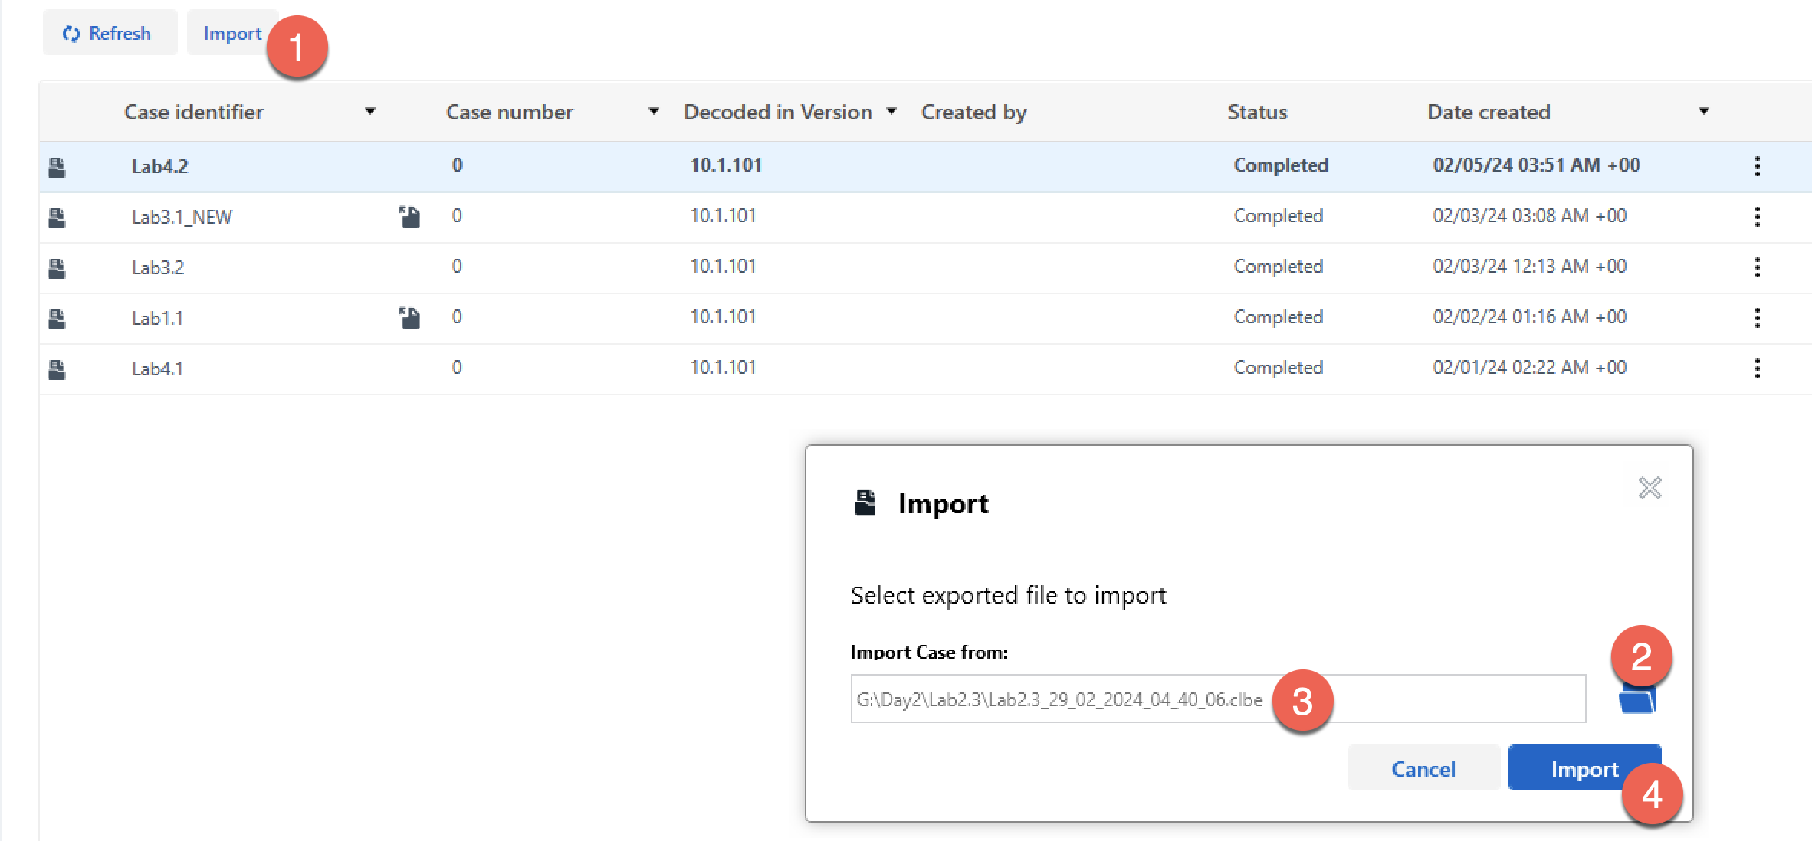
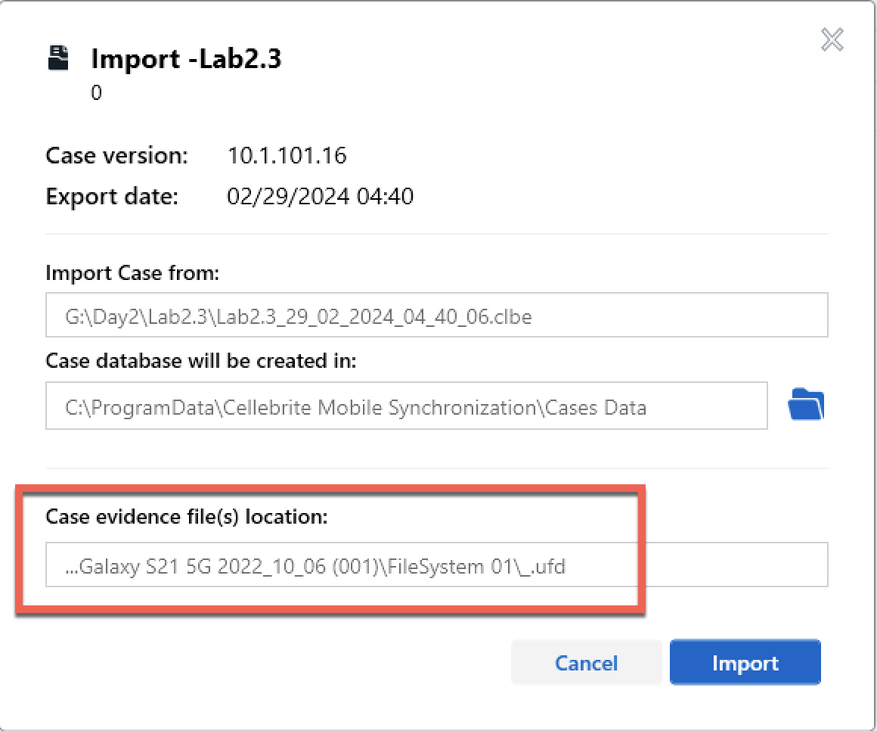
Loading .clbe Files
If a case has been pre-processed, you can simply load it, and associate the evidence file back to the case.
Notes:
If a case has been pre-processed, you can share it with other examiners and import it for fast analysis. Most of the cases in this course have been pre-processed for you. These steps can be followed to preload all of the labs that have .clbe files. The first step is to select Import while in the Cases model. Next, navigate to the .clbe file and select Import. Before selecting Import make sure that the Case evidence file location is correct. When you have any downtime during the class, feel free to preload the .clbe files for upcoming labs.

Slide 77
Familiarization with Physical Analyzer
Lab 1.2
Notes:
This area is intentionally left blank.

Slide 78
Course Roadmap
78
Notes:
This area is intentionally left blank.

Slide 79
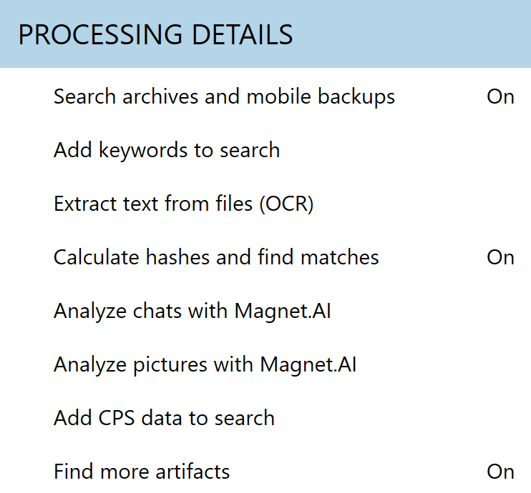
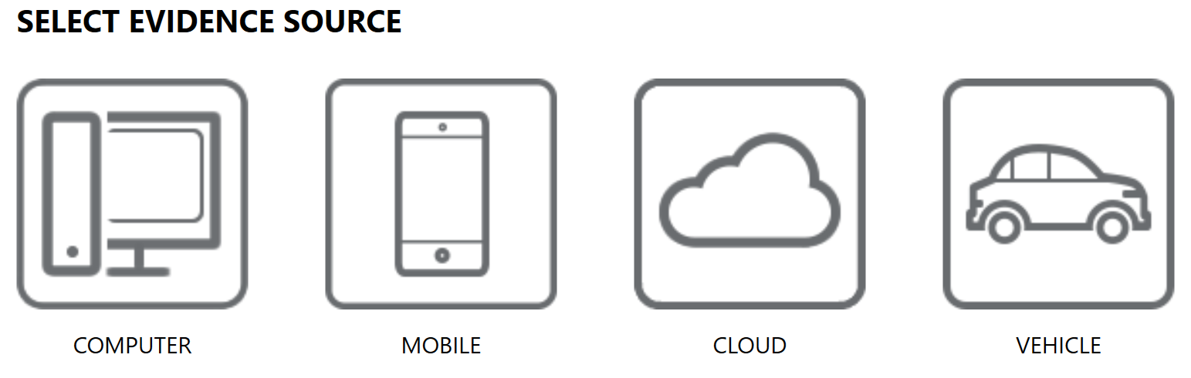
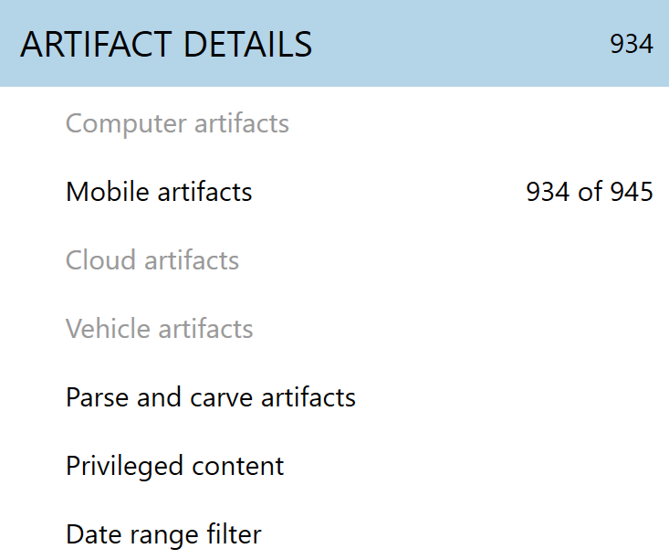
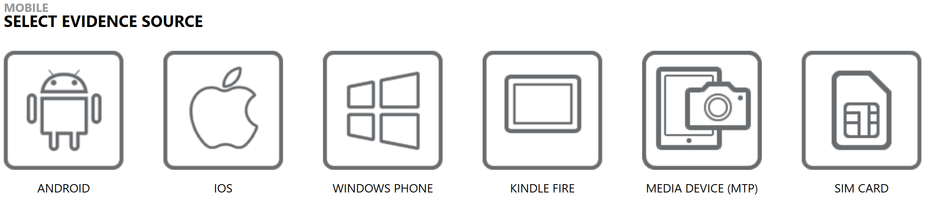
Magnet AXIOM: Overview
Notes:
Magnet AXIOM is a great tool for acquiring and examining mobile devices. Your instructor will provide a demo of the tool, and you will become more familiar with it through your lab work in this course. By the end of this course, you should be familiar enough with all of the tools to know the strengths and weaknesses of each as well as possibly develop a preference of certain tools over others. Outside of the two tool-specific Lab exercises, we encourage you to use the tool(s) you are most comfortable with, or those that you will have access to in your lab environment., but also take time to consider if some tools provide advantages over other for certain tasks. AXIOM is strong at parsing browser artifacts, carving for additional SQLite databases, timelining, filtering, and categorizing data.
We will utilize both AXIOM Process and AXIOM Examine throughout the course. AXIOM Process can ingest and configure data for examination from Computers, Phones, Cloud repositories and Vehicles. This data can be (and is most often) acquired using other tools, which for Mobile, now includes GrayKey after their partnership, but launching AXIOM Process is always the first step to accessing your data.
During the processing phase, there are options to incorporate many different processing scripts and search capabilities, many of which we will discuss during our Familiarization with AXIOM Lab.

Slide 80
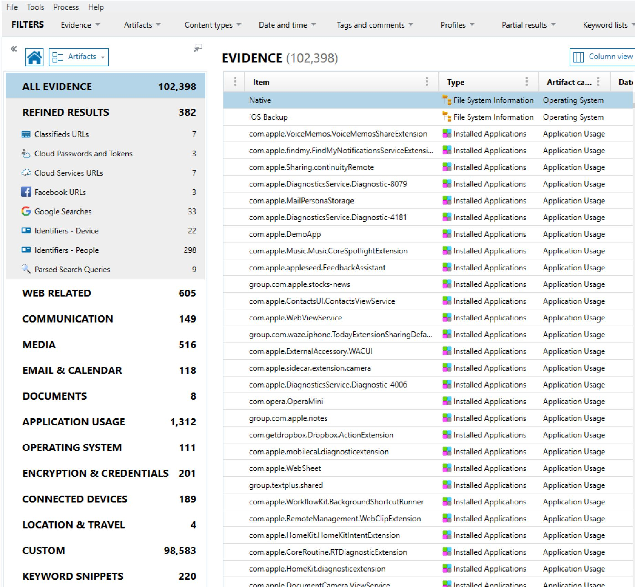
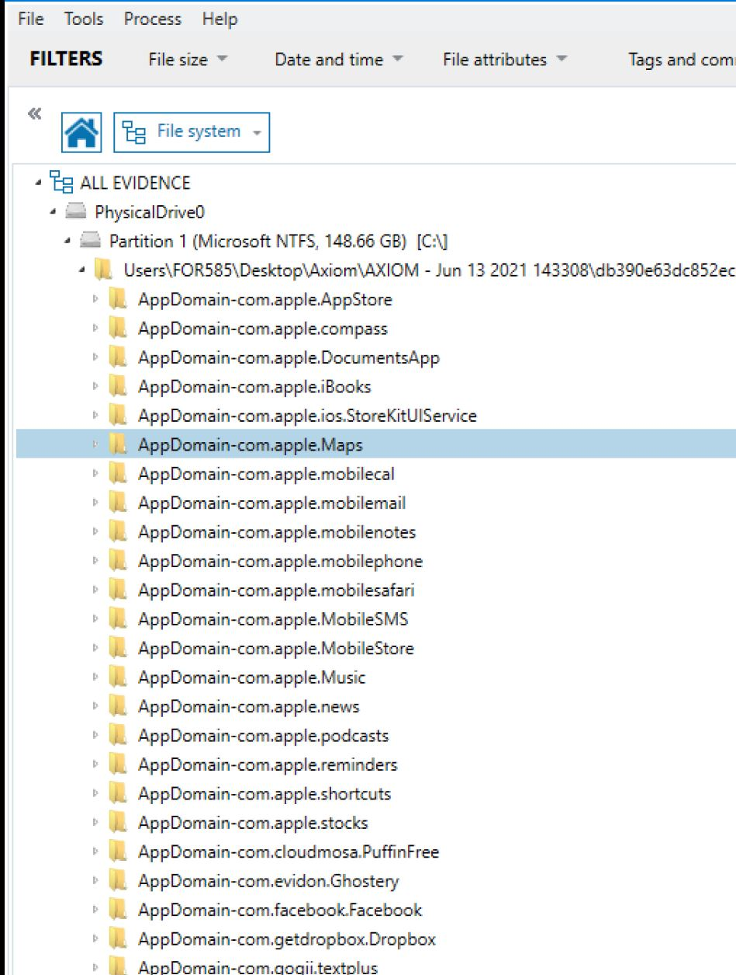
AXIOM: Image Loaded
Notes:
AXIOM Examine is the analysis tool and is where your investigation of mobile devices will be conducted. Similar to Cellebrite Physical Analyzer, many scripts are run against the dataset during the processing phase, many of which can be turned on and off, the resulting output of running these scripts are recognizable in AXIOM Examine’s Artifacts viewer, depicted on the left. This tool is strong at parsing browser artifacts (as it has evolved from IEF – Internet Evidence Finder), carving for additional SQLite databases, keyword searching, timelining, filtering and categorizing data.
The Artifacts view is the most common place to start and is a great way to begin triaging your mobile devices. Keyword searching, filtering, timelining, establishing connections and tagging artifacts of relevance are available in this field. To dive into the File system view, select the dropdown menu to the right of the Home icon. Should you ever want to return to the Artifacts view, simply press the home button. Similarly, if you have issues removing filters and want to get back to your case data as it was initially loaded into Examine, you can Select File and from the dropdown menu, Refresh Case.

Slide 81
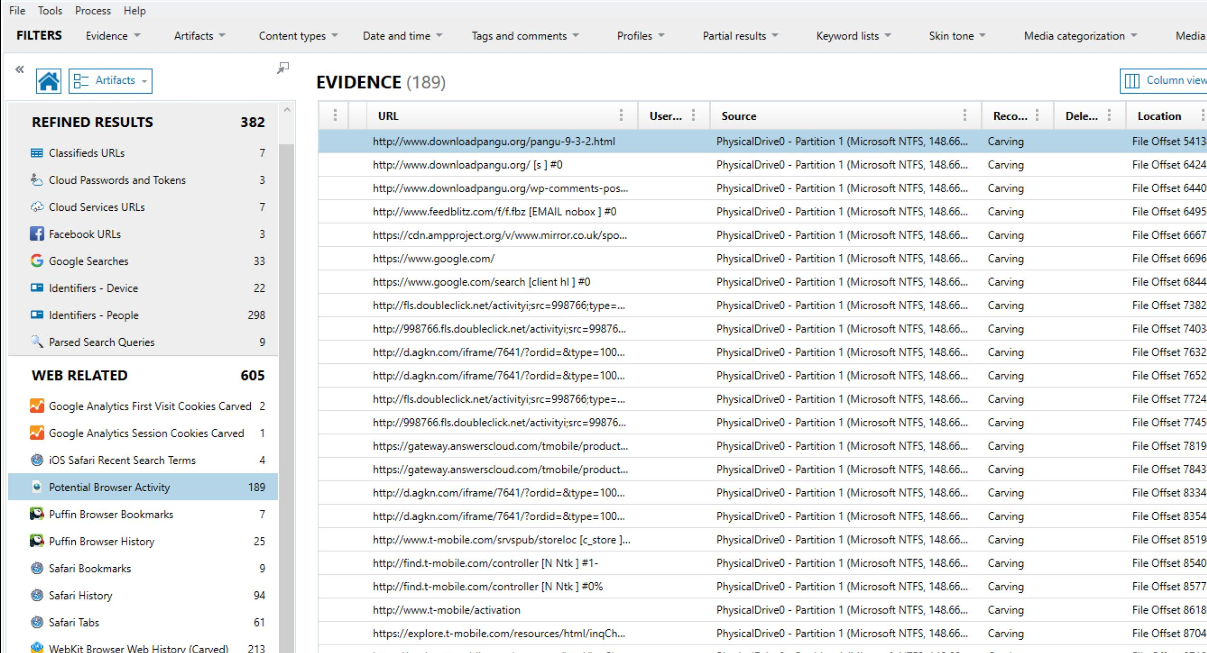
AXIOM: Third-Party Application Parsing
Notes:
Just like in other tools, not all native and third-party application and/or operating system level log files will be Analyzed and available in the Artifacts view. This is a great place to start, but after this course, you will understand the depths of the filesystems and often find yourself drilling down into the data to do extensive manual searches. This is the nature of mobile device forensics, as there are constantly new files being introduced or changed.

Slide 82
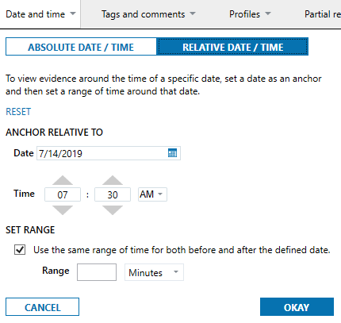
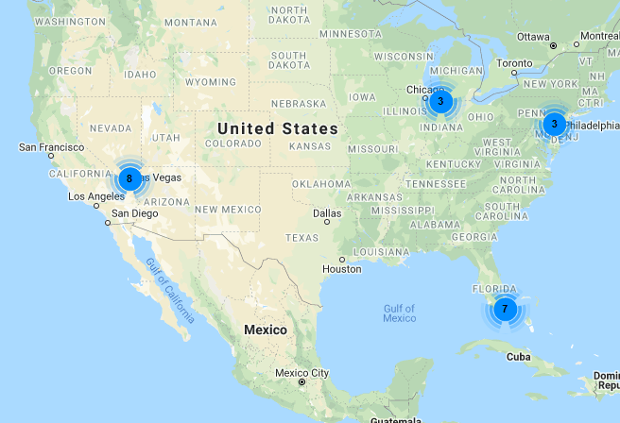
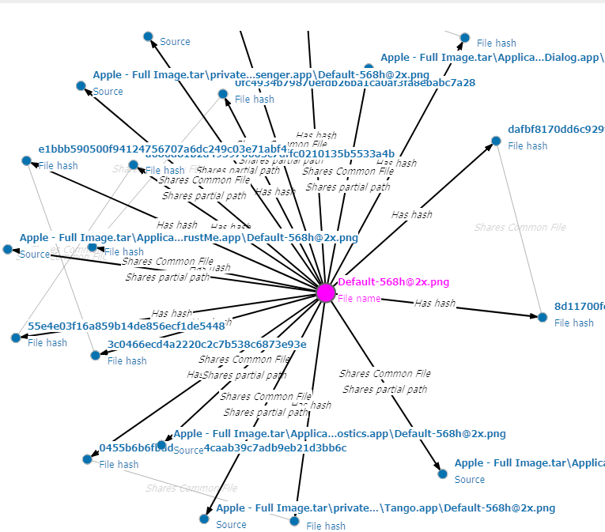
AXIOM: Key Features (1)
Dynamic App Finder
Timeline
Mapping
Internet of Things
Connections
Filtering
Image Type Categorization
Notes:
Several features are provided in AXIOM via the main toolbar. From here, you can create a timeline, view connections, examine artifacts with geolocation information and more. The Dynamic App Finder is a great feature within AXIOM that is selected during the parsing piece in AXIOM Process. Here, the examiner can elect to search for additional artifacts that are part of SQLite databases not parsed by the tool.

Slide 83
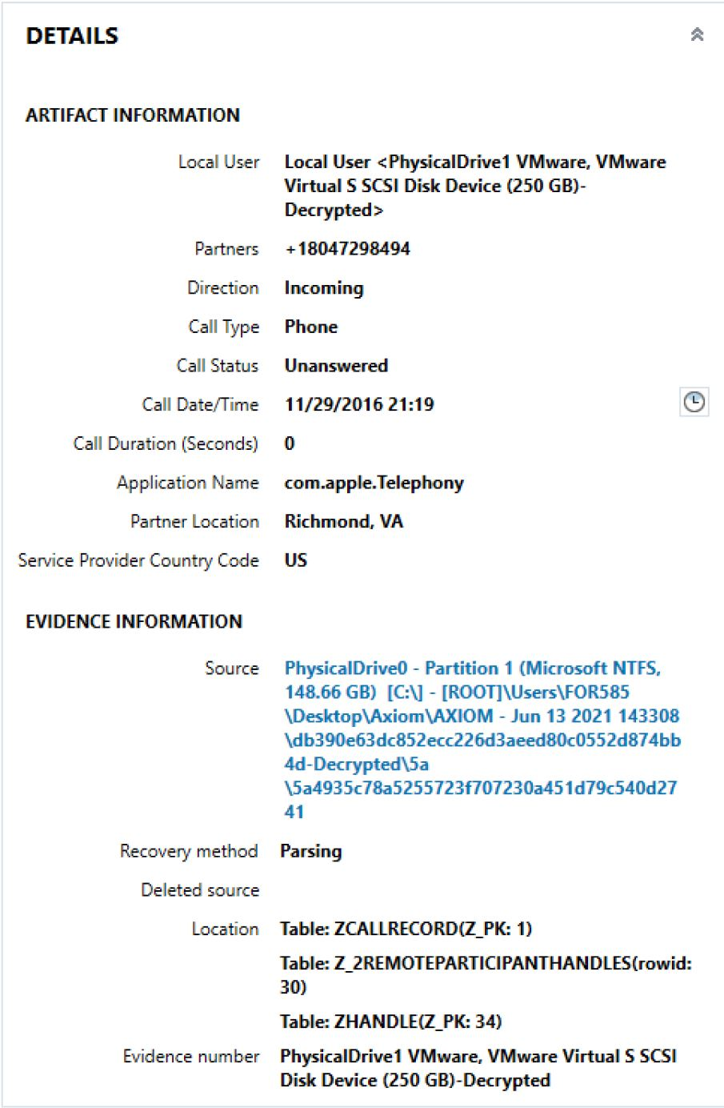
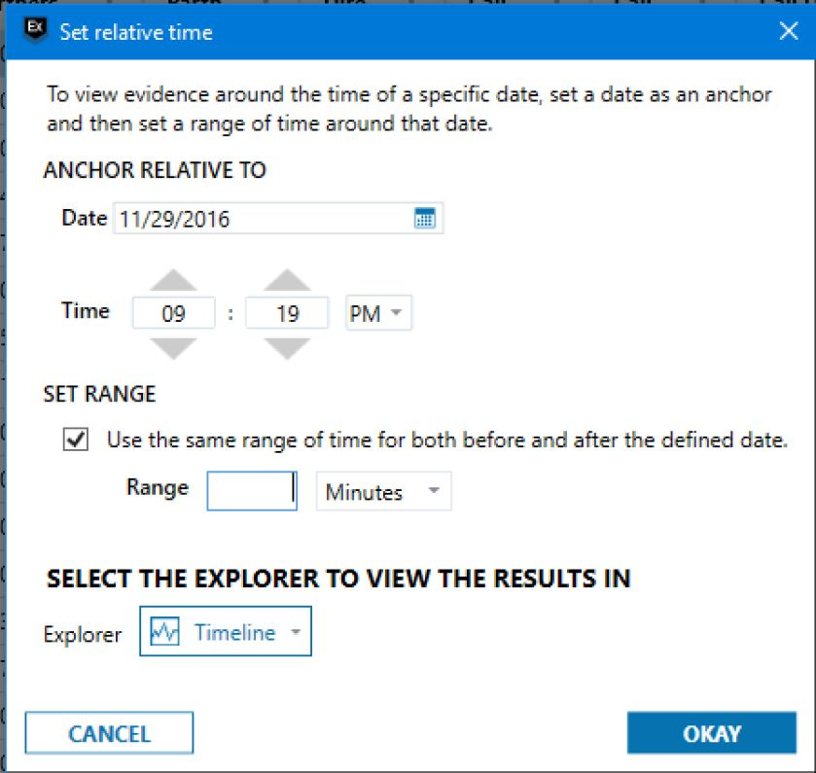
AXIOM: Key Features (2)
Relative Time – aka “Timeline on the fly”
Searching for text in “File content” will search some of the contents of files not parsed by AXIOM
Great for full file system GK images
Magnet.AI for finding similar images
Notes:
There are hidden features inside of AXIOM that are extremely beneficial. One is the Relative Time, which I like to call “Timeline on the Fly.” Not all artifacts show this little clock to the right of them, but when they do, it can be extremely helpful. Let’s say you are working an investigation, and you need to know what happened immediately before an artifact hit the device or need to see what happened after an application or piece of malware was installed – this feature is built to do just that. Timeline a specific item that is relative to that item.
AXIOM also does an “in-content” search, but it is not as thorough as Oxygen.

Slide 84
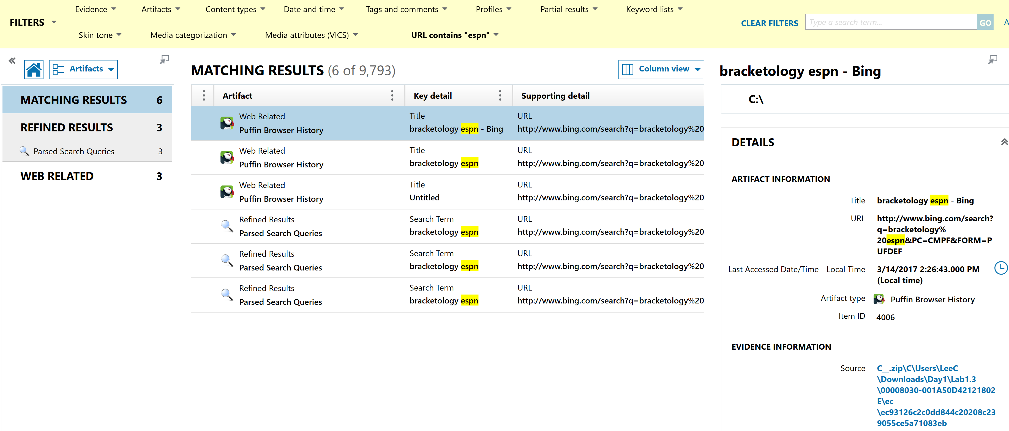
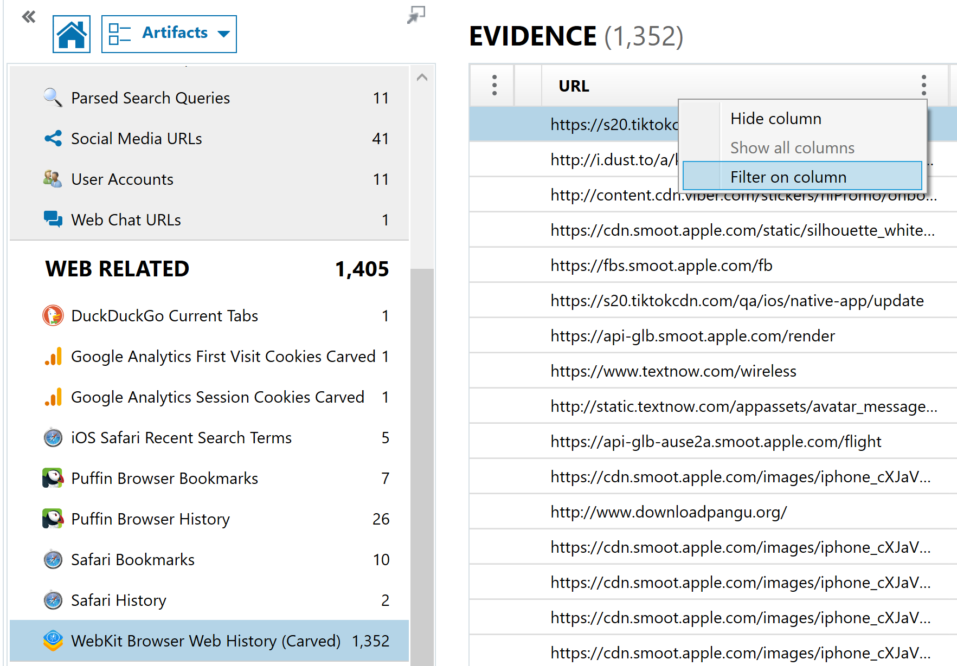


AXIOM: Source Files
1
3
2
4
Notes:
Filtering can be accomplished on data from the Artifacts view for targeted results. Columns that allow filtering will have three vertical dots.
Click on these to Hide columns or Filter for items of interest.
The filter option brings up a Search By Term box where you can enter additional search parameters.
If your search results in any keyword hits, you will notice that the dataset is now filtered (as evidenced by the yellow filter banner at the top of your toolbar. Each filtered hit should contain a hyperlinked “Source file”.
For any hits that you would like to further investigate, clicking on the Source will automatically switch your view to File Systems and take you to the directory where the search hit was located.

Slide 85




AXIOM: Keyword Searching (1)
How and where you search in Axiom matters
1
2
3
4
Notes:
Searching in the upper-right corner of Axiom Examine is considered an “Artifacts” search: It will find terms that are a result of parsed applications and data that Axiom has analyzed. This is slightly different than Cellebrite which will find the term if it is part of the Analyzed data, File name, or File path.
Example:
While in the Artifacts view, conduct a logical search of the media for “domenica” by clicking into the search bar at the upper-right hand corner in Axiom Examine.
Notice that the hit appears in two categories: Communications (where it appears to be part of either an iMessage or SMS message using the native Apple messaging App) and Identifiers, Axiom’s category for artifacts that appear as part of some of the typical “Name” artifacts (to/from, sender/receiver, first name/last name, etc.
As an example, the hits within the Native messaging application can be sourced to the HomeDomain/Library/SMS/sms.db (Apple’s database for tracking iMessage, SMS and MMS messages)
But a search for that particular file name, sms.db turns up 0 hits.
This example is just to reiterate that each of your tools function slightly differently. Understanding how and what your tool searches for, helps form better keywords or will force you to search for artifacts in different ways. If you are searching your dataset for files of interest in Axiom, make sure they are also conducted in Artifacts.

Slide 86




AXIOM: Keyword Searching (2)
Logical Searching
Advanced Searches
AND vs. OR
Notes:
As we saw in Cellebrite, an advanced logical keyword search will give you the ability to further filter your search results like using the AND vs. OR options presented above.
For example, do you want to search for any artifacts as long as they include “bracket” OR “ncaa” (RIGHT), or would you rather search hits for just those artifacts that include the term “bracket” along with “ncaa” (LEFT)?

Slide 87




AXIOM: Keyword Searching (3)
Add keywords during Axiom Process Stage
Keyword Search in Axiom Examine
Initiate Keyword searches in the Process stage (Axiom Process) or the Examination stage (Axiom Examine)
Choose between Artifacts (items parsed by Axiom) and All Content (a full physical index of all words across the entire image) searches
Notes:
Both of the previous search capabilities only gave us the ability to “logically” search artifacts, meaning that results were only returned if the Artifact was analyzed by Axiom Examine. In order to make sure you have not overlooked any artifacts, using the “All Content” search in Examine will conduct a search over all of the indexed files (similar to the search in file content in Cellebrite). This function can be invoked during the Processing stage, or if you would like to add keywords after the case is loaded, you can click on “Keyword Lists” from the tool menu and follow the prompts shown at the bottom of this slide.

Slide 88
Familiarization with AXIOM
Lab 1.3
Notes:
This area is intentionally left blank.

Slide 89
Course Roadmap
89
Notes:
This area is intentionally left blank.

Slide 90

File Systems and Common File Formats for Mobile Devices
Resource dedicated to mobile forensics
Covers prevalent mobile file systems in depth:
APFS (Apple)
EXT4 (Android)
F2FS (Linux/Samsung/removable media)
QNX6 (BlackBerry10 and infotainment systems)
Deep dive into popular file formats like:
SQLite
Property Lists
Java Object Serialization
Realm
Protocol Buffers (protobufs)
Notes:
A fantastic resource was created in 2022, as a precursor to the EU-funded project, FORMOBILE. This FREE resource, which was based on Brian Carrier’s popular “File System Forensic Analysis” book, takes a similar approach to exploring current mobile file systems. Part I of this book is broken into exploring the most prevalent mobile file systems including: APFS (Apple), EXT4 (Android), F2FS (Samsung/removable storage media) and QNX6 (BlackBerry and infotainment systems). Part II of the book dives deep into some of the most popular file formats that you will encounter when examining mobile devices.
The PDF version of the book, written by Nordvik, Currier, Meyer, Pawlaszczyk, Hummert, Humphries, Cobley and Geneste, is free and can be downloaded directly from Springer publishing at https://for585.com/springerfileformats.

Slide 91


Mobile File Formats Android: XML and ABX
Notes:
XML (or eXtensible Markup Language) is an operating system agnostic, self-descriptive, markup language which is similar to HTML introduced for the storage and transport of data. Extensible in this context means that the information is still readable even if data is added or removed from the file.
The Android operating system has historically used XML files to store various configuration information for native and third-party applications as well and it was also the most predominant file format for storing a lot of the operating system-level log files that comprise these devices.¹
Around Android version 12, we have seen a lot of files transition from XML format to ABX. ABX (Android Binary XML) is simply a binary serialization of the XML format. This new structure provides readability (for the operating system), reduction in size (requiring less space on the flash memory), and increased speeds (when reading/writing data to the device memory).²
An in-depth article on this newly introduced file format is available in this blog post at https://www.cclsolutionsgroup.com/post/android-abx-binary-xml.
https://www.w3.org/XML/
https://www.cclsolutionsgroup.com/post/android-abx-binary-xml

Slide 92


Mobile File Formats iOS: Property Lists
XML
JSON
binary
Notes:
Similar to Android, devices running Apple-based operating systems (iOS, iPadOS, macOS) utilize Plist files (Property Lists) for the storage of configuration information. Typically, you would expect to find these files generated as a function of a device backup, as part of each application bundle, associated with every native and third-party application installed on the device, but also in various places in the filesystem where they are used to record all of the different ways that devices have been uniquely configured by the user. Plists can contain a few different structures including, XML, JSON, or binary, all of which you should expect to see on the Apple products you are interrogating.
Like in Android, the binary Plist format provides serialization of XML which makes it smaller on the device for processing the many mobile transactions that occur.¹
1. https://medium.com/@karaiskc/understanding-apples-binary-property-list-format-281e6da00dbd

Slide 93

Mobile File Formats: JSON Files
Some applications do not use any SQLite databases
User data is stored in JSON files
Data is often in plaintext
Not encrypted/encoded
Alternative to XML
Notes:
JSON (JavaScript Object Notation) files can be another file type that contains valuable app-related content. These files are typically used to transfer data between a web server and an application. Data in these files is commonly in readable format and can be carved for strings of relevant content.
For these files, using Python scripts to format the data in a more readable format is useful.

Slide 94


Mobile File Formats: Realm Databases
SQLite alternative
Non-relational database
Supports Java, Objective-C, Swift, and React Native programming languages
Could be on iOS or Android!
Marked by 4 bytes 54 2D 44 42 that begin at offset 10
T-DB (in ASCII)
Notes:
While nowhere near as common as SQLite, you may come across mobile applications that are utilizing Realm databases as a means to store user data. Realm has been in existence since 2014; it is a non-relational database management system that stores data as objects, and it includes programming support for Java, Objective-C, Swift, and React Native.
It has been increasingly common to see Realm databases, especially on iOS devices, but while they may be included in the application directory, developers may still choose to store user-related data in their SQLite counterparts. Realm support has recently been incorporated into most mobile forensic utilities, but Realm Studio can be downloaded for free for stand-alone analysis of databases on Mac OS, Linux, or Windows. Files with the .realm extension will require analysis, with user data often stored in the default.realm file.
Realm databases can be characterized by these four bytes, 54 2D 44 42, which begin at offset 10 and end at offset 13.
Special thanks to the Cheeky4n6monkey for sharing a simple Realm database sample.
Reference:
https://for585.com/realmstudio (Download link)

Slide 95


Mobile File Formats: Protobufs
Created by Google to aid in communication between systems
Provide serialization for structured data
Can be found on any operating system
More efficient than XML or JSON
Structure is stored in .proto file
Notes:
Protocol buffers or protobufs were created by Google as a way to serialize structured data for communication between systems, and they are starting to pop up all over our mobile device images.¹ They are a more efficient equivalent to XML and JSON, and they are operating system and language neutral, which means will we likely see them on any of the operating systems we encounter.
When it comes to parsing these files, it’s hit or miss, but we saw that some of the important artifacts, like the GeoHistory.mapsdata plist file from an iOS device, was correctly interpreted, but many others in this format are not. Forensic utilities are increasingly including support file by file, but every application that utilizes protobufs, native or third-party, will have its own way to structure the data, and therefore what works to interpret the residual data will vary from one application to the next. The structure is stored in a .proto file, but unfortunately, that file doesn’t get stored on the device, so interpreting the structure becomes a manual process.
While it is possible to carve the ASCII strings from a protobuf file, Google’s protobuf compiler, the protoc binary, can be used to decode raw protobuf files and make them slightly easier to interpret.² Two examples are shown above, one from an Android device and another from an iOS device.
https://for585.com/protobuf
https://for585.com/protobufparse

Slide 96
Mobile File Formats: Android Multimedia
Images
Audio
Video
Other
.jpg
.png
.mp3
.amr
.wav
.ogg
.3gp
.mp4
.mkv
.m4a
.exo
Notes:
The list of file formats for Android multimedia files is not exhaustive, and you may come across various other formats when digging into third-party application artifacts, but these file types are consistent among many Android devices.
Photos taken with the device camera or snapshotted often will be in .jpg and .png format.
There are many acceptable audio and video file types that can be accessed and played using the Android operating system resources, and there are some file types that may exist as part of cache data associated with particular application usage.
.exo files often appear in the application directory, VideoCache folder and contain several second snippets of video taken with or played within an application.
Example:
com.<application_package_name>\files\ ExoPlayerCacheDir\videocache

Slide 97
Mobile File Formats: iOS Multimedia
Images
Audio
Video
.jpeg
.png
.ktx
.heif
.mp3
.wav
.mp4
.caff
.aiff
.mov
.avi
.mp4
3gp
Notes:
Again, the list here is not exhaustive, and you can expect third-party applications to use any of the acceptable file formats for creating and storing relevant files in their respective application directories.
One file type, .ktx, replaced the old format (.png) used to store application snapshots on iOS devices through a firmware upgrade. While any files which utilize the .ktx format can be correctly viewed by the macOS and your commercial forensic tools now have built-in viewers to support this file type, you will not be able to natively view these files without converting them first on the Windows platform. The Python script, ios_ktx2png.py, created by Yogesh Khatri, which converts .ktx files to .png files, is available inside of your course Virtual Machine, on the Desktop in the Scripts for Class directory.
Reference:
https://github.com/ydkhatri/MacForensics/blob/master/IOS_KTX_TO_PNG/ios_ktx2png.py

Slide 98
Mobile File Formats: SQLite Databases, and Why They’re So Prevalent
Most common file type for data storage/organization on smartphones
Each SQLite database consists of one or more pages, which are logical units that store data
Relational Databases, used to store, access, and modify data
OS Portable and supported on Windows, Linux, iOS, OS X, and Android
Open Source and not licensed (free = popular)
Supported by Perl, Python, Java, PHP, Ruby scripting languages
Optimized for small/medium applications like smartphones
Not as fast as commercial databases for large datasets
Size can range from 512 bytes to 281 TB
Deleted data is retained in Free Pages
Notes:
SQLite databases are widely used by smartphones, especially Android and iOS devices, for data storage and organization of structured or relational data, such as contacts, SMS, MMS, call history, application data, and so on. Each database consists of one or more pages, which are logical units that store data.¹
A great deal of information about SQLite database structures and uses can be found at: https://www.sqlite.org/docs.html.
SQLite databases were invented in 2000 by D. Richard Hipp from General Dynamics while he was working on Guided Missile Destroyers for the U.S. Navy. SQLite databases are relational databases that are used to store, access, and modify data. SQLite databases are OS Portable and supported on Windows, Linux, iOS, OS X, and Android platforms, making them ideal for smartphone applications.
SQLite is also popular because it’s open source, free, and doesn’t require licensing. SQLite is supported by Perl, Python, Java, PHP, and Ruby scripting languages, making it ideal for forensics purposes. It is optimized for small/medium applications like smartphones, but it is not as fast as commercial databases for large datasets. SQLite database sizes can range from 512 bytes to 281 TB.¹
Most every phone operating system we discuss will utilize SQLite databases, and this is great for examinations because the databases are often not encrypted and contain deleted data. You have many options including commercial tools and free scripts that are capable of carving out the deleted items from the free pages, but it is just as easy to view deleted content by viewing the database in a hex viewer.
1. https://for585.com/1baqh (SQLite.org)

Slide 99


Mobile File Formats: SQLite Databases: Active and Deleted Data
SQLite is the storage mechanism used by most mobile operating systems
SQLite has a small footprint, making it great for mobile devices
Tables, definitions, indices, and user data all stored within SQLite
Enables multi-access data reads
Database file can grow in size to support data requirements
SQLite databases may contain deleted content
Not all tools and SQLite Viewers are created equal
Notes:
SQLite is the storage mechanism of choice for the major mobile operating systems in the smartphone market today. It is a standalone database and does not operate under the traditional server-client protocol, which is one reason it is so desirable for mobile devices. Its small, self-contained footprint is also a draw to device engineers. Just as the engineers like that all the data and application functions are contained within one file, mobile device examiners could also agree that this database file makes the recovery of data a less daunting task.
One feature of SQLite that has proven to be a hidden gem for mobile forensic examinations is the fact that ACTIVE SQLite database files often contain DELETED content. When user data is deleted from within an application, many times, the data is simply “marked for deletion” in the SQLite database. When information is deleted from the database, pages containing that data are no longer actively in-use. Unused pages are stored on the freelist and are reused when additional pages are required.¹
As the smartphone tools became more sophisticated, they began capitalizing on the fact that it was relatively easy to recover deleted SQLite database entries if they understood the schema of that particular database. The big commercial vendors began recovering deleted content from the obvious user-generated databases, such as Address Book, Call History, Calendar, Notes, and SMS. Why did they start here? Most mobile platforms were developing devices that came standard with those entities, and the SQLite Schema would, for the most part, stay the same. As the commercial vendors realized that the recovery of deleted content from more than just the standard cell phone files was in demand, they began adding deleted content from third-party applications into the mix.
What is most important to note: All the major vendors are offering the recovery of deleted information from SQLite databases. What the examiner must always be cognizant of is that the vendors cannot support every application from every app store that is available on the market. Research has shown that the most in-demand apps and those that would contain communication and geographical data are often at the forefront of the development list. Just because a tool does not report deleted content related to an application does not mean that deleted content does not exist. Application databases of interest to the

Slide 100
Notes:
examination should always be reviewed for deleted content in a Hex viewer or a tool that can access deleted SQLite records.
It is important to note that not every database will retain deleted records, as you will notice that many of Apple’s native databases no longer retain deleted content. Second, not all database viewers including those built into your mobile forensic analytical platforms are created equally. One of the best stand-alone SQLite database tools is Sanderson’s Forensic Browser for SQLite, and I prefer Oxygen’s built-in database browser over the built-ins supplied by other prominent vendors. If you are utilizing Cellebrite Physical Analyzer (Figure 1), be sure to click on the pickaxe at the far right to display deleted entries per table. If you are using Oxygen’s database browser (Figure 2), which can be used as a stand-alone utility, it will display deleted entries per table or from the entire database. There is also a free SQLite database deleted records parser created by Mari DeGrazia, which has been included in your VM and can be downloaded from GitHub.²
Figure 1
Figure 2
1. https://for585.com/kjnw9 (SQLite.org)
2. https://github.com/mdegrazia/SQLite-Deleted-Records-Parser

Slide 101
Course Roadmap
101
Notes:
This area is intentionally left blank.

Slide 102

So How Did They Do That?
This example is an application parsed by commercial tools.
When data is analyzed, tools will pull out various components from the source database file including elements like:
Participant/username
Message Body
Filenames
Attachments
Timestamps.
Message Direction
Remember, there is often a lot more data than what your tool will “analyze”
Notes:
To illustrate what the tools are doing with SQLite databases behind the scenes, take a look at this chat application and the types of information that was extracted by a commercial tool, Cellebrite. The application was identified as Communication/messaging and as expected, it contains data like messages, timestamps, participants, etc. In addition to these items, these databases can store coordinates, phone numbers, addresses, notes, files, file paths, and more.
While commercial tools may be able to extract and package this information for the analyst in a concise manner, if the tool does not parse the application, this same data can be presented by manually querying data from the original database file where it is all contained. This is why it is important to understand how to get just the important data from databases if they aren’t being parsed for you.

Slide 103




iOS and Data Storage
Full File System Cellebrite
Full File System
(Axiom)
Look in both Application and Group/Shared directories
User data in .plist files and SQLite databases
Notes:
The first step in manually analyzing a database is to locate the file of interest.
The example above depicts locating the database file that contains all of the message data for the Kik application installed on an iOS device. Data can be contained in one or more databases and other associated files: plists (iOS), XML (Android), and others.
The database (on the sample iOS device) was located by examining the contents of the file system in two main areas where application data is expected. This may look different depending on which forensic tool you are utilizing to display the file system.
Cellebrite: This is the true path to where the data resides locally on a physical or jailbroken (FFS) iOS device:
private/var/mobile/Containers/Data/Application/<GUID>/ – Where GUID is represented by the application directory (Ex: com.kik.chat)
private/var/mobile/Containers/Shared/AppGroup/<GUID>/ – Where GUID is represented by the shared directory (Ex: group.com.kik.chat)
Axiom: Loading the same dataset into Axiom, you will notice that the paths differ slightly as each artifact is referenced by its particular “Domain”.
AppDomain-com.kik.chat/
AppDomainGroup-group.com.kik.chat/
Neglecting to review the Shared (Group) directories would have meant overlooking the database that holds all of the important information.
Use this same approach to locate database files on the iPhone located in the mobile/Library, such as call history, address books, SMS, etc.

Slide 104
Notes:
Several options for triaging an iOS device include:
Reviewing the Installed Applications: This is not always all-inclusive of the applications loaded on the device.
Expanding the file system: The iOS file system layout stores each of the native iOS applications under the Library folder (depicted at right in notes).
Here you will notice a folder for items such as Address Book, Call Logs, Calendar, SMS, and more. The location of third-party application files may vary
based on the method of acquisition and the tool that is used to analyze the file system (as depicted in the slide above in the differences in displaying the filesystem between Axiom and Cellebrite).
Common locations for third-party application data: private/var/mobile/Containers/Data/Application and private/var/mobile/Containers/Shared/AppGroup followed by the ”third-party application name folder” or GUID (which is unique in each location).

Slide 105



Android and Data Storage
User data in SQLite databases
Review the USERDATA partition/data directory
Examine the USERDATA partition/media directory
Notes:
Similar to iOS devices, Android most often uses SQLite databases for application data storage. The Android file system structure is conducive to thorough application examinations. Each application is stored in its own sub-folder on the root of the device. That application sub-folder may contain other supporting application files, such as .xml files, which are stored in their own directory. Most often, a folder labeled “Databases” contains the bulk of the user data in an SQLite database.
Similar to iOS, it is also a good idea to review the list of Installed Applications provided by your forensic tool. Many times, this assists in narrowing the search for data of interest.
These mobile device platforms should be treated akin to the Program Files Directory on a Windows PC. As you scroll through the list of software (or in the case of our smart devices, applications), any unknown software/applications should be researched to determine their functionality. As most forensic examiners would scroll through a long list of common program files and gloss over Microsoft Office and Adobe (because they are undoubtedly familiar with these programs), if they came across a program such as “Daum PotPlayer” (or any other unrecognized program), they wouldn’t hesitate to look it up to see what kind of functions it performs. Mobile examinations of applications are no different. There are roughly 300 new mobile applications created each day. It would be impossible to stay on top of every application across every mobile platform.

Slide 106

Information Overload
SQL Queries can eliminate unwanted or unnecessary data.
Notes:
In order to narrow down the information that an analyst needs to process, SQLite queries can be used to pull only necessary or valuable data from database tables.
The following slides will illustrate how to use a free tool like SQLite Database Browser to query a database for items of interest and return intelligible results.
Several for-purchase tools also provide the ability to query SQLite databases using point-and-click or drag-and-drop techniques instead of writing out an actual query. Cellebrite has incorporated an SQLite Wizard and Sanderson Forensics has a compilation of tools called Sanderson Forensic Toolkit for SQLite.

Slide 107


Basic Terminology: SQLite Databases
Tables
Columns
Rows
Notes:
Each SQLite file corresponds to a database that can contain many tables. Each table contains rows of data.
In order to successfully perform a query on a database, it is important to become familiar with some of the SQLite terminology.
Identify a database of interest from the device.
Each database is made up of a series of items:
​Tables are the different categories of data contained in the database. In this example, tables contain categories like ZKIKCHAT, ZKIKUSER, and ZKIKMESSAGE.
Each table or category consists of multiple columns. The columns describe the data in each category. They are descriptions or properties. In this example, some of the columns that make up the ZKIKMESSAGE table are ZUSER, ZRECEIVEDTIMESTAMP, ZTIMESTAMP, and ZBODY.
Finally, the user data that is categorized in tables and defined by column descriptors can be found in each row or record.
Identify items of interest by looking at the contents of each table and their associated columns.

Slide 108


SQLite: Behind the Scenes
Notes:
With the database located, it was opened in Physical Analyzer. A quick peek into the ZKIKMESSAGE table proved to contain lots of meaningful information. In fact, this table may contain MORE information than what is essential to analyzing communication with this application. This particular table holds more than 20 different columns.
To simplify this example, examine just the ZKIKMESSAGE table. ZKIKMESSAGE holds a significant amount of data, but we are interested in just pulling the following information:
The User
Message Timestamp
Content of the Message
The Timestamp that the Message was Received
(These are pictured in the screenshot above by rearranging the columns.)
To do this, we can query the particular table within this database to return just the isolated results that we are seeking. In addition, we can display the columns in terms that make sense to us if they are obscure or not altogether self-explanatory in their native form.

Slide 109

Narrow Down the Data: Simple SQLite Query
SELECT
ZUSER,
ZTIMESTAMP,
ZBODY,
ZRECEIVEDTIMESTAMP
FROM
ZKIKMESSAGE
No comma here!
Notes:
To accomplish this task manually, the free tool, SQLite Database Browser, is being utilized to open and query the database for those items of interest.
The SELECT statement is what is used to retrieve specific data from these databases. When writing a SELECT statement, you must identify:
The information you wish to retrieve (columns)
The table that contains the above information using the previous database as an example, to pull:
The User
Message Timestamp
Content of the Message
The Timestamp that the Message was Received
A simple SQLite query would be:
SELECT
ZUSER,
ZTIMESTAMP,
ZBODY,
ZRECEIVEDTIMESTAMP
FROM ZKIKMESSAGE
where ZUSER, ZTIMESTAMP, ZBODY, and ZRECEIVEDTIMESTAMP are the columns and ZKIKMESSAGE is the table.
Pay special attention to the commas that separate each column. More detailed instructions on generating SELECT statements can be found in the link in the reference below.¹
This information was entered into SQLite Database Browser by selecting the tab “Execute SQL”.
1. https://for585.com/sqlitestatements

Slide 110

Changing the Column Names
110
Apply custom column names by using AS along with Quotation Marks
Rename columns so that the data makes sense to an examiner
Notes:
Use AS along with quotation marks to change the name of a resulting column to make the output of the query make more sense.
The example below shows the original query language that has been replaced by the new strings to account for the renaming of the columns:
SELECT
ZUSER
ZUSER AS “User”,
ZTIMESTAMP,
ZTIMESTAMP AS “Timestamp”,
ZBODY,
ZBODY AS “Message”,
ZRECEIVEDTIMESTAMP,
ZRECEIVEDTIMESTAMP AS “Message Received”
FROM ZKIKMESSAGE
*Strikethroughs represent the original query. The new query language with applied column names appears directly below.

Slide 111
Accounting for Timestamps
111
UNIXEPOCH
The number of seconds since 01/01/1970 00:00:00 – 10 Digits
The number of milliseconds since 01/01/1970 00:00:00 – 13 Digits
The number of microseconds since 01/01/1970 00:00:00 – 16 Digits
Mac Absolute/Mac Epoch/Cocoa Core
The number of seconds since 01/01/2001 00:00:00 – 9 Digits
The number of nanoseconds since 01/01/2001 00:00:00 – 18 Digits
Chrome
The number of microseconds since 01/01/1601 00:00:00 – 17 Digits
Notes:
Timestamps are stored in the databases as one of several numerical representations. Most applications will use UNIXEPOCH time, where the time is representative of the number of seconds since 01/01/1970 00:00:00. This is usually easy to spot since it is a 10-digit number. This ten-digit number is converted to supply the resulting time in UTC:
SELECT datetime(time COLUMN, 'unixepoch');
or in local time: NOTE: This will produce output (display your query results) that is reflective of your forensic workstation time zone settings.
SELECT datetime(time COLUMN, 'unixepoch', 'localtime’);
UNIXEPOCH is also calculated to the millisecond in some applications for an even more accurate representation of the time. Also, easy to spot, this is a 13-digit number that must first be divided by 1,000 before making the conversion.¹
MILLISECONDS (13-digit number)
Convert milliseconds in your query, like this
SELECT datetime(time COLUMN/1000,'unixepoch’);
MICROSECONDS (16-digit number)
SELECT datetime(time COLUMN/1000,'unixepoch’);
Another commonly used time format is Mac Absolute time (also referred to as Mac Epoch and/or Coca Core depending on your tool), which is defined as the number of seconds since 01/01/2001 00:00:00. Like the name suggests, this timestamp is utilized by most iOS applications. In order to correctly convert this timestamp, first add the number of seconds since UNIXEPOCH time to Mac Absolute time, 978307200, then convert to local time, as in the queries above.² This number is the number of seconds that is different from the Unix Epoch start date of 1/1/1970 and the Mac Absolute start date of 1/1/2001 (or 31 years).

Slide 112
Notes:
SECONDS (9 Digit Number)
SELECT datetime(time COLUMN + 978307200, 'unixepoch’);
NANOSECONDS (18 Digit Number)
SELECT datetime(time COLUMN + 978307200/1000000000, 'unixepoch’);
These are not the only timestamps that you may come across when analyzing application data, but they are the timestamps that appear most frequently. Some timestamps, like Chrome, as an example, account for time that is accurate to the MICROSECOND, which requires dividing the number by 1,000,000:³
SELECT datetime(time COLUMN/1000000 + (strftime('%s','1601-01-01')),’unixepoch','localtime')
https://for585.com/unixepochtimestamps
https://for585.com/macabsolutetimestamps
https://for585.com/chrometimestamps

Slide 113

Choosing the Correct Timestamp Conversion
Based on the timestamps from the kik.sqlite database from the previous examples, which one of these conversions will provide the correct datetime result?
Notes:
It may not always be apparent by simply looking at the timestamps, but by using the process of elimination, it is usually easy to apply the correct timestamp conversion to the database.
Below is a list of possible query strings to convert the timestamp:
datetime(ZTIMESTAMP, ‘unixepoch’,'localtime') AS "Timestamp"
datetime(ZTIMESTAMP/1000,’unixepoch','localtime') AS "Timestamp"
datetime(ZTIMESTAMP+ 978307200,'unixepoch','localtime') AS "Timestamp“
datetime(ZTIMESTAMP+ (strftime('%s','1601-01-01')),’unixepoch’,'localtime') AS “Timestamp”
By process of elimination, we can likely eliminate option 1 because the field contains more than 10 digits and option 2 because the field also doesn’t contain 13 digits. This leaves option 3, the conversion for Mac Absolute time. If you remembered that we have been utilizing the kik.sqlite database from an iOS device, this would also be another way to narrow down the correct timestamp query.

Slide 114


Adding the Timestamp String to the Query
Notes:
Now, using the original query that we have been building upon, add in the correct conversions for both columns that contain timestamps.
SELECT
ZUSER AS "User",
ZTIMESTAMP AS “Timestamp”,
datetime(ZTIMESTAMP+ 978307200,'unixepoch','localtime') AS "Timestamp",
ZBODY AS "Message",
ZRECEIVEDTIMESTAMP AS “Message Received”
datetime(ZRECEIVEDTIMESTAMP+ 978307200,'unixepoch','localtime') AS "Message Received"
FROM ZKIKMESSAGE
The result of applying the Mac Absolute time conversion should be legible timestamps.
Each timestamp conversion will ALWAYS begin with datetime.
Immediately following this syntax, you will reference the ORIGINAL column name that contains the timestamp (e.g., ZTIMESTAMP and ZRECEIVEDTIMESTAMP in the above example).

Slide 115


Sorting and Filtering your Results
115
WHERE is selective use LIKE along with wildcards ‘%’
ORDER BY will SORT in asc or desc order
Notes:
Depending on the information you are analyzing, you may have hundreds or thousands of results returned as a result of your query, and it can be very beneficial to sort and/or filter results for brevity or ease of viewing.
Sorting is a good way to make sure you still have the same number of records and that you don’t accidentally redact important information. This can be accomplished using the ORDER BY syntax.
Filtering will limit your records to just those that satisfy a certain criteria. For example, the GROUP BY syntax will limit results to just one record for any particular specified column.
The WHERE syntax is easily used to only return results that match a specified value. If you want it to match on the entire value, you can utilize an equal (=) sign, for example:
WHERE column = 0
If you are looking for a particular value within a result, like for example a word within the message body, use LIKE along with a wildcard (%).
For example:
WHERE column LIKE ‘%yourvalue%’ where the exact phrase is contained between two %s.
Should you want to filter on just the beginning or end of a particular phrase or value, you can use LIKE ‘A%’ for anything that begins with the letter A for example, or LIKE ‘%Z’ for anything that ends in Z. The % in these examples acts as a wildcard and says any value can come after the A or before the Z respectively.
Several examples have been provided on the following pages.

Slide 116
Notes:
ORDER BY will return the same number of records but sort them in ascending or descending order. This is a good choice if you do not want to accidentally eliminate any records.
GROUP BY will return just one unique record per column requested. Notice that only one record per user is returned in the result below.
WHERE is selective in that it only returns results that match your particular request. In the statement below, only records where the user is equal to 41 are returned.

Slide 117
Notes:
WHERE can also be used along with LIKE to match on an entire element or to matching on records that begin or end with a specified value or values. Use % as a wildcard. Notice below we want only those message that contain the word “Lloyd”.
We could use wildcards to return records with a message body that begin with the letter “W”.
Or we could use wildcards to return records whose timestamp ends in the number “7”.

Slide 118
Notes:
This may seem confusing at first since the results for that column do not end with a 7.
But remember, all of the SORTING and FILTERING occurs on the RAW data and not on the resulting output of your query, which often manipulates the way the data appears.
If you review the raw timestamps from the ZTIMESTAMP column, you will see that there are two records that end with ‘7’.

Slide 119
Why Is This So Important?
119
Smartphones rely on SQLite to store data
New features can be added to applications
Database schemas can change
Not everything is parsed
Not every bit of information is extracted
Tools use these queries to extract pertinent data
Notes:
Now that we’ve shown you how to complete a simple SQLite query on a database, why is this so important to examiners?
Smartphones are almost exclusively using SQLite databases to store data.
New features are added to applications constantly: Applications are updated constantly. Sometimes the update may fix an existing bug or security flaw or sometimes the update may change or add to the functionality of an application.
Database schemas can change: If even a small change is made to the database schema, like a change in a COLUMN or TABLE name, this will break a query. An overall change to the file path will also break the query if the tool no longer knows where to look to find the data.
All data is not always parsed: As noted earlier, the applications that have the most users or may garner the biggest payloads are often the apps that are built into commercial tools. If only a handful of the population is using an application, it may not make sense to invest engineering dollars on parsing out the contents.
Not every bit of information is always extracted: You may notice that there is often only a subset of the data presented to you when a commercial tool parses an application. This may help prevent information overload for the examiner, but what other data is stored in those applications that may be of interest to your analysis?
These methods are the same way that the commercial tools are dissecting and parsing these databases: Commercial vendors realize that they don’t have time to parse out every single application available in the app stores these days, so some have even offered easy point-and-click alternatives for creating SQLite queries that are easier than the method you just learned.
These tips will make it possible to parse even those applications that your tool cannot handle.

Slide 120
SQLite Analysis and Query Language
Lab 1.4
Notes:
This area is intentionally left blank.

Slide 121
Mobile File Formats: SQLite Temporary Files
SQL Temporary Files can contain evidentiary data, but this data can be missed by non-forensic SQLite viewers.
Journal Files
Store original data before a transaction change so the database can be restored to a known state if an error occurs (created by default).
WAL (Write Ahead Logs) content that is committed for the SQLite database
Contain new data changes, leaving original database untouched. This speeds up multiple changes to the same table/row. After a set number of page changes, the WAL is used to update the actual database (optional).
If the contents of the original database is encrypted, oftentimes the WAL is not
SHM (Shared Memory File)
Stored in the same directory as SQLite database and WAL file
Temporary memory
Notes:
Some temporary files may also be created, including Journal files and Write Ahead Logs. Journal files store original data before a transaction change so the database can be restored to a known state if an error occurs. They are created by default.
Write Ahead Logs (WAL) contain new data changes, leaving the original database untouched. This speeds up the database when multiple changes are made to the same table or row. After a set number of page changes, the WAL is used to update the actual database. Write Ahead Logs are optional.
Journal files and Write Ahead Logs can be great sources of evidence and may or may not be supported by the forensic tools. Manual examination of these files using an appropriate forensics tool may be important. ¹
Use of non-forensic SQLite viewing tools to try to view WAL files may not show you the data that exists within them but may instead show the live files from the current database (when the WAL is present), or the state of the database before the first transaction in the WAL, or just the records in the database without any of the changes in any of the transactions in the WAL. Using an appropriate forensic SQLite browser such as the Forensic Browser for SQLite (Sanderson Forensics), you can see all of the records from the DB along with all of the changes that have occurred, and often many copies of the same page comprising multiple transactions.
These files can be viewed within a Hex editor, carved for strings, or parsed by creating Python scripts that target application content.
1. https://for585.com/1baqh (SQLite.org)

Slide 122
How the WAL Gets Populated: Initial State
Original SQLite Database
Write Ahead Log: WAL
Page 1
Page 2
Page 3
Empty
0 bytes
Notes:
The SQLite database is one file that is segmented into individual pages of a specified length. The size of each page will be indicated in its header. Page numbering begins with 1, and pages are listed in sequential order.¹ In the initial state of the SQLite database, the database file will contain the original, unaltered information.
1. https://for585.com/sqlitewal

Slide 123
How the WAL Gets Populated: New Page Is Written
Original SQLite Database
Write Ahead Log: WAL
Page 1
Old Page 2
Page 3
New Page 2
### bytes
The database engine reads the New Page 2 from the WAL instead of the original database
Notes:
The Write Ahead Log method replaced journaling in SQLite versions beginning with 3.7.0.
Using the WAL method, when new information is added to a database or edits to existing data are necessary, instead of altering the existing SQLite database, a new Page is written to the Write Ahead Log, leaving the main database unaffected. Pages are written in sequential order for efficiency. In the example above, the database engine will now read Page 2 from the WAL and not from the original database.¹
In the example above, new information is being added to Page 2. Instead of making any changes to the original database, the information is committed to the WAL file where a new Page 2 is created.
The commit only Writes data into the WAL, at this point, it is still not pushed back into the original database.
Data can grow in size to 1,000 pages (the default number) before reaching its maximum capacity, leaving the WAL as a potentially large source of information for forensic examiners.
It is not until a Checkpoint is reached (when the WAL has reached 1,000 pages in size or a command is issued by an application), that all of the data that was written (or committed) to the WAL is then transferred to the main database.²
Because the WAL can hold up to 1,000 pages, it is a file that should not be overlooked in investigations.
You may have noticed that many of your analyses will reference source files where the data still exists in the WAL associated with the database. Also consider, if an application is encrypting content, sometimes the data in the WAL and associated SHM files is in an unencrypted state.
https://for585.com/sqlitewal
https://for585.com/wal-analysis

Slide 124
How the WAL Gets Populated: Try this Hands-on Demo
Access the Lab1.4 Lab directory
Notice that only the database and no WAL exists
Now open up the Lab1.4 database in DB Browser for SQLite
Notice that a WAL 0 bytes in size has been created in the Lab1.4 folder
Add your phone number to the ZCALLRECORD Table from the Browse Data Tab
Check the WAL – did the size change?
Click on the “Write” option in DB Browser for SQLite
Check the WAL – did the size change?
Open the WAL in Notepad, search for your number, can you find it?
Close the database
Do you still have a WAL?
Check the original database, is your phone number there?
Notes:
Your instructor may demo this information to provide clarity following the first of the Day1 SQLite exercises, but to illustrate this concept:
Open up the database from Lab1.4 in the DB Browser for SQLite located on your Desktop under Mobile Device Tools.
You will notice that both a WAL and a SHM file are created. Your WAL will be 0 bytes in size.
Go into the Browse Data Tab
Click on the symbol of a Database with a (+) to insert a new record in the ZCALLRECORD Table
Scroll over to the ZADDRESS column and add YOUR phone number (this will aid in searching since it is unique to you and not part of the original dataset)
Go back into the folder that contains the data and notice that the WAL is still 0 bytes in size.
Now click on the Write Changes Tab within the DB Browser for SQLite.
Take notice how the size of the WAL has now increased (to a byte size larger than 0).
Now open up the WAL, you can double-click the file which will ask you which program you would like to use to open it. You can scroll down and select Notepad from the list of available programs.
Now search the WAL for your phone number.
Did you find it? YES
The Write command we issued within DB Browser simulates the Commit command
Notice that even after a Write (or COMMIT) the data is still not pushed to the original database file.
Now go back into your original database within DB Browser (it should still be open)
Go to File Save All (this simulates our CheckPoint) and then close the database. Similarly, just closing the database will push the WAL data to the original database.
Is your WAL still accessible? NO
Now reopen the database….is your phone number in the ZCALLRECORD Table? YES

Slide 125
Mobile File Formats: SQLite Databases: Deleted Data in the WAL
No data in the free pages
In current devices, it is less likely to see data that exists in the free pages of the SQLite databases
Deletion events can still be found in the Write Ahead Log (WAL)
This requires a Full File System acquisition
This is a function of the database VACUUM command being used more often
Some acquisition methods (iTunes backups) VACUUM the database contents, rewrite the entire cleaned-up database to the flash memory, then use the phone’s APIs to extract or backup allowable content
Use a forensic SQLite tool
DB Browser for SQLite isn’t a forensic tool
Utilize built-in browsers
FQLite/Paul Sanderson’s Forensic Browser for SQLite
Notes:
In modern devices we are finding that less data is winding up in the free pages of the original SQLite databases and this is a function of how developers are employing SQLite data management when deleting entries. Deletion events can be handled in a few ways:
Delete a record, which simply moves the entire record to the free pages. It is possible that some data may be overwritten, but often times the record can be completely recovered.
Delete a record, which moves it to the free pages, then wipe that free block by overwriting that space with zeros
Delete a record then the free page where that deleted record was residing is purged – this is what happens when database VACUUMING occurs. Only active pages are strung together, and all unused or free pages are not part of the new database.¹
As we are presented with some of these more modern approaches to deletion, we begin to rely less upon the free pages and focus our efforts on write ahead logs, which may be a source of deleted content.
When examining SQLite databases, it is imperative that are using a forensic utility, as regular browsers, like the DB Browser for SQLite that was used in the last example, must read in (forcing a CHECKPOINT) ALL of the data from the write ahead log before they can open the database, essentially changing the data. Using the utilities built into your mobile forensic suites is a good step and FQLite and Sanderson’s Forensic Browser for SQLite are two good standalone solutions.
Reference:
https://for585.com/springerfileformats

Slide 126


Is the Database Using Journaling or Write Ahead Logging?
Journaling
Bytes at Offset 18 and 19 are 01 and 01
WAL
Bytes at Offset 18 and 19 are 02 02
Notes:
If you are using commercial tools to conduct analysis, the guesswork of determining whether or not the content was written into temporary memory already has most likely been handled by the tool, but if you are working with more obscure databases that may not have been decoded by your tool of choice or you enjoy manually reviewing databases, this determination can be important to retrieving all of the available data.
First, determine if the database you are examining is using journaling or Write Ahead Logs as the mechanism for storing temporary data. The SQLite header for every database file will contain these offsets to differentiate between the two:¹
File Offset 18 (1 byte) 01: Legacy Journal
File Offset 19 (1 byte) 01: Legacy Journal
or
File Offset 18 (1 byte) 02: WAL
File Offset 19 (1 byte) 02: WAL
*To count the offsets, the first byte is 0.
1. https://for585.com/database-format

Slide 127


Recovering Attachments: Embedded in Database
Notes:
In the example above, Shared.data is an SQLite database, and the Contacts table is undergoing analysis.
The table stores a contact ID, phone number, display name, and an icon, among other attributes. Within the Contacts table, the “icon” column contains an embedded PNG image, which in this case is storing the contact’s avatar associated with this application.
Applications that embed image data within the tables make the process of correlating images to contacts (like in this example) relatively simple. This same scenario can apply to audio, video, or image files that are sent as message attachments, posts made to social media pages, etc.

Slide 128


SQLite Storage Classes: BLOBs
Binary Large Objects
Typically used for pictures, videos, audio files
Binary format
Can be exported for additional review
EXPORT
Notes:
At the time of creation, when the database schema is created, the columns used to store data will be assigned a storage class. The storage class will define the type of data that can be input into each field in the database. The following are acceptable storage classes as defined by SQLite.org¹:
NULL. The value is a NULL value.
INTEGER. The value is a signed integer, stored in 1, 2, 3, 4, 6, or 8 bytes depending on the magnitude of the value.
REAL. The value is a floating point value, stored as an 8-byte IEEE floating point number.
TEXT. The value is a text string, stored using the database encoding (UTF-8, UTF-16BE or UTF-16LE).
BLOB. The value is a blob of data, stored exactly as it was input.
Defining storage classes helps to dictate the preferred data type, or affinities, that can be entered into a database and increases cross-compatibility.
When databases need to store files internally, they make use of BLOBs or Binary Large Objects. BLOBs are used when the data is not easily defined or not typical, so BLOBs can basically, be used to store anything.
Like the name suggests, BLOBs are comprised of binary data. The embedded PNG file was stored as a BLOB. This data can be exported and then opened with a compatible program.
1. https://for585.com/sqlitestorageclass

Slide 129
Notes:
Sample database creation and assigning affinity types to columns in the Messages table.

Slide 130

Recovering Attachments: Located by Filename/Path
Notes:
Sometimes the attachment itself is not stored in the database but rather the path to where that attachment resides in the file system.
In the example above, the messages table stores datetime stamps, message body, file path information, and type of message, among other attributes. Within the messages table, the “extra_uri” column contains the path to the original image/audio/video attachment that was delivered as part of the message.

Slide 131



Navigate to Referenced Path
Notes:
To view the original attachment, navigate to the area referenced in the messages table.
Each application may have its own method for storing attachments, but if the information is referenced in the database in the same table with the message text, it is easy to correlate the data.
*The file system view has been redacted slightly to show file paths. The full string is referenced in the text boxes to the right.

Slide 132

Attachments Data Reference - Protobufs
Notes:
As protobufs become a more common file format for exchanging data between devices, you may notice that sometimes message content as well as any attachment data is stored in this file type. This is much like the previous example wherein the file attachment is referenced in the protobuf file along with the sender (at the top) and the receiver (at the bottom). This attachment could then be located on the filesystem if available.

Slide 133


Locating Attachments by Joining Two Tables
Notes:
The final example above is when attachments are referenced in a database, but they are contained in a table that is different from the table where the message content resides.
In this example, the “_video_id” from the message table is used to locate the file path, “_localPath,” which is stored in a second table, labeled video.
Finding attachments this way requires adding a JOIN statement to an SQLite query.
The “_video_id” from the message table matches the “_id” from the video table, which lists the path to where the original video is stored on the device.

Slide 134


Identify the TABLE that contains the MOST data you’re seeking
(1) Locate Database of interest
(2) Locate table that contains the bulk of the items of interest
Notes:
In this example, the MESSAGE table contains a lot of information, but more importantly, in this table, we see that there are column names that satisfy a lot of the data points we are looking for. For that reason, let’s use the MESSAGE table as our starting point.
We intend to pull the following data in the query:
Username – a reference to our user/participants appears to exist in the SENDER_ID column
Message (BODY) – this is available in the MESSAGE table as is
Timestamp (DATE) – this exists in the MESSAGE table but will require reformatting
Attachment Filename – it’s still unclear but we likely will need to use the ID column to correlate our attachments
Notice this references to a SENDER_ID, we can assume for now that this is our username, but we are still unsure of how and where the attachment data is stored.

Slide 135

Building the Query and Changing the Column Names
SELECT
MESSAGE.ID,
MESSAGE.BODY AS
"Message",
MESSAGE.DATE AS
"Timestamp",
MESSAGE.SENDER_ID AS
"Sender"
FROM
MESSAGE
Notes:
This will look much the same as in our previous lab. The only noticeable differences in this example are that we are using the convention, TABLE.COLUMN, as this will help to query our more complex queries clear. For example. You will likely find many tables that have a date or timestamp column. If you are joining multiple tables together and many use the same column name (like date or timestamp), it is impossible for your query to know where this information should come from without the table reference.
SELECT
MESSAGE.ID,
MESSAGE.BODY AS "Message",
MESSAGE.DATE AS "Timestamp",
MESSAGE.SENDER_ID AS "Sender"
FROM
MESSAGE

Slide 136

Timestamp Is Determined and Applied
SELECT
MESSAGE.ID,
MESSAGE.BODY AS
"Message",
datetime (MESSAGE.DATE/1000, 'unixepoch') AS
"Timestamp",
MESSAGE.SENDER_ID AS "Sender"
FROM
MESSAGE
Notes:
The DATE column has converted using the unixepoch in millisecond timestamp conversation, because the raw timestamp is 13 digits in length, while the rest of the statements remain untouched.
SELECT
MESSAGE.ID,
MESSAGE.BODY AS "Message",
datetime (MESSAGE.DATE/1000, 'unixepoch') AS "Timestamp",
MESSAGE.SENDER_ID AS "Sender"
FROM
MESSAGE
*New lines added to the query are bolded.

Slide 137
Combining Data from Another Table
Identify one of the columns you want to add from the main table.
Notes:
When preparing to join tables …
In the MESSAGE table, there is a reference to SENDER_ID, but that reference doesn’t include a username, which we want to add to the final output. The information we need, the actual user’s name, is being stored in a different table. In order to use that information in the final output, we must JOIN these two tables together.
Inventorying the database for possible tables that would contain the username resulted in the CONTACT table. Now that we have located the table that contains the information we are after, the task becomes JOINING these two tables by matching them on a common entry.
The SENDER_ID column within the MESSAGE table uses a number that correlates to each individual user’s name.

Slide 138


Matching On Like Column Entries
Notes:
Looking at the CONTACT table, we can see both usernames and phone numbers (for those that don’t have a contact name listed), which lets us know we are in the right table. The ID column contains a list of unique numbers ,which makes sense since each stored contact would need to be uniquely identified.
It makes sense now that the MESSAGE table which contained a SENDER_ID for each record needs to pull that USERNAME and PHONE_NUMBER information from this table.
This step often takes a bit of trial and error, and the column names are not always indicative of the information they contain. Every table should have a primary key which is referenced in the database schema, even though it may not be explicitly labeled PK or PRIMARY key in the database tables.

Slide 139
Table JOINS
CONTACT TABLE
MESSAGE TABLE
Notes:
After the columns containing similar items are identified, it’s time to JOIN the tables in the SQLite query so that information from both tables can be included in the final result.
There are many different types of JOINS and looking deeper into each of the tables to be joined will assist in making the best selection.
Sample SQL JOIN types:¹
LEFT JOIN: resulting rows are returned from the LEFT table even if there are no matches in the right
RIGHT JOIN: resulting rows are returned from the RIGHT table even if there are no matches in the left table
INNER JOIN: resulting rows are returned when both items are a match
FULL JOIN: resulting rows are returned when there is a match in either table
Currently, SQLite only supports the LEFT JOIN and the INNER JOIN. This means that you can join data when there is a match in every column, INNER JOIN, or join data when there is a match in only some columns, LEFT JOIN.
In our example above, we will start with a LEFT JOIN. It is easiest to distinguish between the JOIN types once our query is complete.
1. https://for585.com/sqljoins

Slide 140

Adding a JOIN Statement to the Query
Notes:
The final step before adding the JOIN statement to the query is to add in a statement for including the USERNAME column since this is the information we desire in the final output. This is accomplished the same as in prior examples where the TABLE.COLUMN name is included after the SELECT statement.
Example: CONTACT.USERNAME AS “Sender”
To add the JOIN statement, you must include:
The table you want to JOIN
and the column from that table that matches a column in the existing table.
In the example:
JOIN ZCONTACT (the new table being added)
on ZCONTACT.USERNAME [where username is the column from contact containing matching data]
=MESSAGE.SENDER_ID [where sender_id is the column from message with matching data]
Adding the JOIN statements and the USERNAME to the working query looks like this:
SELECT
MESSAGE.ID,
CONTACT.USERNAME as “Sender”,
MESSAGE.BODY AS "Message",
datetime (MESSAGE.DATE/1000, 'unixepoch') AS "Timestamp"
MESSAGE.SENDER_ID AS "Sender"
FROM
MESSAGE
LEFT JOIN CONTACT on CONTACT.ID=MESSAGE.SENDER_ID

Slide 141
Notes:
*New lines added to the query are bolded.
**Non-applicable lines have a strike-through.
We can also remove the SENDER_ID column from the query since we are now able to show the real name of our sender.

Slide 142


Now Locate the Attachment Filenames
Search for a Table that meets your requirements, the identified record numbers (MESSAGE_ID) should be unique – that’s how you know you’re on the right track!
Notes:
The query is almost complete now, but one thing missing is the name of the attachment.
In this database, the answer was fairly clear as there was a table labeled ATTACHMENT. Remember, it’s totally up to the developer on how they label tables and columns in their schema.
In this table, there is a column for MESSAGE_ID that appears to correlate to the record numbers from the previous table that contain attachment data. Now the task becomes matching the MESSAGE_ID from this table to this same ID number you found in the MESSAGE table using one of the other columns that share a common entry.

Slide 143
Aligning the Tables with Matching Column Entries
Notes:
Going back to review the MESSAGE table confirms that the ID column appears to contain a unique identifier for every record in this table. This makes sense when thinking about how messages/and attachments would exist on a device. There may be many messages, but not all of them would have attachments. But each message record must have a unique entry number so those that DO have an attachment can be appropriately mapped.

Slide 144
JOIN the ATTACHMENT Table
ATTACHMENT TABLE
MESSAGE TABLE
Notes:
After the columns containing similar items are identified, it’s time to JOIN the tables in the SQLite query so that information from both tables can be included in the final result.

Slide 145

Adding a Second JOIN Statement to the Query
Notes:
The final step before adding the JOIN statements to the query is to add in a statement for including the filename of the attachment (ATTACHMENT.NAME), since this is the column that contains the information, we would like to see in the final output. This is accomplished just as in prior examples where the column name is included in the SELECT statement. We chose to put in near the end, since we would likely read the message and then the information about the attachment.
To add the JOIN statement, you must include the table you want to JOIN and the column from that table that matches a column in the existing table.
In the example:
JOIN ATTACHMENT (the table being added)
on ATTACHMENT.MESSAGE_ID [where message_id is the column from attachment containing matching data]
=MESSAGE.ID [where id is the column from message with matching data]
Adding the JOIN statements and the NAME to the working query looks like this:
SELECT
MESSAGE.ID,
CONTACT.USERNAME as “Sender”,
MESSAGE.BODY AS "Message",
ATTACHMENT.NAME AS "Filename",
datetime (MESSAGE.DATE/1000, 'unixepoch') AS "Timestamp"
FROM
MESSAGE
LEFT JOIN CONTACT on CONTACT.ID=MESSAGE.SENDER_ID
LEFT JOIN ATTACHMENT on ATTACHMENT.MESSAGE_ID=MESSAGE.ID

Slide 146
Notes:
*New lines added to the query are bolded.
**Non-applicable lines have a strike-through

Slide 147




Did I Use the Correct JOIN?
LEFT JOIN = 36 records
INNER JOIN = 14 records
Notes:
Explaining the different JOIN type options is most easily illustrated using our attachment data.
For example, it is understandable that a chat application may contain hundreds of message records, but conceivable that NOT every message will have an attachment. Using that theory:
Using the LEFT JOIN is equivalent to saying, “display all of the text messages in the output, including those with and without attachments”.
Using the INNER JOIN (which can also be achieved by typing “JOIN” in the query) therefore is equivalent to saying, “only display the messages that include attachments in the results”.

Slide 148

Accounting for Data in Another Database Your Query
Notes:
To add one more layer of complexity to our already growing database queries, you may come across examples where the data you are seeking is not just spread amongst multiple TABLES but multiple DATABASES as well. An excellent example of this, and one that was investigated in-depth by researcher, Josh Hickman, and available on his Blog site: The Binary Hick, is the changes that occurred to WhatsApp after it was purchased by Meta.¹
Data was historically stored in the msgstore.db but after Meta’s takeover, they started utilizing a second database, wa.db. Without access to both databases, a query for contacts and messages would be incomplete. To account for incorporating more than one database into your query language, you can implement the following syntax into your query BEFORE the SELECT statement:
Example:
ATTACH DATABASE ‘%PATH_TO_wa.db%’ AS “whatsapp_db”;
If you are utilizing the DB Browser for SQLite, you can simply use the GUI “Attach Database” option which will require that you navigate to the location of the additional databases being added to your query. While only a small portion of this blog post is dedicated to the ATTACH DATABASE function, it provides a comprehensive investigative approach to piecing together the new artifacts that occurred within the Whatsapp application.
https://thebinaryhick.blog/2022/06/09/new-msgstore-who-dis-a-look-at-an-updated-whatsapp-on- android/

Slide 149



The Importance of Case Statements
1st: Identify the meaning behind the flag
2nd: Use a CASE STATEMENT to output the meaning in the results
Notes:
Case statements can be utilized as part of your SQLite query language to further simplify the data returned from the database. As we noticed in the first SQLite query lab, many applications will utilize flags to symbolize different application features, actions, or to represent the flow of data from one device to the next.
Those underlying flags must be researched for their meaning but and they most certainly can be returned as flags, but a final step in clarifying the output is to have the query output the action or feature that was represented by a flag. We also saw how necessary a case statement was to solving the initial bug that broke most queries on the sms.db file from iOS devices when they introduced a new timestamp into a particular column. Case statements basically allow for data inside of a particular column to be represented in a myriad of ways by supplying the different conversions or interpretations.
In the example above, we’ve utilized a symbol query to output the meaning behind a flag to the screen vs the raw flag data (as it was stored in the database). In the upcoming lab, we will use this same concept to correct some erroneous timestamps.

Slide 150
Notes:
Examine the raw database:
Develop your query language, then determine the meaning of the flags:
Use a CASE STATEMENT so that the meaning instead of the underlying flag is returned:

Slide 151
SQLite Table JOINS and Recovering Attachments
Lab 1.5
Notes:
This area is intentionally left blank.

Slide 152
Contacts and Resources
AUTHOR
DFIR RESOURCES
Heather Barnhart
Domenica Crognale
Digital-forensics.sans.org
hmahalik@gmail.com
domenica.crognale@gmail.com
@sansforensics
@heathermahalik
@domenicacrognal
Notes:
Heather Mahalik Barnhart
To say that digital forensics is central to Heather Mahalik's life is quite the understatement. Heather has worked on high-stress and high-profile cases, investigating everything from child exploitation, homicides to Osama Bin Laden's media. She has helped law enforcement, consulting firms, and the federal government extract and manually decode artifacts used in solving investigations around the world. Heather began working in digital forensics in 2002 and has been primarily focused on mobile forensics since 2010 - there's hardly a device or platform she hasn't researched or examined or a commercial tool she hasn't used.
Domenica Crognale
Domenica Lee Crognale is a Certified Instructor and co-author of FOR585: Advanced Smartphone Forensics with SANS as well as a principal security engineer. She spent 15 years as a contractor to various federal government agencies providing support to both Law Enforcement and the Intelligence Community with digital forensic investigations and cybersecurity best practices. She has provided training to military special forces, the United States Coast Guard, FBI and others, and in her spare time, she tests various mobile forensics utilities and provides security assessments for mobile applications. She holds a Bachelor of Science in Business Administration from Old Dominion University and a Master of Science in Cybersecurity Management from Purdue University Global.

